Slide 1
Module 4 Healthy food
Unit 3 Language in use
WWW.PPT818.COM

Slide 2
Language practice
We’ve got lots of apples.
We haven’t got any meat.
She hasn’t got any coffee.
Have we got any chocolate?
Yes, we have.
Let’s get some chicken.
We haven’t got any oranges.

Slide 3

Talk about the picture.

Slide 4
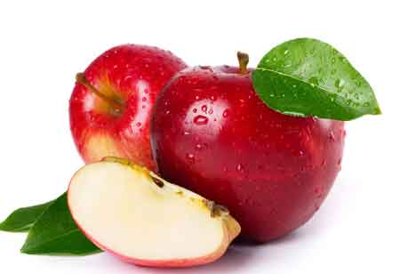
apple

Slide 5
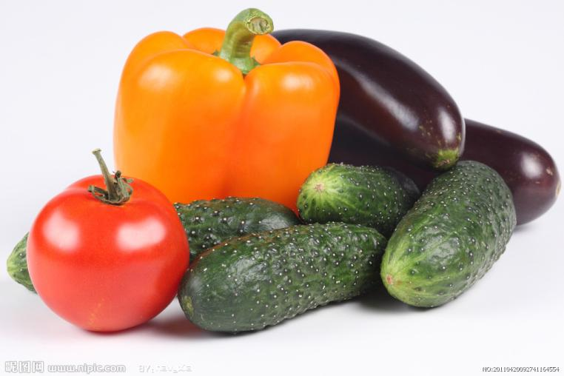
vegetables

Slide 6
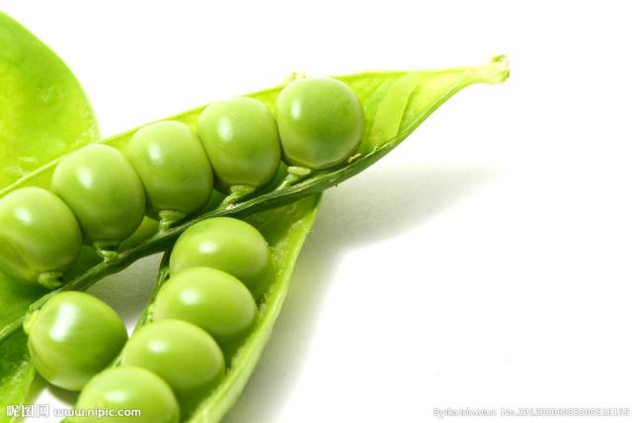
bean
carrot

Slide 7
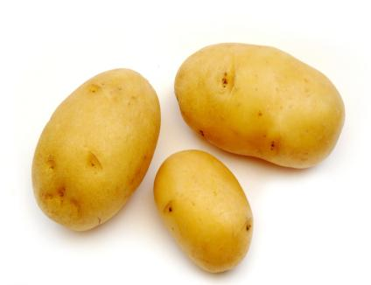
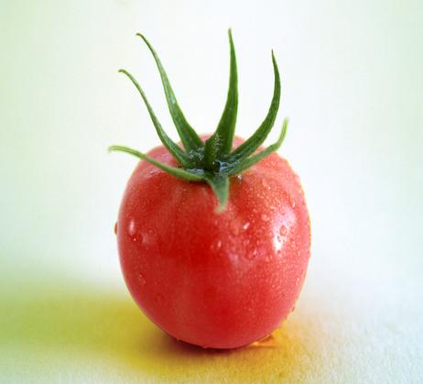
tomato
potato

Slide 8
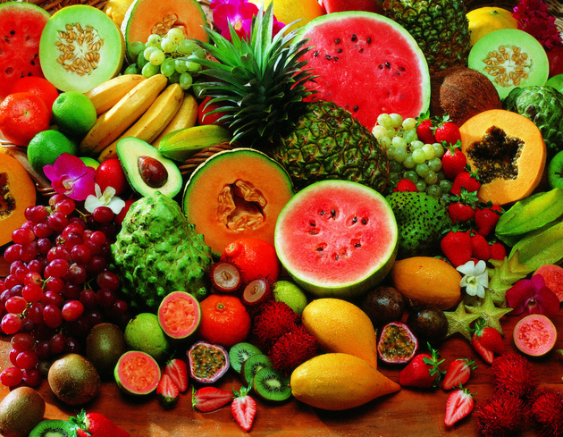
Fruit

Slide 9
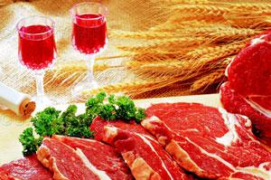
Meat

Slide 10
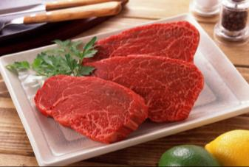
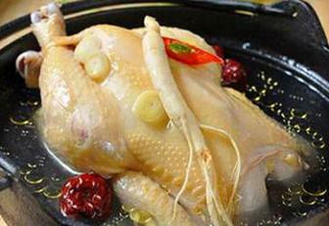
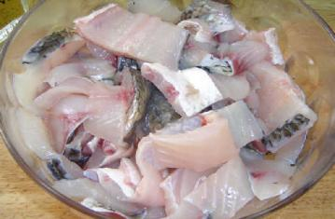
beef
chicken
fish

Slide 11
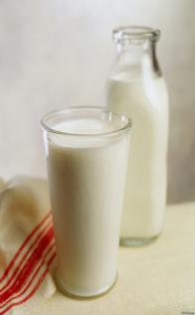
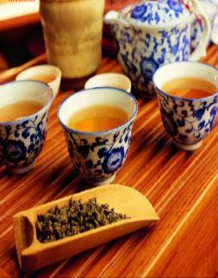


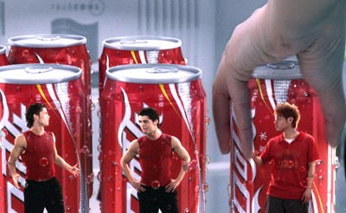
coffee
milk
tea
water
cola
Drinks

Slide 12
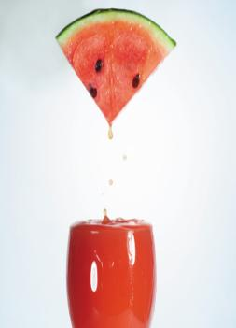
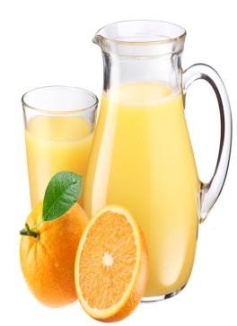
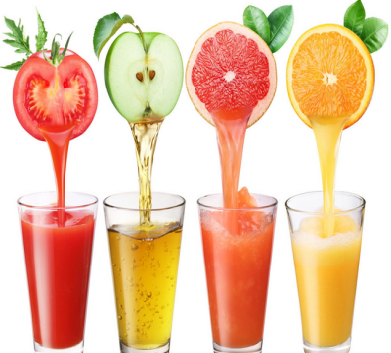
juice

Slide 13
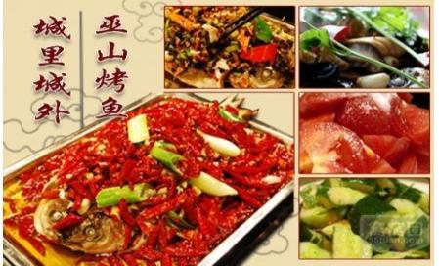
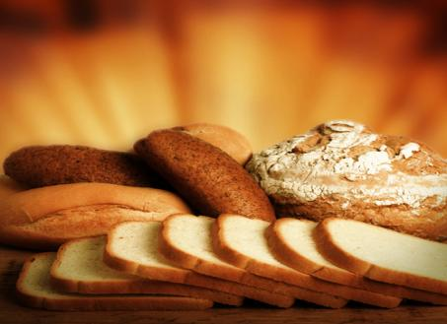
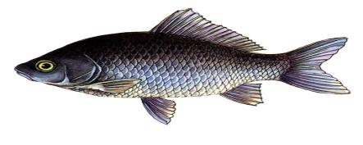
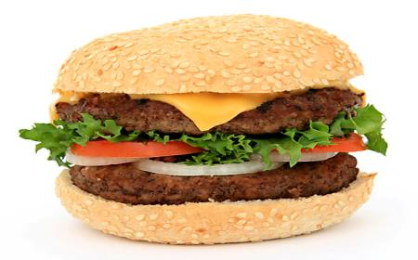
bread
hamburger
fish

Slide 14
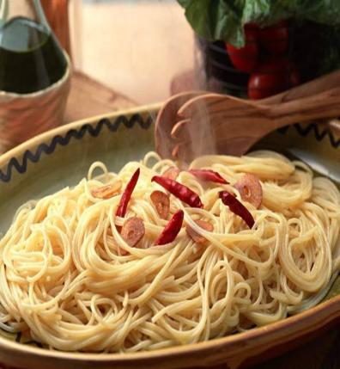
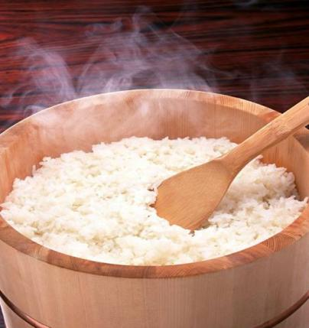
rice
noodles

Slide 15
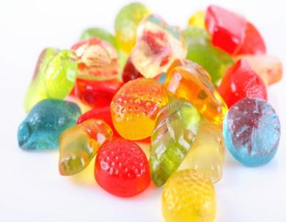
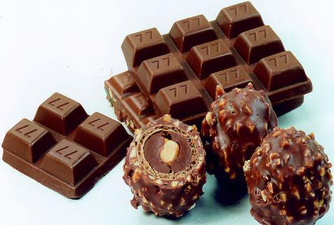
candy
chocolate

Slide 16
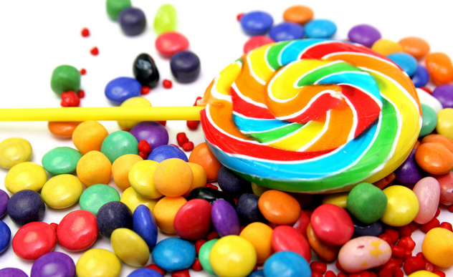
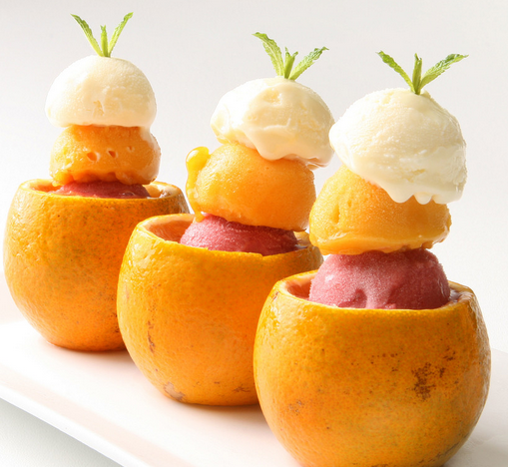
ice cream
sugar

Slide 17
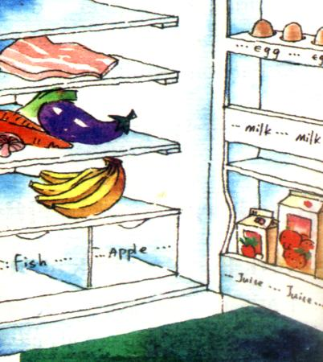
Talk about the things in the fridge.
— Have we got any
meat in the fridge?
— Yes, we have.
— Have we got any…?
—Yes, we have. /
No, we haven’t.

Slide 18
Now write about the food in
the fridge.
We’ve got some meat.
We haven’t got any fish.
1. ________________ vegetables.
2. _________________ orange.
3. _________________ apples.
We have got some
We haven’t got any
We haven’t got any

Slide 19
4. _________________ eggs.
5. _________________ bananas.
6. _________________ orange juice.
7. _________________ milk.
We have got some
We have got some
We have got some
We haven’t got any

Slide 20
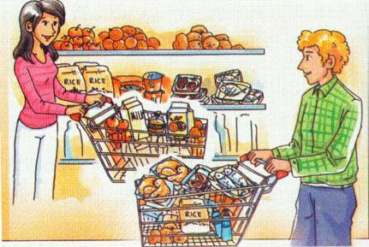
Look at the picture and talk
about it.
apple | hamburger | orange | potato | tomato
apples | hamburgers | oranges | potatoes | tomatoes
fish meat rice milk juice chicken water

Slide 21
He has got some a(n)…
He hasn’t got any…
She has got some a(n)…
She hasn’t got any…
The have got some a(n)…
They haven’t got any…

Slide 22

名词单数变复数

Slide 23
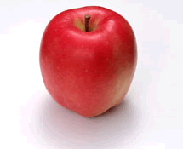
What’s this in English?
It’s an apple.
What are these?
They are two apples.

Slide 24



--What’s this?
--It’s a pen.
--What are these?
--They are pens.

Slide 25


--What’s this?
--It’s a book.
--What are these?
--They are books.

Slide 26
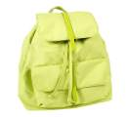

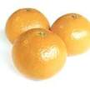

backpacks
oranges
watches
pens
--What’re these ?
--They’re … .

Slide 27



--What’re these ?
--They’re … .
maps
cases
keys

Slide 28
单数
规则变化
规则变化
如 何 变 化？
可数名词
不规则变化
复数

Slide 29
1.一般情况下，直接在词尾加-s构成复数形式。
tiger
tigers
panda
pandas
dog
dogs
2. 以s, x, ch, sh等结尾的名词，在词尾加-es构
成复数形式
class
classes
fox
foxes
watch
watches
brush
brushes

Slide 30
3. 以“辅音字母+y”结尾的名词，应改y为i，再加-es。
family
families
lady
ladies
4. 以“元音字母+y”结尾的名词，直接在词尾加-s构成复数形式 。
boy
boys
monkey
monkeys

Slide 31
5. 以f或fe结尾的名词，先将f或fe变成v，再加-es构成复数形式。
knife
knives
half
halves
巧记：
“小偷”(thief)的“妻子”(wife)用“刀子”(knife)和
“树叶”(leaf)把“狼”(wolf)劈成两“半”(half)。

Slide 32
6. 以o结尾的名词，有的加-s, 有的加-es构成复数形式。
photo
photos
zoo
zoos
(动物园)
tomato
tomatoes
(西红柿)
hero
heroes
(英雄)

Slide 33
以o结尾的名词,
表示无生命事物的名词，词尾加-s,
表示有生命事物的名词，词尾加-es。
加-es的名词有:
potato, tomato, hero
巧记:
英雄爱吃
土豆炖西红柿。

Slide 34
Sum up:
1.一般情况下,直接在名词词尾加-s.
2.以s,x,sh,ch结尾的名词,在词尾加-es.
3.以辅音字母加y结尾的名词，要变y为i再加-es.
4.以“元音字母+y”结尾的名词，直接在词尾加-s .
5.以f或 fe结尾的名词，先将f或 fe变为v,再加-es.
6.以o结尾的名词,表示无生命事物的名词加-s,
表示有生命事物的名词加-es。

Slide 35
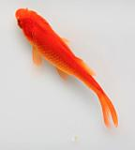
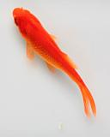
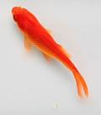
7、单复数同形 ，保持原音。
例词：
fish— fish

Slide 36
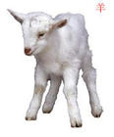

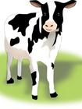




sheep— sheep
cattle— cattle
deer— deer

Slide 37




8、复数形式没有任何规律
例词：
man—men
woman— women

Slide 38

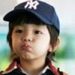



child—children
foot— feet

Slide 39
A.写出下列名词的复数形式
1. apple – apples 2. orange – oranges
3. potato – potatoes 4. carrot – carrots
5. banana – bananas 6. egg – eggs
7. hamburger – hamburgers
8. noodle – noodles 9. onion – onions
10. vegetable – vegetables
11. tomato – tomatoes 12. melon – melons

Slide 40

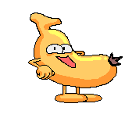
Complete the word map.
chicken
beef
tomatoes
fish
carrots
potatoes
meat
vegetables
water
milk
juice
oranges
healthy food
healthy
drink
fruit
apples
food
drink
bananas
favourite
food
favourite
drink
carrots
beef
juice
milk

Slide 41
Complete the sentences with the correct form of the words from the box.
1. _________ to buy some fruit.
2. It’s _________ to eat healthy food.
3. Eat well and ____ healthy.
4. Orange juice is ________. Let’s buy some.
5. I am a ___ tired.
bit delicious important remember stay
Remember
important
stay
delicious
bit

Slide 42
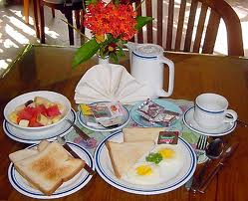
Around the world
A Western breakfast
What do people usually have for breakfast in the West?
People usually eat bread and eggs and drink coffee or tea, milk and fruit juice.

Slide 43
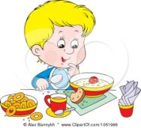

Making a poster about a healthy breakfast
Take a list of questions about a healthy breakfast.
Talk to students from another group about a healthy breakfast.
Make a poster about your healthy breakfast.
Put your poster in your classroom.
Talk about it with your classmates.

Slide 44
Writing
Introduce your healthy breakfast, lunch and super. And tell us your favourite food and drink.

Slide 45
One possible version:
I’m Kitty. I have some bread and milk for breakfast. For lunch I have some rice with meat and vegetables. After lunch, I often have an egg. For supper, I have some noodles and fruit. There are some healthy food and drinks in our fridge. We haven’t got any unhealthy food in it. My favourite food is fish, and my favourite drink is juice. They are healthy and they are good for our health.

