Slide 1
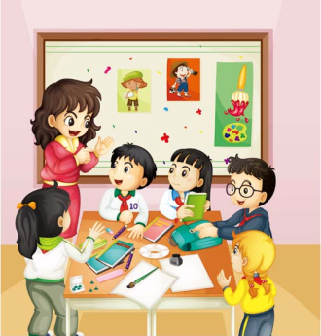
Unit5
Is this your schoolbag?
五年级上册
WWW.PPT818.COM

Slide 2
学习目标：
1、语言知识目标:
①能听、说、读、写词汇：put，schoolbag，ruler，crayon，yes
②能够听、说、读、写句子：Is this your schoolbag？Yes，it is. 并且能 在四线格中规范书写。进一步运用Is this your...? Yes, it is. / No, it isn’t.
2、能力目标：运用本课核心句型、词汇，以及原来学过的词汇在
真实语境中进行交流。
3、情感态度目标：
能够养成良好的生活及学习习惯，将学习用品分类整理，有序摆放。
学习重难点：1、词汇：put、 schoolbag、ruler、crayon、yes
2、句型：Is this your schoolbag ? Yes, it is;
3、结合所学的单词，学生能够完成本课重点句的替换练习

Slide 3

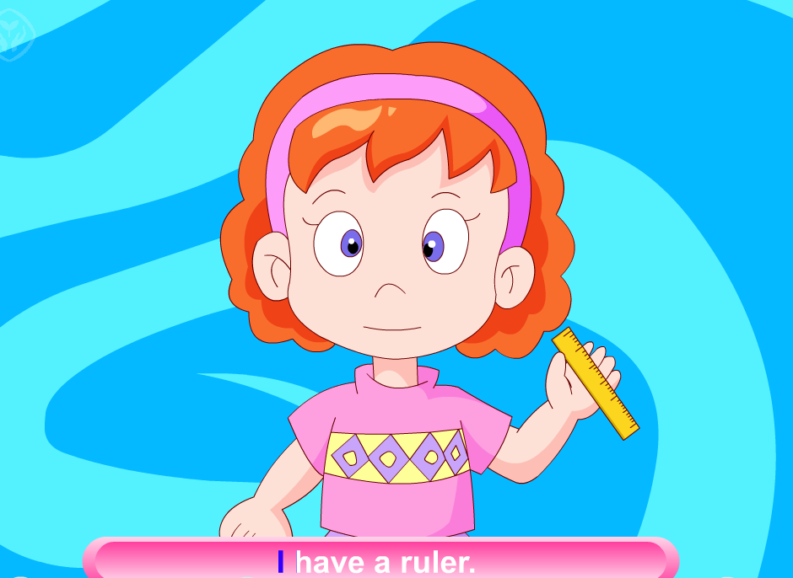
>>Review
Let’s sing

Slide 4

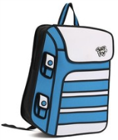





>>Review
Play a game
I say you do
Show me your pen.

Slide 5

>>Presentation
Look and say
schoolbag
This is my schoolbag.

Slide 6

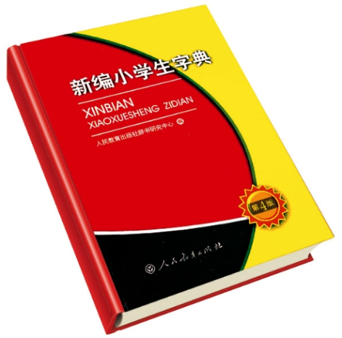
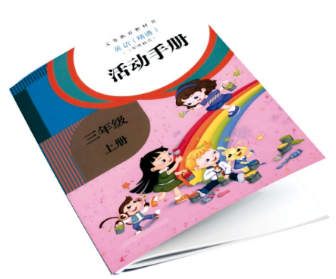
Look!What is in the schoolbag?

Slide 7



>>Presentation
Look and say
crayon
Is this your crayon?
Yes, it is.
No, it isn’t.

Slide 8

>>Presentation
Look and say
activity book
Is this your activity book?
Yes, it is.
No, it isn’t.

Slide 9
>>Presentation
Look and say
dictionary
Is this your dictionary?
Yes, it is.
No, it isn’t.

Slide 10
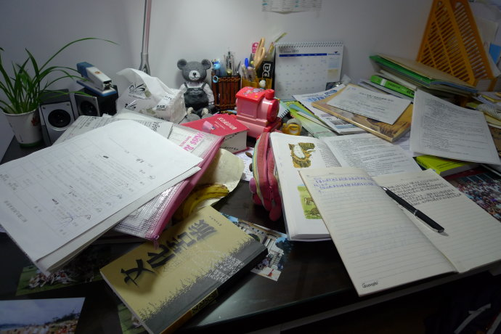
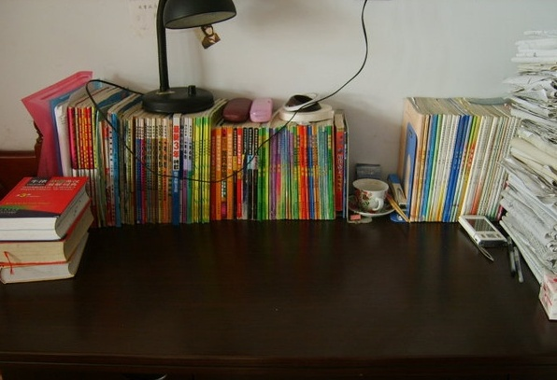
Don’t leave your things like this.
Put them away.

Slide 11
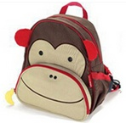

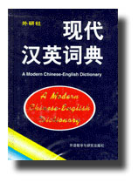
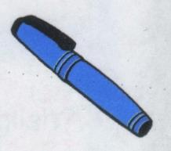
>>Presentation
Practice
Work with your partners.Use these
sentences.
Is this your ruler/schoolbag…..
Yes,it is./No,it isn’t.

Slide 12
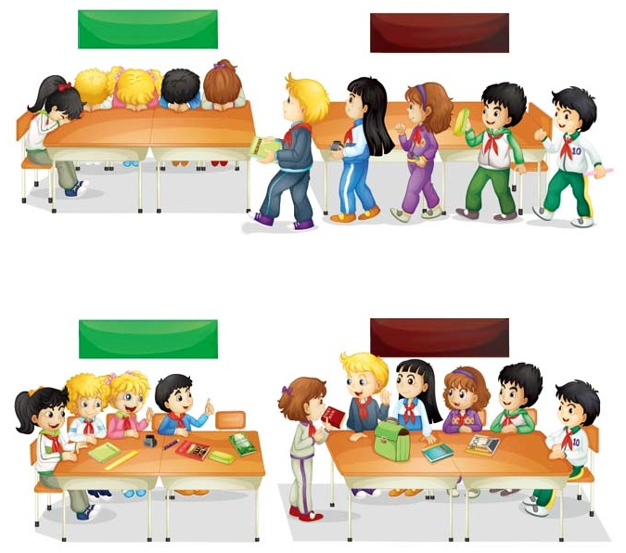
>>Practice
Let’s act
GREEN BIRD GROUP
BROWN BEAR GROUP
1
Whose storybook is this?
2
3
Is this your storybook?
No, it isn’t.
5
No, it isn’t.
4
Is this your storybook?
BROWN BEAR GROUP
GREEN BIRD GROUP

Slide 13




>>Summary
本课的重点单词：
activity book
schoolbag
dictionary

Slide 14
>>Summary
如何询问某物是否属于某人并做否定回答？
—Is this your …?
—No, it isn’t.

