Slide 1
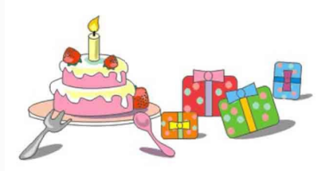
陕旅版
四年级下册
Unit6 Today Is Her Birthday
第二课时
WWW.PPT818.COM

Slide 2
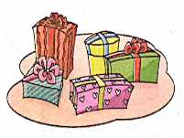
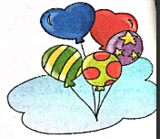
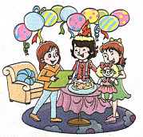
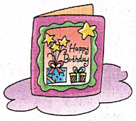
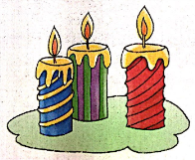
>>Review
Magic fingers

Slide 3
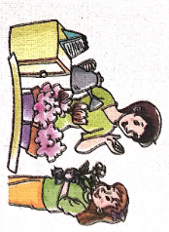
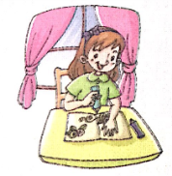
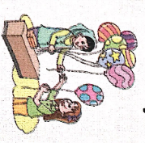
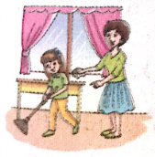
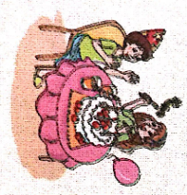
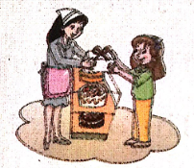
>>Lead-in
Think and tick
What are you going to do for your mother on her birthday?

Slide 4
>>Presentation
Listen, then ask and answer
Q1: What is Wu Chen going to do?
She’s going to buy a gift for her grandma.
Q2: Is Wu Chen going to buy some flowers?
Yes, she is.
Q3: What are Wu Chen’s father and mother
going to do?
They are going to buy a birthday card.
答案

Slide 5
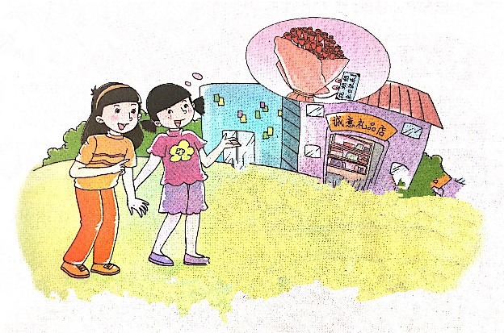
>>Presentation
Let’s talk
Where are you going, Wu Chen?
I’m going to buy a gift for my grandma. Today is her birthday.
Good idea!
And I’m going to make a card for her.
How about flowers?

Slide 6
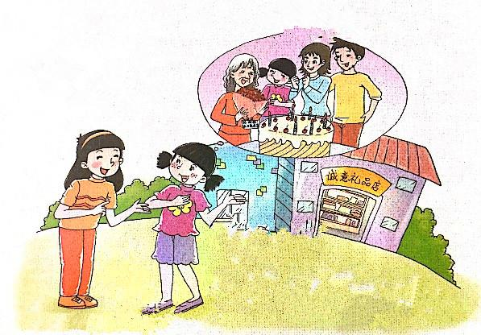
>>Presentation
Let’s talk
Happy birthday to you!
Happy birthday to you!
Happy birthday to you!
Are you going to have a birthday party?
Yes, I am.
They’re going to buy a birthday cake.
How about your parents?

Slide 7
>>Practice
Read it by yourselves for one minute.
自读对话一分钟。
一分钟倒计时
60
10
50
Tips:
当你自己朗读时，遇到不会读或不明白意思的单词或句子，可以把它圈起来，请教同学或老师！
20
40
30
开始

Slide 8
>>Practice
Role play
角色扮演，小组先进行练习，然后展示，其他同学评价。
 | 小组合作，声音洪亮，有感情地正确朗读课文。 |  | C
 | 小组合作默契，声音洪亮，脱离课本，口语表达较准确流利，感情与肢体语言较丰富。 |  | B
 | 小组合作默契，声音洪亮，能结合已有知识或生活，对内容有创新，口语表达准确流利，感情与肢体语言丰富。 |  | A
Good
Great
Excellent

Slide 9
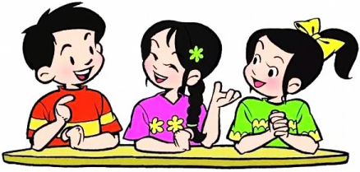
>>Practice
Make sentences
Are you going to have a birthday party?
…
How about …?
…going to …

Slide 10
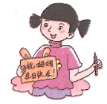
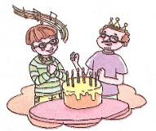
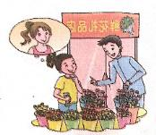
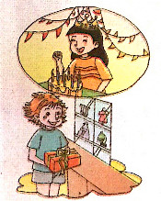
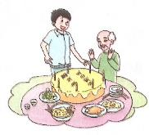
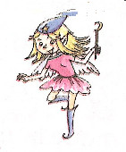
>>Practice
Look and talk
A: What is … going to do for his/her … on the birthday?
B: He / She is going to …
What are you going to do for your mother on her birthday?

Slide 11
>> Summary
本课所学的重点句型：
I’m going to … for …
How about …?
… going to have …?
Yes, …
Happy birthday to you!

Slide 12
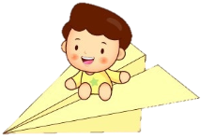
>> Homework
1.听课文录音并跟读，按照正确的语音、语调朗读并表演课文对话。 2.学生2人一组，分角色表演课文Let’s talk。
3.预习 Unit6 B Let’s learn more。
close

