Slide 1
陕旅版四年级上册 Unit3 What’s for breakfast? 第4课时
WWW.PPT818.COM

Slide 2
教学目标：
1.听懂理解Let’s chant 部分的内容，并且能有节奏地跟读说唱，要求模仿正确，语音语调自然。
2.懂得珍惜粮食的意识，养成健康的饮食习惯。

Slide 3
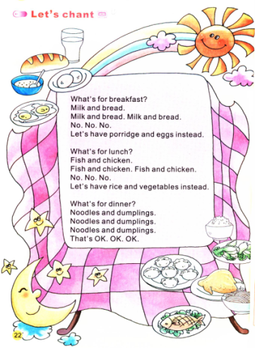
1. What can you see in the picture?
2. Do they have milk and bread for breakfast?
3. What do you like for dinner?

Slide 4
What’s for breakfast?
Milk and bread.
Milk and bread. Milk and bread.
No. No. No.
Let’s have porridge and eggs instead.
What’s for lunch?
Fish and chicken.
Fish and chicken. Fish and chicken.
No. No. No.
Let’s have rice and vegetables instead.
What’s for dinner?
Noodles and dumplings.
Noodles and dumplings.
Noodles and dumplings.
That’s OK. OK. OK.
Let’s chant

Slide 5
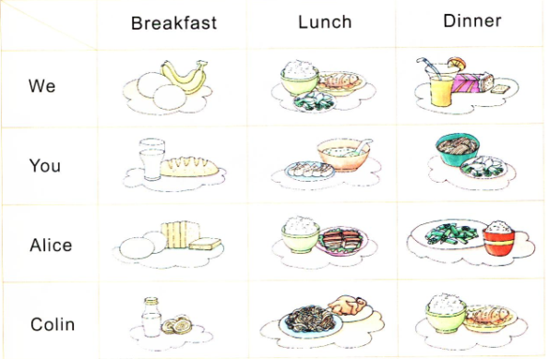
Ask and answer
A: What do we/ you have for…?
B: We/ I have…
A: What does he/ she have for…?
B: He/ She has…

Slide 6
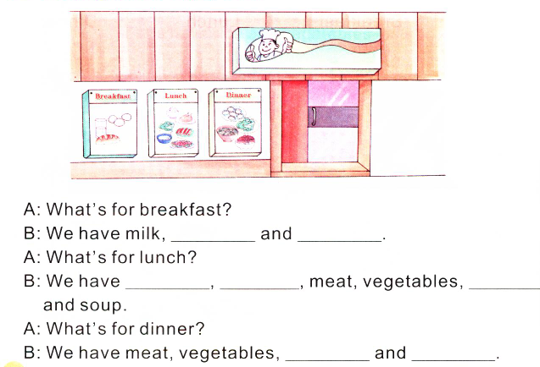
Complete and act

