Slide 1
义务教育教科书英语（广州版） 四年级上册
Module 1 My Bedroom
Unit 2 They’re near the window
WWW.PPT818.COM

Slide 2
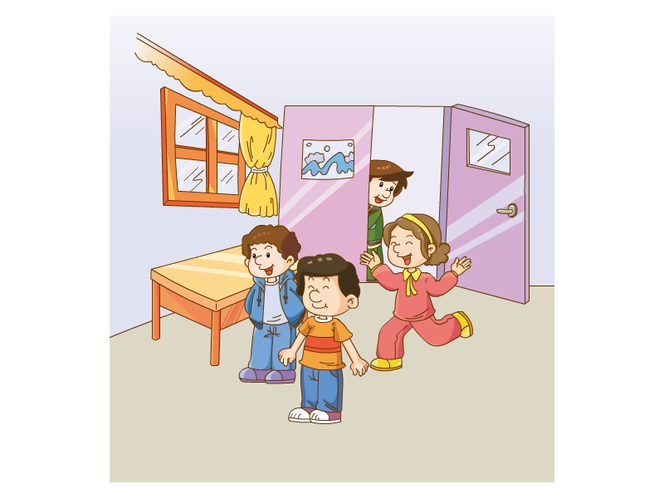
Let's sing

Slide 3
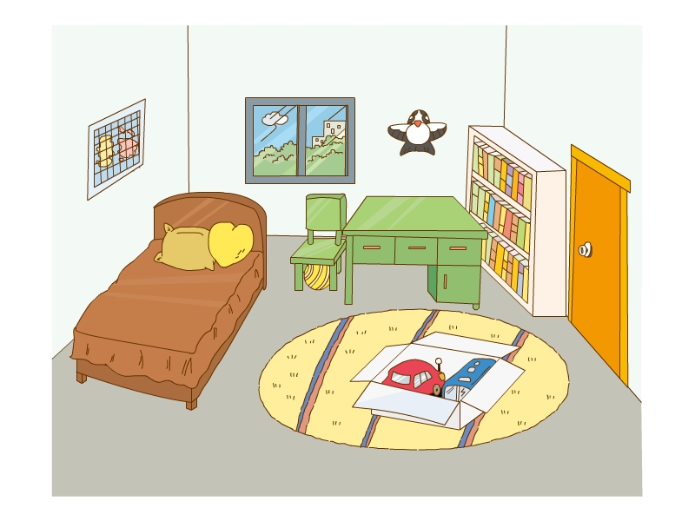
What’s in the room?
There is/are…… in/on/next to…..

Slide 4
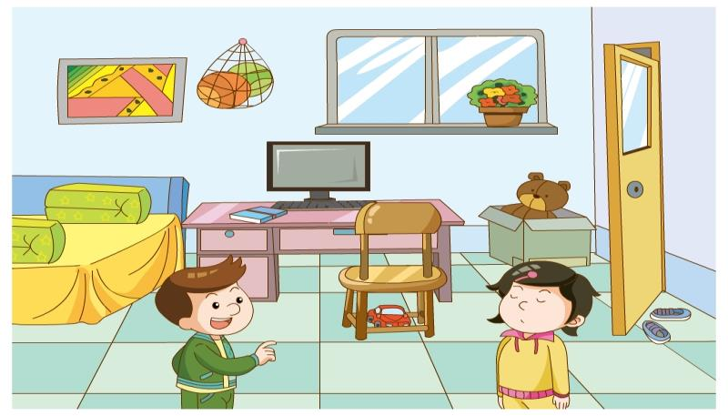
Let's play a game
for one minute
Now close your eyes.
open your eyes
Close your eyes

Slide 5
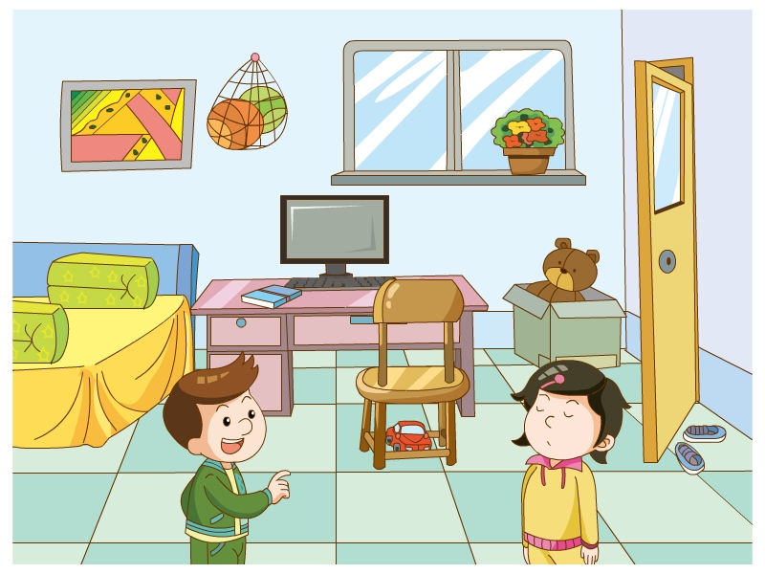
Let's play a game
Is there a computer in my room?
Yes, there is.

Slide 6
Let's play a game
Is there a desk in my room?
Yes, there is.

Slide 7
Let's play a game
Is there a map in my room?
Yes, there is.

Slide 8
Let's play a game
Are there any balls?
Yes ,they are under the desk.

Slide 9
本课时内容：
1. 复习u2 对话。
2. 完成Fun with language 练习。
3. 学习Story time.
4. 巩固、运用There be 句型的疑问形式。
1/17/2023

Slide 10
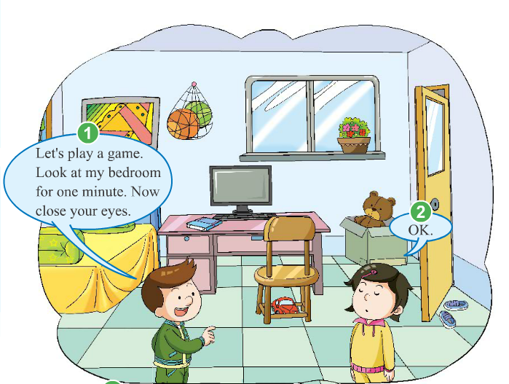
Let’s recite.
1/17/2023

Slide 11
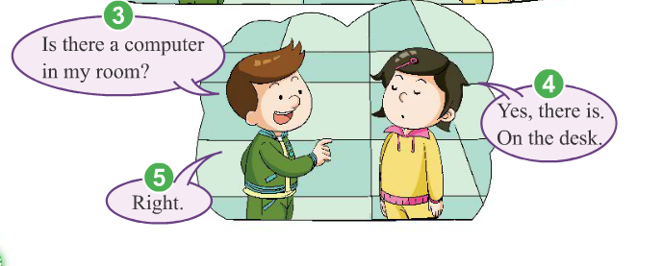
1/17/2023

Slide 12
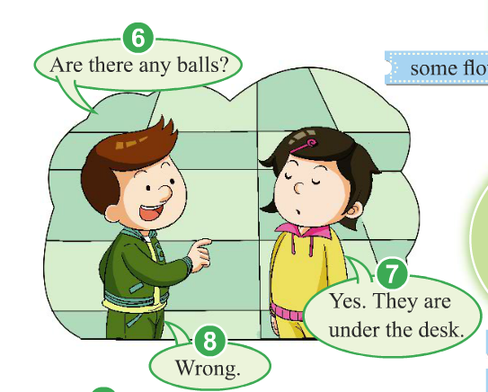
1/17/2023

Slide 13
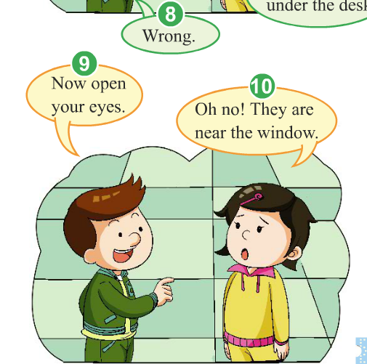
1/17/2023

Slide 14
Let’s try.
Ben: Let’s play a game. Look at my bedroom ____(to, for) one minute. ____ (Now, New) close your eyes.
Xiaoling: OK.
Ben: Is there a ____ (computer, clock) in my room?
Xiaoling: ____ (Yes, No), there is. On the desk.
Ben: ____(Right. Wrong.)
Ben: Are there ____ (some, any) balls?
Xiaoling: Yes. ____ (It is, They are) under the desk.
Ben: ____(Right. Wrong.) Now ____ (open, close) your
eyes.
Xiaoling: Oh no! They are ____(next to, near) the window.
1/17/2023

Slide 15
Let’s practise.
P10 Ex 1
Fun with language 练习：Is there/Are there …句型的听力训练。
1/17/2023

Slide 16
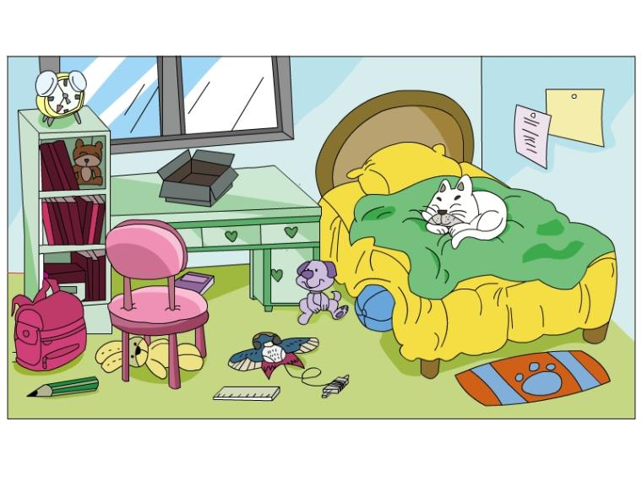
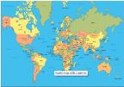
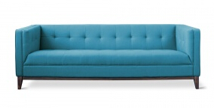
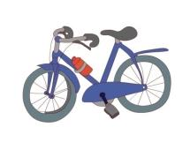
Look at the bedroom for two minutes.
练习“Is there…/Are there…?”句型。
如：“Is there a clock on the desk?”
引导学生回答：“No, there isn’t. You’re wrong.”
1/17/2023

Slide 17
Is there…/Are there…?
练习“Is there…/Are there…?”句型。
如：“Is there a clock on the desk?”
引导学生回答：“No, there isn’t. You’re wrong.”
1/17/2023

Slide 18
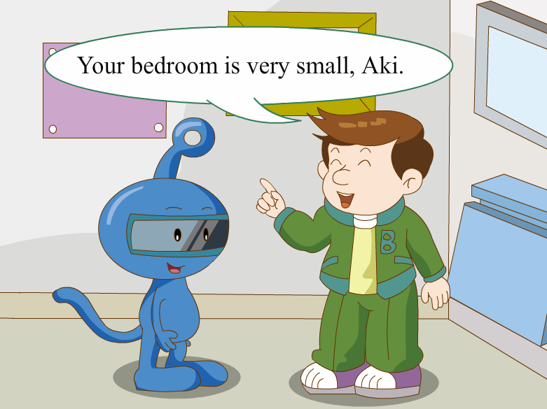
Let’s learn.
Aki’s bedroom is very small.
What’s in the bedroom?
故事学习：
让学生带着问题看故事。
1/17/2023

Slide 19
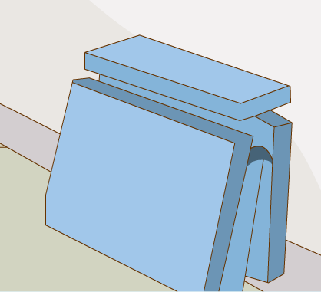
Is there a desk in Aki’s bedroom?
Yes, there is.
1/17/2023

Slide 20
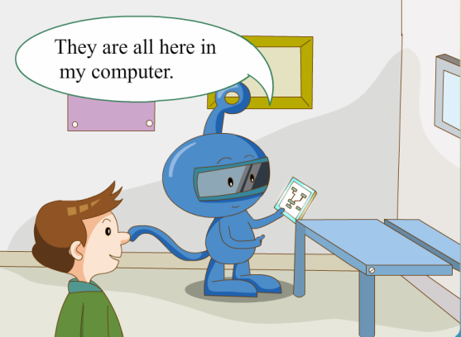
Are there any books in Aki’s bedroom?
Yes, there are.
Where are Aki’s books？
They’re in Aki’s computer.
1/17/2023

Slide 21
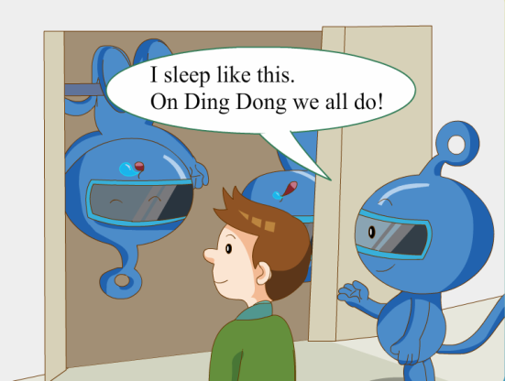
Is there a bed in Aki’s bedroom?
No, there isn’t.
1/17/2023

Slide 22
Let’s guess.
拓展想象：
让学生在想象Aki卧室的其他物品的过程中运用 语言。
如：
There is a bike in the desk./…
Is there a clock/map/picture/…
in Aki’s bedroom?
Are there any flowers/pens/toys/…
in Aki’s bedroom?
If yes, where is it?/ where are they?
1/17/2023

Slide 23
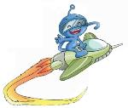
1、完成U2 《活动手册》练习。

