Slide 1
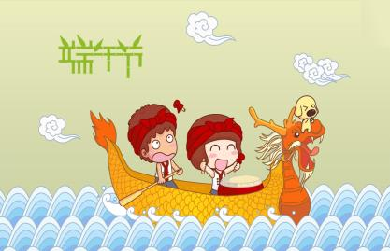
Unit 7
Chinese festivals
第二课时
WWW.PPT818.COM

Slide 2
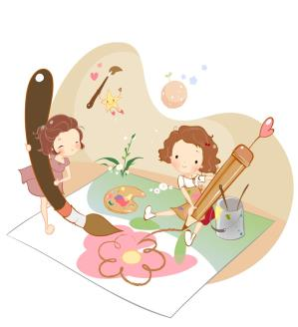
Introduce
When’s Spring Festival?
What do people usually do at Spring Festival?
What do people usually eat at this festival?
When’s Dragon Boat Festival?
What do people usually do at Dragon Boat Festival?
What do people usually eat at this festival?

Slide 3
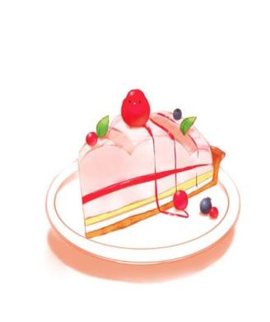
words
cake [keik]
名词，意为“糕饼，蛋糕”。
eg： a wedding cake 婚礼蛋糕
fish cakes 煎鱼饼
potatoes cakes 土豆饼
小练习：汉译英：
一块生日蛋糕
a birthday cake

Slide 4
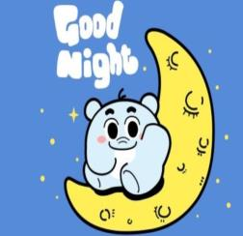
words
night [nait]
名词，意为“夜晚”。
（1）at与night连用，意为在晚上。
（2）by与night连用，意为在夜晚做的事情。
（3）on与night连用，表示某个特定的晚上。
eg： I had a strange dream last night.我昨天晚上做了一个奇怪的梦。
小练习：汉译英：
孩子哭了一整夜
The child cried all night.

Slide 5
words
double [ˈdʌbl]
作形容词，意为“双倍的，两倍的”;作名词，意为“双倍，两倍”;
作副词，意为“成双地，成对地”。
eg： My phone number is two, four, double three, four.
我的电话号码是二四三三四。
When I saw her with her twin sister I thought I was seeing double.
我看见她和她孪生妹妹时，还以为是看重影了。
小练习：汉译英： 双扇窗
double windows

Slide 6
words
for [fɔ:, fə]
（1）表示帮助的对象；（2）意为表示，代表；
（3 )表示为了做，为得到；（4）表示目的地，前往，前去。
eg： Is this train for Beijing? 这列火车是开往北京的吗？
Here is a letter for you.这里有一封信是给你的。
小练习：选择合适的介词填空：
There is some milk _____（for / to）you.
for

Slide 7
words
mountain [ˈmauntin]
名词，意为“山”、“山岳”,其复数形式mountains 常表示 “山脉”；
通常指比hill 大或陡峭的高山。
eg： The city lies in a valley with high mountains all around it .
城市坐落在高山环抱的山谷中。
The house stands on the top of the hill. 房子位于山顶上。
小练习：汉译英：
它是世界上最高的山。
It’s the highest mountain in the world.

Slide 8
Expressions
People visit their parents and grandparents.
人们拜访他们的父母和爷爷奶奶。
visit后接人，意为拜访某人，如后接人称代词，人称代词即用宾格形式;visit后接地点表示参观某地。
eg： I want to visit San Ya this summer holiday.
这个暑假我想去三亚旅游参观。
小练习：用所给词适当形式填空：
He ____（visit）his teachers every year.
visits

Slide 9
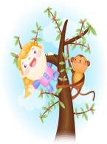
Expressions
They also climb mountains and eat rice cakes at this festival. 在这个节日特闷还爬山吃重阳糕。
climb意为“爬”，后接mountain，意为“爬山”, climb up意为“向上爬”;
eg： Don’t climb trees again. 不要再爬树了，
Cats often find it easier to climb up a tree than to climb down.
猫爬树往往是爬上去比爬下来容易些。
小练习：汉译英：
爬树
climb the tree

Slide 10
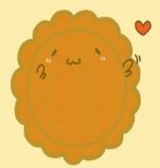
Dialogue
The Mid-Autumn is in September or October.
中秋节在九月或十月。
People look at the moon at night with their family. They eat moon cakes and fruit.
人们和他们一家赏月。他们吃月饼，吃水果。
The Double Ninth Festival is in October or November. It is a festival for old people.
重阳节在九月或十月，它是一个属于老人们的节日。
People visit their parents and grandparents. They also climb mountains and eat rice cakes at this festival.
人们拜访他们的父母和爷爷奶奶。在这个节日人们还爬山吃重阳糕。

Slide 11
Expand
春 节
春节，是中国最盛大、最热闹、最重要的一个古老传统节日，也是中国人所独有的节日。是中华文明最集中的表现。春节一般指除夕和正月初一。但在民间，传统意义上的春节是指从腊月初八的腊祭或腊月二十三或二十四的祭灶，一直到正月十五，其中以除夕和正月初一为高潮。在春节这一传统节日期间，我国的汉族和大多数少数民族都有要举行各种庆祝活动，这些活动大多以祭祀神佛、祭奠祖先、除旧布新、迎禧接福、祈求丰年为主要内容。活动形式丰富多彩，带有浓郁的民族特色。2006年5月20日，“春节”民俗经国务院批准列入第一批国家级非物质文化遗产名录。

Slide 12
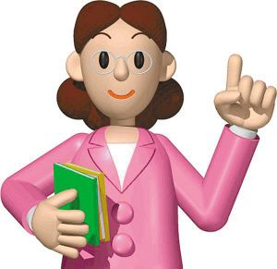
Summary
cake
night
for
double
mountain
People visit their parents and grandparents.

Slide 13
Exercise
阅读短文，判断正（T）误（F）。
The Mid-Autumn is a very important Chinese festival. It falls on the 15th day of August. A few days before the festival, everyone in the family will help to make the house clean and beautiful.
On the evening there will be a big family dinner. People will try to come back for the union. Also, children will play with their own toy lanterns happily.
At night the moon is usually round and bright. People can enjoy the moon while eating moon-cakes .I love The Mid-Autumn Festival.

Slide 14
Exercise
（ ）1.This passage is about Mid-Autumn Festival.
（ ）2.At Mid-Autumn, people usually clean the house clean and beautiful.
（ ）3.Children don’t like Mid-Autumn Festival.
（ ）4. At Mid-Autumn, the moon looks like a boat.
（ ）5.Mid-Autumn usually comes in September or October.
T
T
F
F
T

Slide 15
Homework
Talk about your favorite festivals.

