Slide 1
Unit 11
How was your school trip?
Section B
WWW.PPT818.COM

Slide 2
创设情境
What do you usually do on your weekends?
I usually …………

Slide 3
Match the activities with the pictures.
启发思考
1a
1. go to the zoo ____ 4. climb a mountain ____
2. visit a museum ___ 5. visit a fire station ____
3. ride a horse ____ 6. go fishing ____
a
e
c
d
b
f

Slide 4
Listen and answer the questions.
1b
1. How was Jane’s trip?
___________________________________
2. How was Tony’s trip?
___________________________________
It was terrible.
It was great.

Slide 5
1c
Listen again. What did Jane and Tony do on their
last school trip? Check (√) Tony or Jane.
 | went to the countryside | climbed a mountain | went to an art museum | saw some paintings | drew pictures
Tony
Jane
√
√
√
√
√

Slide 6
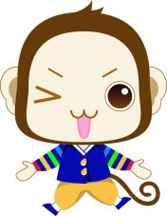
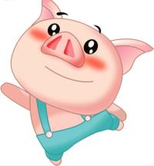
1d
What was your last school trip like? Discuss it with
your partner.
I went to …
That sounds …

Slide 7
What do you most want to do on your school trip?
I want to … I think it is (sounds) good (great / OK / fun / funny).
Is there anything you don’t want to do on your school trip?
What are they? Why?
I don’t want to … It is not good / terrible boring …

Slide 8
自主探究
Learn New Words

Slide 9
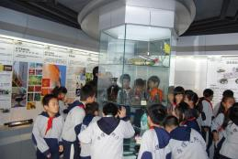
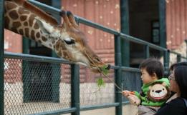
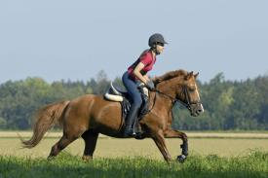
go to the zoo
visit a museum
ride a horse

Slide 10
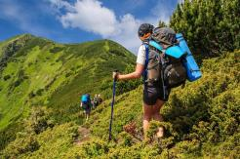
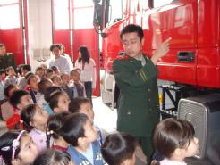
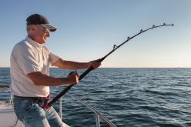
climb a mountain
visit a fire station
go fishing

Slide 11
Reading

Slide 12
2a
Do the following words describe good things or bad things? Put a√ for good and an ×for bad. Leave a blank if they can mean both.
____ interesting ____ difficult ____ lovely ____ slow
____ exciting ____ boring ____ cool ____ hot
____ lucky ____ large ____ expensive ____ terrible
____ delicious ____ great ____ cheap ____ fast
√
×
√
×
√
×
√
√
√
×
×
√
√

Slide 13
2b
Fast reading
1. Did Helen and Jim go on the same trip?
Yes, they did.
2. How do they feel about the trip?
Helen thought the trip was really interesting, but Jim thought the trip was terrible.

Slide 14
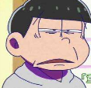
Today I went on a school trip. We
visited the science museum and it was
really interesting.
All in all, it was an exciting day.
Helen
I think today's school trip was terrible.
We took the train to the museum.
I didn't like the trip at all.
Jim

Slide 15
Reading strategy
（阅读策略）
Find out the topic sentences
or the key sentences
of the article to help you
master the main idea.

Slide 16
The trip to the ________
museum
interesting & exciting
terrible & boring
fast
slow
The train was _______.
The train was _______.
interested
He's not _______
in robots.
a lot
She learned _______
about _______.
robots
The rooms were very ______ and there were ________ people.
dark
She bought some ______. They were ______ and cheap.
too many
gifts
lovely
The gifts were so ________.
expensive

Slide 17
2c
Complete the chart. How do Helen and Jim describe these things?
 | Helen | Jim
the trip
the train
the museum
the gift shop and gifts
exciting
terrible
fast
slow
big, boring, dark, too many people
really interesting
lovely, not expensive
so expensive

Slide 18
协作交流
Language points
1. All in all, it was an exciting day.
总之，这是令人兴奋的一天。
all in all 相当于汉语中的“总的说来；总之；
整体上说”，用来对所阐述的内容进行概括性总
结及归纳。例如：
All in all, I think you did a good job.
总的说来，我认为你干得很好。

Slide 19
2. Everything was about robots and I’m not interested in that.
每个东西都是关于机器人的，我对此不感兴趣。
be interested in 对……感兴趣
例如：
We are interested in English.
我们对英语感兴趣。

Slide 20
辨析：interested / interesting
interested / interesting 二者均为形容词，
interested 用于“be (become) interested in的结构中，表达的是某人对某事或某物是感兴趣的；
而 interesting 则指某事或某物本身具有使人感兴趣的特性，即某事（物）本身是“有趣的；有意思的”，在句中既可作定语，也可作表语。
I am interested in collecting stamps.
我对收集邮票很感兴趣。
That is an interesting book，you must read it.
那是一本很有意思的书，你一定要读读。

Slide 21
用interesting / interested 填空。
1. The book is very _________. Most of the teachers are _________in it. 
2. The boy has much _________ in drawing.
3. 3岁的时候，他开始对音乐产生了兴趣。
He ______ _________ _______music when he was 3 years old.
interesting
interested
interested
was interested in

Slide 22
3. I didn’t like the trip at all.
我一点都不喜欢这次行程。
not at all / not… at all 意思是“根本不；完全不”例如：
I don’t like mutton at all.
我一点都不喜欢羊肉。
She’s not at all good at badminton.
她完全不擅长打羽毛球。

Slide 23
3a
Look at the pictures of Bob’s school trip. Complete his diary entry.
June 23rd
Yesterday my school visited the zoo. It was really __________. We went there by bus. At the zoo, I saw a lot of __________ and I took some photos. My classmates and I also went to the __________ and bought some ___________. It was a great day.
interesting
animals
gift shop
gifts

Slide 24
Linda is Bob’s classmate. Complete her diary entry.
3b
June 23rd
My school went to the zoo yesterday. The trip was ____________.
At the zoo, I _________________ but I didn’t like them. I also went to _____________ with my classmates, but I didn’t buy anything because ___________________. It was a boring day.
boring
saw many animals
the gift shop
they were so expensive

Slide 25
总结提高
Now write a diary entry for your own school trip. Explain if you liked it or didn’t like it and why.
3c

Slide 26
Sample writing
I had a great weekend. On Saturday morning, I did my homework. In the afternoon, I played tennis with my friends Nina and Mary. I felt a little tired, but we really had a great time. After that, we went to McDonald’s for dinner. On Sunday morning, I visited my grandparents with my dad and mom. I was glad to see they were in good health. On Sunday afternoon, I went to the piano class. It was a little difficult, but I loved it. I played it very well. What a happy weekend I had!

Slide 27
Self Check
1 Write more verbs and their past forms in each group.
climb climbed | arrive arrived | study studied | stop stopped | get got

Slide 28
1 Write more verbs and their past forms
in each group.
climb-climbed | arrive-arrived | study-studied
pick-picked
milk-milked
play-played
stay-stayed
want-wanted
hope-hoped
live-lived
move-moved
dance-danced
worry-worried
cry-cried

Slide 29
2 Complete the conversations with the correct forms of the verbs in the box.
have do swim go
be see feed

Slide 30
A: I went to the countryside this summer.
B: Really? How _____ the trip?
A: It ______ great!
B: What ______ you _____ there?
A: I _______ the chickens and _______ in a river.
was
was
do
did
fed
swam

Slide 31
2. A: _______ you _______ a nice weekend?
B: Yes, I did.
A: ______ you ______ anywhere?
B: Yes, I ________ to the mountains. The air _______ so clean, and I ______ a lot of flowers.
Did
have
Did
go
went
was
saw

Slide 32
Homework
Do the other exercises in this part.

