Slide 1
This is my new friend!
Unit 1
WWW.PPT818.COM

Slide 2
doctor

Slide 3
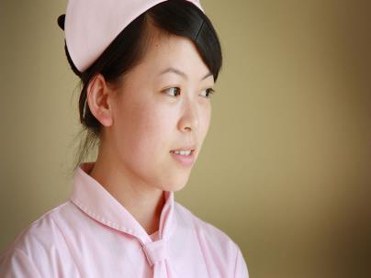
nurse

Slide 4
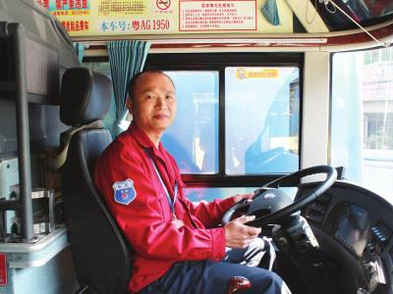
driver

Slide 5
Look ,this is my mother
Wow,she is so beautiful!
What does she do?
She is a doctor.

Slide 6
What does she do?
She is a nurse.

Slide 7
说说家人的职业
My mother is a nurse.
My father is a docter.
My uncle is a postman.
My aunt is a driver.

Slide 8
职业小集锦
doctor 医生
nurse 护士
driver 司机

Slide 9
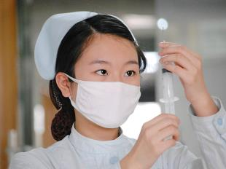
重点句型
What does your mother do?

Slide 10
小习题
一、单词连线。
doctor 农民
nurse 医生
postman 护士
teacher 邮递员
driver 教师
farmer 司机

Slide 11
小习题
二、背诵下列句子。
1. Peter is a postman.
2. My father is a driver.
3. My mother is a teacher.
4. Jack is a farmer.
5. My uncle is a doctor.
6. My aunt is a nurse.

Slide 12
see you!

