Slide 1
I have a ball.
第5课时
WWW.PPT818.COM

Slide 2
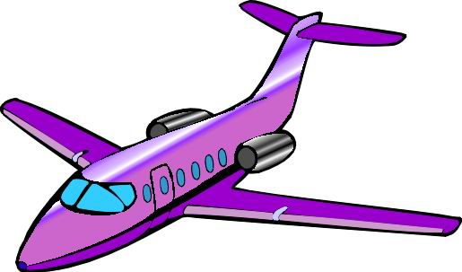
I have a plane.
plane

Slide 3
I have a purple plane.
I have a yellow plane.

Slide 4
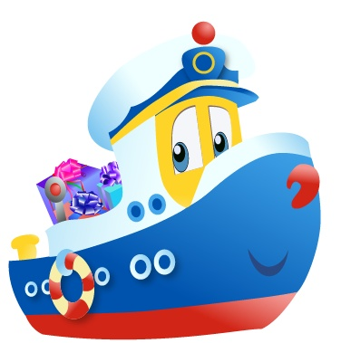
I have a ship.
ship

Slide 5
I have a nice ship.
I have a big ship.

Slide 6
I have a boat.
boat

Slide 7
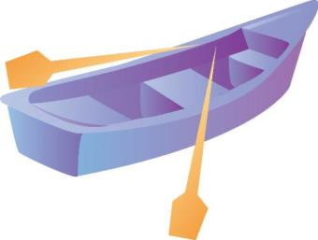
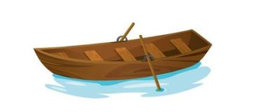
I have a boat.
Row, row, row in the river.

Slide 8
Ship, ship, plane. Plane, plane,
ship.
Boat, boat, ship. Ship, ship,
boat.
Plane, ship, boat. Ship, boat,
plane.

Slide 10
Let’s chant
Look, look. I have a plane.
Can I see it? Can I see it?
Sure, sure!
Here you are.

Slide 11
Homework
1.Make up the text into another song or chant.
2.Use the words to make more sentences.

