Slide 1
Unit 5 Languages Around The World
Section A Listening and Speaking
WWW.PPT818.COM

Slide 2
There are now about 376 million people who speak English as their first language,and about the same number who have learnt it in addition to their mother tongue.It is said that there are one billion people learning English now and about 80% of the information on the Internet is in English.

Slide 3
Is this a good thing,or a bad thing?Should we celebrate^{①} the fact that more and more of us can communicate^{②},using a common language,across countries and cultures?Or should we worry about the dangers of “mono-culturalism”,a world in which we all speak the same language,eat the same food and listen to the same music?
Does it matter if an increasing number of people speak the same language?I would have thought the other way around(相反) although I have never accepted the argument^{③} that if only we all understood each other better,there would be fewer wars.Ask the people of India (where many of them speak at least some English) and Pakistan (the same situation with India)...

Slide 4
If we all speak English,will we then all start eating McDonald’s burgers?Surely not.If English becomes more dominant(占主导地位的),it will kill other languages.I doubt it.When I travel in Africa or Asia,I am always surprised by how many people can speak not only their own language but also one or more other related languages,as well as English and perhaps some French or German as well.
When we discussed^{④} this on Talking Point a couple of years ago,we received a wonderfully poetic email from a listener in Ireland.“The English language is a beautiful language.Maybe it’s like a rose,” he said.“But who would ever want their garden just full of roses?”
Well,I love roses,and I think they make a beautiful addition to any garden.But the way I see it,just by planting a few roses,you don’t necessarily need to pull out everything else.If more and more people want to plant English roses,that’s fine by me.

Slide 5
词海拾贝
①celebrate vt. 庆祝
②communicate vi. 交流
③argument n. 争论
④discuss vt. 讨论
典句欣赏
Should we celebrate the fact that more and more of us can communicate,using a common language,across countries and cultures?
译文:我们是否应该庆祝这样一个事实:越来越多的人可以使用一种共同的语言在不同的国家和文化之间进行交流?
分析:本句是一个复合句。that引导的句子做fact的同位语,using a common language是动词-ing形式短语做状语。

Slide 6
理解诱思
What is the author trying to show by saying “Ask the people of India...and Pakistan”?
答案:Speaking the same language doesn’t necessarily bring peace.

Slide 7
Ⅰ
Ⅱ
Ⅲ
Ⅰ.知识体系图解
billion
native
attitude
refer
system

Slide 8
Ⅰ
Ⅱ
Ⅲ
指的是;描述;提到;查阅
对……的态度
想做某事
注意
官方语言
和……做生意
在将来
既不……也不……
本族语
如果可能的话

Slide 9
Ⅰ
Ⅱ
Ⅲ
Ⅱ.释义匹配
1.billion A.a person who lives in a particular place,especially sb who has lived there a long time
2.native B.to mention or speak about someone or something
3.attitude C.a group of things,pieces of equipment,etc. that are connected or work together
4.refer D.the number 1,000,000,000
5.system E.the opinions and feelings that you usually have about something
答案:1.D 2.A 3.E 4.B 5.C

Slide 10
Ⅰ
Ⅱ
Ⅲ
Ⅲ.听说导学
听教材P60的听力短文,回答第1至3小题。
1.Which is the second widely used native language in the world?
A.Chinese. B.English. C.Spanish.
2.Why do many students choose to learn one of the languages spoken at the UN?
A.It means better job chances in the future.
B.It can bring them more money.
C.It makes them communicate more easily.
答案:C
答案:A

Slide 11
Ⅰ
Ⅱ
Ⅲ
3.What does the passage mainly talk about?
A.How many languages there are in the world.
B.Why many people like to learn English.
C.Why people learn a foreign language.
答案:C

Slide 12
重点词汇
重点句式
随堂练习
1.native adj.出生地的;本地的;土著的 n.本地人
【课文原句】They are spoken by around 2.8 billion people as their native or second languages.
约有28亿人把它们作为母语或第二语言使用。
【词汇精讲】句中的native是形容词,意为“出生地的”,在此做定语修饰language。
Staying with a native speaker is better for children than simply sitting in a classroom.
对孩子而言,和说母语的人待在一起比仅仅坐在教室里更胜一筹。
The eagle is the animal most sacred to the Native Americans.
对土著美国人来说,鹰是最神圣的动物。
At first the natives and Europeans were getting along well.
起初,本地人和欧洲人相处融洽。

Slide 13
重点词汇
重点句式
随堂练习
【词汇拓展】
I speak English well because English is my native language.
我说英语好是因为那是我的母语。
Many of the plants are native to Brazil.
这些植物中有很多原产地在巴西。

Slide 14
重点词汇
重点句式
随堂练习

Slide 15
重点词汇
重点句式
随堂练习
2.attitude n.态度;看法
【课文原句】What is the attitude of the speaker towards foreign language learning?
说话者对外语学习持有什么样的态度?
【词汇精讲】句中的attitude意为“态度”,是可数名词。
As soon as he found out I was a doctor his attitude changed.
他一发现我是医生,态度就变了。
Your attitude would be improved when you fix your attention on good things.
当你注重好的事情的时候你的看法会改善。

Slide 16
重点词汇
重点句式
随堂练习
【词汇拓展】
I am trying to have a positive attitude towards my job and life.
我正试图以一种积极的态度看待我的工作和人生。

Slide 17
重点词汇
重点句式
随堂练习

Slide 18
重点词汇
重点句式
随堂练习
3.refer vi. 提到;参考;查阅 vt. 查询
【课文原句】Pronouns refer to something or somebody mentioned earlier.
代词指的是前面提到的事物或人。
【词汇精讲】句中的refer to意为“指的是”。
Although she didn’t mention any names,everyone knew who she was referring to.虽然她没有提到任何名字,但每个人都知道她指的是谁。
Does what he says refer to me?
他的话里指的是我吗?

Slide 19
重点词汇
重点句式
随堂练习
【词汇拓展】
You can refer to online articles to complete your education.
你可以参考在线文章,以完成学习。
Please refer to the dictionary if you don’t know the word.
如果你不认识这个单词,请查字典。
We agreed never to refer to the matter again.
我们同意不再提及这件事情。

Slide 20
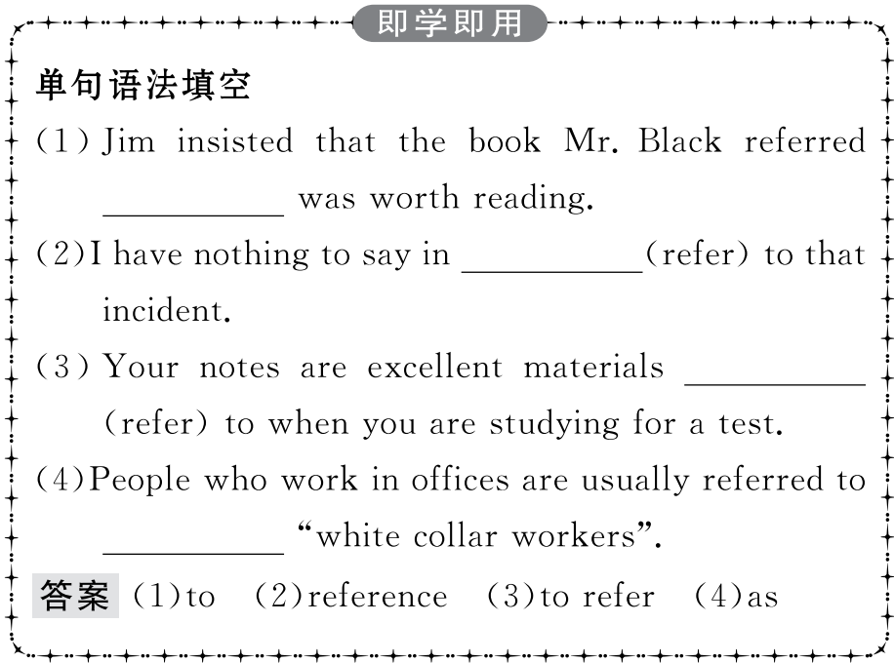
重点词汇
重点句式
随堂练习

Slide 21
重点词汇
重点句式
随堂练习
Learning English is very useful,but it is wise to learn at least one other foreign language,if possible.学习英语是非常有用的,但如果可能的话,至少学习另外一门外语是明智的。
【句式剖析】本句是一个并列句。Learning English...是第一个分句的主语,在第二个分句中it是形式主语,真正的主语是后面的动词不定式短语to learn...;if possible是省略形式,省略了主语it和连系动词,补全为:if it is possible。
If(it is) possible,please come to the party before 7.
如果可能的话,七点前来参加聚会。
If(it is) possible,you hand in your homework tomorrow.
如果可能的话,你可以明天交作业。

Slide 22
重点词汇
重点句式
随堂练习
【句式拓展】

Slide 23
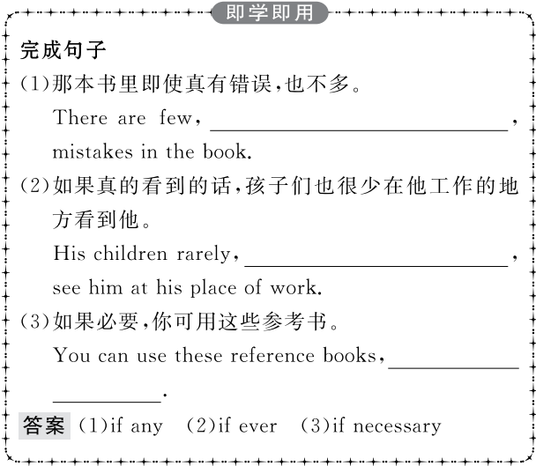
重点词汇
重点句式
随堂练习

Slide 24
重点词汇
重点句式
随堂练习
Ⅰ.选词填空
1.Tom,a Californian,received his doctor’s degree at the University of California.
答案:native
2.The underlined word “rainbow” in the last paragraph to something imaginative and fun.
答案:refers
3.The has been designed to give students quick and easy access to the digital resources of the library.
答案:system
attitude,native,billion,system,refer

Slide 25
重点词汇
重点句式
随堂练习
4.From the experience I learnt a lot about how the of the leader can affect the members of a team.
答案:attitude
5.If you want to go into the car industry,you’d better have a few dollars.
答案:billion

Slide 26
重点词汇
重点句式
随堂练习
Ⅱ.介词填空
1. many of us,it is important to learn a foreign language.
答案:To
2. Chinese,Spanish is the language with the most native speakers.
答案:After
3.When doing our work,we must pay attention ways and means.
答案:to
4.If you know English,it is easy for you to do business foreigners.
答案:with
5.His statement refers people in general,not to anyone in particular.
答案:to

