Slide 1
初中英语外研版七年级下
Module1 Lost and found
Unit1 Whose bag is this?
WWW.PPT818.COM

Slide 2
内容结构
Review
1
Presentation
2
Language Points
3

Slide 3
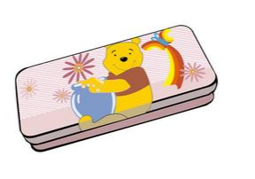
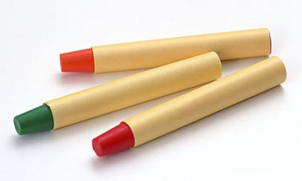
Review
Look and say.

Slide 4
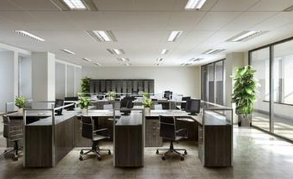
Presentation
Activity1: Look the pictures and answer the questions.
What’s Lost and Found?
lose (lost) find (found)
a film/movie
an album
an office

Slide 5
What are in the lost and found box?
some crayons
an eraser
a wallet
a watch
a pair of
gloves
some tapes

Slide 6
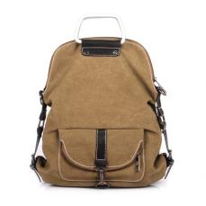
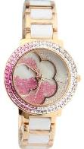
-- Whose bag is this?
-- It’s Tony’s.
This is his bag. The bag is his.
-- Whose watch is this?
-- It’s Linda’s.
This is her watch. The watch is hers.

Slide 7
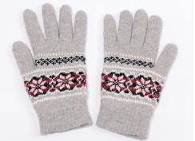
-- Are these gloves Tony’s?
-- Yes, they are.
These are ____ gloves. The gloves are ____.
his
his
-- Are these crayons Linda’s?
-- Yes, they are.
These are ____ crayons. The crayons are ____.
her
hers

Slide 8
Activity2: Read the sentences and find something useful.
This is his bag. The bag is his.
These are her crayons. The crayons are hers.
It’s my book. The book is mine.
They are your books. The books are yours.
形容词性物主代词
名词性物主代词
What’s the difference?

Slide 9
主格 宾格 形容词性 名 词 性 物主代词 物主代词
I me my mine he him his his she her her hers you you your yours it it its its we us our ours they them their theirs
做主语
做宾语
后加名词
不可加名词

Slide 10
1
Match the words from the box with the pictures.
bag crayons eraser
football gloves wallet watch
①
②
③
④
⑦
⑥
⑤

Slide 11
2
Listen and answer the questions.
1 Is the football Tony’s?
2 Are the crayons Betty’s?
3 Whose gloves are these?
Yes, it is.
This is ____ football, it’s ____. (he)
his
his
These are not ____ crayons,
they aren’t _____. (she)
her
No, they aren’t.
hers
They are Betty’s.
my
mine
They are ____ gloves, they are _____. (I)

Slide 12
Activity3: Work in groups of four. Put some school things on the desk. Ask and answer like the model:
A: Whose English book is this?
B: It’s mine. It’s my English book.
A: Is this your pen, C?
C: No, it isn’t. It’s not mine.
It’s his/hers. It’s his/her pen.
A: And is the pencil yours, D?
D: No, it isn’t. It’s his/hers. Mine is here.
…
注意正确运用物主代词

Slide 13
3
Listen and read.
Activity4: Listen and match the people with their things.
Lingling crayons
Daming gloves
Tony tapes
Betty wallet
Ms Li watch

Slide 14
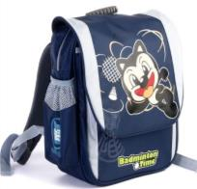
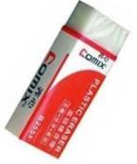
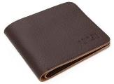
4
Work in pairs. Ask and answer.
注意正确使用物主代词和名词所有格
-- Are the crayons Betty’s?
-- No, they’re not hers. They’re Lingling’s.
-- Is the eraser Lingling’s too?
-- Yes, it’s hers. It’s her eraser.

Slide 15
5
Complete the passage with the correct form of the words from the box.
careful hers mine purple tape yours
Ms Li: Lingling’s bag is in the lost and found box. The
crayons are (1) ________too. Daming’s (2) __________
and Tony’s (3) _______ wallet are here. Is the watch (4)
_______, Daming? Please be (5) __________ with your
things! And whose gloves are these? Oh sorry. They are
(6) _______.
hers
tapes
purple
yours
careful
mine

Slide 16
6
Listen and repeat.
/ /
back bag thank
eraser name
wallet watch
/ /
/ /

Slide 17
Language points
1. First of all, come and look in the lost and found box!
first of all 的意思是“首先”，常用于句首。
例：
First of all, let me introduce my friend Lily to you.
首先，让我向你介绍我的朋友莉莉。

Slide 18
find v. 发现；找到
Many people here cannot find work.
这里很多人都找不到工作。
So far they have not found a way to fight the virus.
迄今为止，他们还没有找到一种对抗该病毒的方法。

Slide 19
2. whose 是代词，意思是“谁的”，一般用于提问物品
的所有者。
常用句子结构: Whose +名词+谓语动词+其他+？
eg: Whose pen is that?
Whose flowers are these?
Whose books are those?

Slide 20
3. Everyone, please be careful with your things from
now on.
be careful with 的意思是“小心（对待）……”。例：Be careful with that knife, or you’ll cut yourself.
小心那把刀子，否则你会划伤自己。
from now on 的意思是“从现在开始”，例：
From now on, things are going to be different around here.
从现在起，这附近的情况将发生变化。

Slide 21
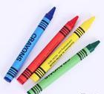
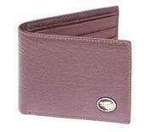
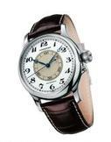
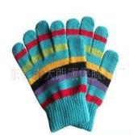
Exercise
一、根据句意及所给图片提示补全句中所缺单词。

Slide 22
crayons
1. My English teacher’s son likes using to draw pictures.
2. There is some money in his .
3. Mum, it’s very cold outside. Where are my ?
4. Jim, put your in your pencil-box, please.
5. Mike has got a nice , you can ask him the time.
wallet
gloves
eraser
watch

Slide 23
二、根据句意从方框中选择恰当的单词填空，有的需要变换形式，每词限用一次。
1. — Tony, is this _______ bag?
— No, it’s not _______. Let me ask Lingling, maybe it’s _______.
2. — _______ pen is this?
— It’s _____ pen. I am looking for it.
whose, lose, mine, my, your, yours, her, hers, careful, purple
your
mine
hers
Whose
my

Slide 24
3. — What color are Mary’s shoes?
— _______ shoes are ________.
4. — Where is Mr. Smith?
— He is talking to a boy at the _______ and found
office.
5. — Is this sweater ________, Tom? Please be
_________ with your things.
— Thanks a lot. I will.
Her purple
lost
yours
careful

Slide 25
三、根据汉语意思完成下列英语句子，每空一词(含缩略形式)。
1. 首先，让我告诉你这个消息。
_____ ___ ____, let me tell you the news.
2. 买一套房子要花一大笔钱。
It takes ____ ____ _____ money to buy a house.
3. 这个小男孩正面带微笑地看着我。
The little boy ____ _______ ____ me with a big smile.
First of all
a lot of
is looking at

Slide 26
4. 从现在开始我们要尽量做得更好。
______ ______ ____, we will try to do better.
5. 让我想想，哦，是我的。
_____ ____ ____. Oh, they’re ______.
6. — 这台电脑是Betty的吗？
— 不，不是她的。是Kate的。
— Is the computer _______?
— No, it isn’t _____. It’s _______.
From now on
Let me see
mine
Betty’s
hers Kate’s

