Slide 1
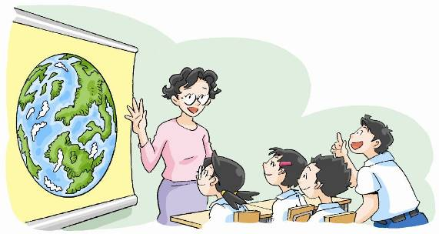
The Earth
12
WWW.PPT818.COM

Slide 2
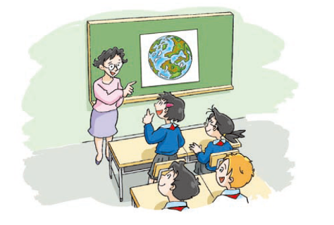
Ms Guo:
Kitty:
Ms Guo:
Joe:
Ms Guo:
Alice:
Peter:
Kitty:

Slide 3
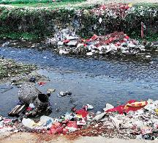
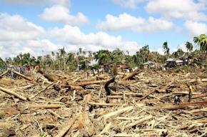
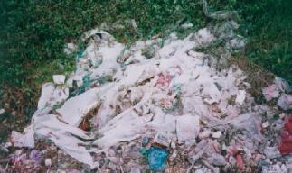
Look and read
Let’s read！
We should stop throwing rubbish into rivers.
We should stop cutting down so many trees.
We should stop using plastic bags.

Slide 4
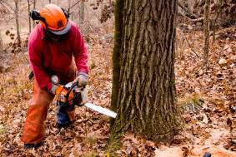
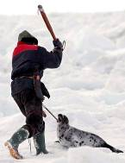
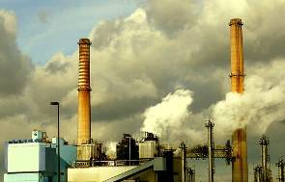
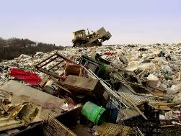
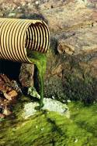
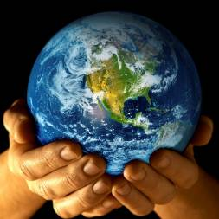
We must save the Earth.
People must stop cutting down forests.
People must stop killing animals.
People must stop polluting the air.
People must stop polluting the land.
People must stop polluting the sea.

Slide 5
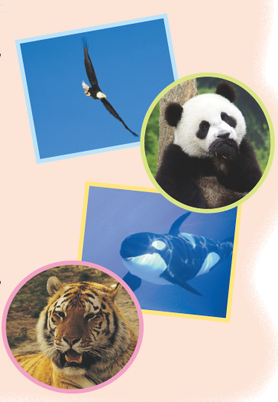
Think and say
We should …

Slide 6
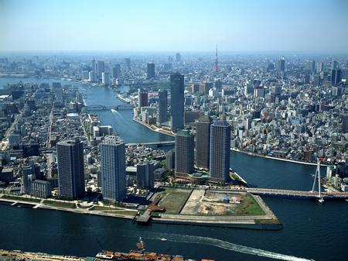
Think and say
We should …

Slide 7
We should …
We should

Slide 8
Think and write

Slide 9
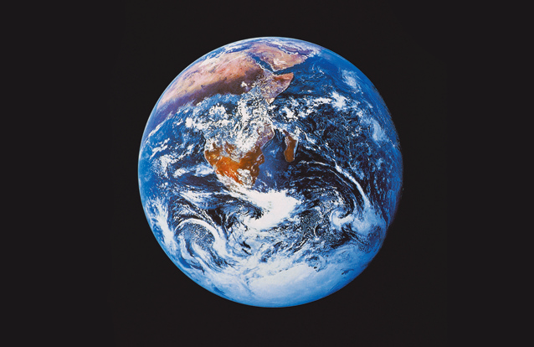
Think and say
What do you know about the Earth?

Slide 10
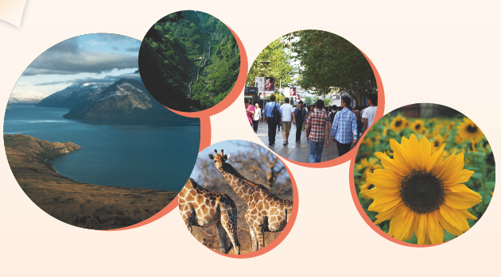
We live on the Earth. The Earth is a beautiful place. There are rivers, oceans, land and forests. There are many different plants and animals too.

Slide 11
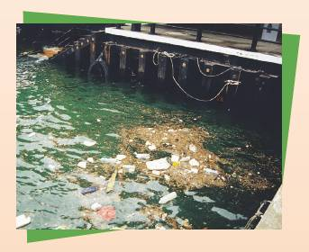
People, plants and animals need clean water and air. Sometimes people throw rubbish into rivers and oceans. Sometimes people cut down too many trees. Smoke from cars and factories makes the air dirty. The Earth gets sick.

Slide 12
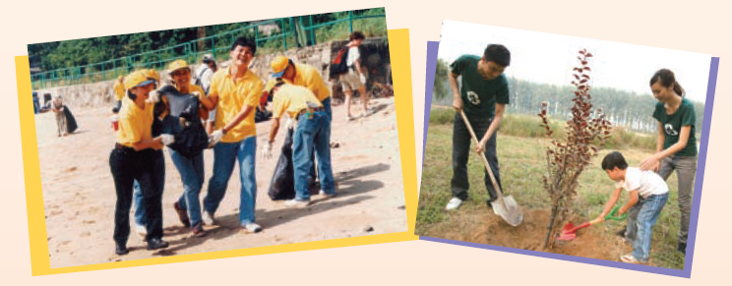
Now people work together to keep the Earth clean and healthy. They pick up rubbish. They plant trees every year.

Slide 13
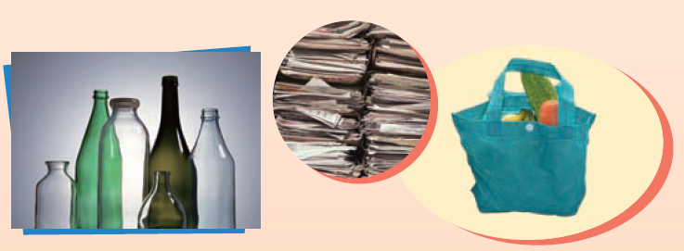
They recycle glass and paper. They bring their own shopping bags and stop using plastic bags.

Slide 14
Answer the questions.
1 Why does the Earth get sick?
2 What do people do to keep the Earth clean and healthy?

Slide 15
The Earth
We live on the Earth. The Earth is a beautiful place. There are rivers, oceans, land and forests. There are many different plants and animals too.
People, plants and animals need clean water and air.
Sometimes people throw rubbish into rivers and oceans. Sometimes people cut down too many trees. Smoke from cars and factories makes the air dirty. The Earth gets sick.
Now people work together to keep the Earth clean and healthy. They pick up rubbish. They plant trees every year.
They recycle glass and paper. They bring their own shopping bags and stop using plastic bags.

Slide 16
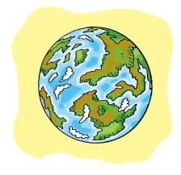
Look and read
Earth Day is on 22nd April.
The first Earth Day was in 1970.
Earth Day is a great time to learn about our planet and how to take care of it!
Earth Day

Slide 17
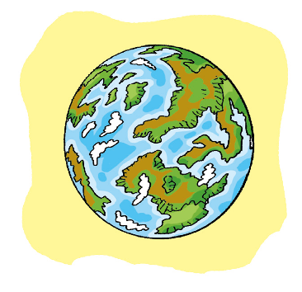
Look and read
Things to do on Earth Day
Wear something green
Plant a tree
Turn off the lights
Walk or bike
Eat green

Slide 18
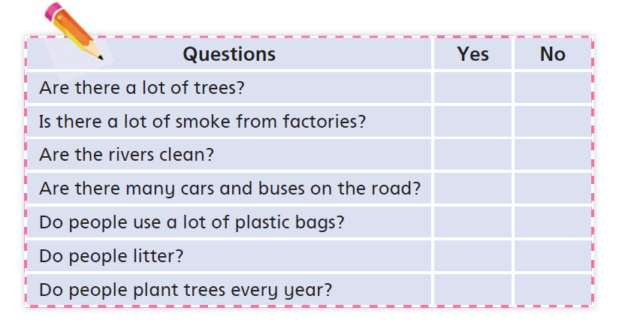
Think and complete

Slide 20
THE ENGLISH SOUNDS

Slide 22
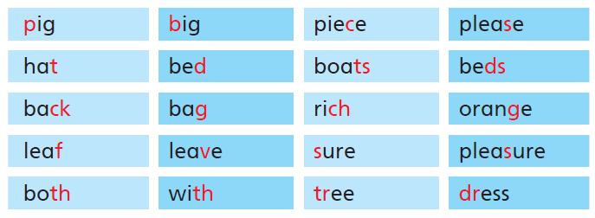

Slide 23
THE VOWEL SOUNDS
THE SIMPLE SOUNDS

Slide 24
a big pig
a green bee
a bad dragon
a glass jar

Slide 25
a hot dog
a short horse
a funny sun
a dirty girl

Slide 26
a good book
a blue moon
a red cherry
a lovely flower

Slide 27
THE CONSONNANT SOUNDS

Slide 28
three theatres
those clothes
a shy sheep
a Chinese child

Slide 29
a giant giraffe
An unusual television
a happy halloween
your yesterday

Slide 30
wonderful weather
a young king
thin twins

Slide 31
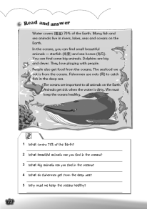
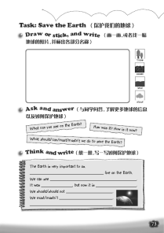
Homework
1. Review Unit 12.
2. Review all the sounds.
3. Make a picture book about the Earth.
4. Finish Workbook pages 72 and 73.

