Slide 1
Unit 4 A good read
Grammar 2
WWW.PPT818.COM

Slide 2
Objectives
To learn to use question words + to-infinitives
To learn to use must and have to

Slide 3
Words and phrases review
hand
hand in
and so on
review
return
on time
renew
vi. 交；递，给
上交，递交
……等等
n. 评论
vt. 归还
准时
vt. 续借；更新；重新开始

Slide 4
Gulliver didn’t know what to say.
Gulliver didn’t know how to get away.
Use a question word with a to-infinitive after a verb.

Slide 5
Using question words + to-infinitives
what to read
Millie has decided .(读什么)
Daniel didn’t say .(与谁聊天)
Simon forgot .(何时与朋友见面)
Sandy is wondering .(去哪里寻求帮助)
Amy doesn’t know .(如何写报告)
who to talk to
when to meet friends
where to ask for help
how to write the report
All question words can be used with a to-infinitive, except why.
She will explain why to recommend this book.
×
√
She will explain why she recommends this book.

Slide 6
e.g.
Millie has decided what to read.
Daniel did not say who to talk to about this book.
Simon forgot when to meet his friends.
Kitty cannot decide which to choose first.
Sandy is wondering where to ask for help.
Amy does not know how to write the report.
Let’s pay attention to who takes action.

Slide 7
疑问词+to do 构成简单句，这个简单句的主语(subject)与主句的主语一致
×
I wonder when the meeting will end.
He doesn’t know what he can do next.
Tom showed us how the police caught the
thief.
Nobody can tell where the plane has gone.
He is interested in how he can look after a pet.
√
×
×
√

Slide 8
He didn’t know where he could find other people.
where to find other people
He didn’t know how he could break the ropes.
how to break the ropes
He wondered who he could ask for help.
who to ask for help
At last, he found out what he could do with the tiny men.
what to do with the tiny men
And he decided when he should leave Lilliput.
when to leave Lilliput

Slide 9
I only care about what to eat. I want to introduce foodie guider .

Slide 10
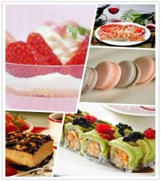
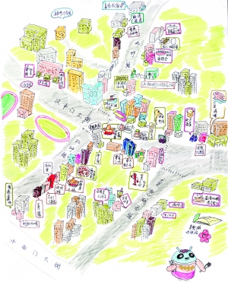
Foodie guider is a useful book. It’s all about what to eat. There is also a map at the end of the book. It tells you where to find nice food . It also shows you which bus to take.
V+
宾语+
疑问词+ to do

Slide 11
V + 宾语+ 疑问词+ to do
advise, ask, decide, discuss find out, forget, know, learn remember, say, show, teach think, understand, wonder

Slide 12
Foodie guider is a useful book. It’s all about what to eat. There is also a map at the end of the book. It tells you where to find nice food . It also shows you which bus to take.
V+疑问词+n+ to do
what
which
whose
how many/how much

Slide 13
Eg:
我们还没决定住哪个房间。
We haven’t decided which room to live in.
他们在讨论暑假去几个地方游玩。
They are discussing how many places to visit in the summer holiday.

Slide 14
PS:
I’m not sure how much money to take. The book doesn’t mention(提及) it. I think the more, the better.
adj+ 疑问词+ to do

Slide 15
在“疑问词 + 动词不定式”结构前，有时也可以是如sure, clear等的形容词。
Eg:
我不确定怎样照顾电子狗。
2. 你清楚下一步该做什么吗？
I’m not sure how to look after an e-dog.
Are you clear what to do next?

Slide 16
Let’s work out the rules
动词+疑问词+to do
动词+宾语+疑问词+to do
动词+疑问词+名词+ to do
形容词+ 疑问词+ to do

Slide 17
how
what
when
where
which
who
ask for
find
hand in
read
travel
write about
Amy: Mr Wu has recommended so many interesting books. Have you decided________________ first, Daniel?
Daniel: Yes. I want to read Black Beauty first. But I don’t know _______________the book first.
Amy: You can try our school library or Sunshine Library. Oh, did you know Peter is reading Around the World in Eighty Days? He wants to find out _________
________ around the world in such a short time.
which to read
where to find
how to
travel

Slide 18
what
when
who
ask for
hand in
write about
Daniel: Wow, that’s amazing! By the way, can you tell me _______________our book report?
Amy: Before next Friday. I’m still not sure __________
___________ in the report.
Daniel: You can write anything about your book—what the book is about, what you think of it and so on. You should read some reviews about the book before writing.
Amy: Thank you. Anyway, I know __________________
Help with writing. Mr Wu is always there to help.
when to hand in
what to
write about
who to ask for

Slide 19
Summary
他想知道明天在哪会见他的朋友。
昨天她问我们何时上交工作。
我们正在商量去参观哪个地方。
我不确定明天怎么去上学。
她不能决定买哪条裙子。
He wonders where to meet his friends tomorrow.
She asked us when to hand in the work yesterday.
We are discussing which place to visit.
I’m not sure how to go to school tomorrow.
She can’t decide which skirt to buy.

Slide 20
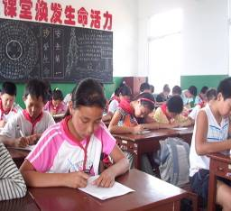
We use must when the speaker feels that something is necessary.
Gulliver was tied to the ground. So he must run away.
Study is very important.
So we must study hard.

Slide 21
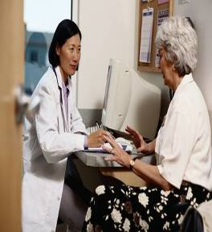
We use have to when the situation makes something necessary.
Gulliver was tied to the ground. He has to lie on the ground.
Grandma is ill. She has to see the doctor.

Slide 22
must与have to是两个常用的情态动词，两词后面都接动词原形。在使用时，应注意两词间的差别。
must 表示主语“有义务”的“必须”做某事，强调说话人的主观看法，主要用于肯定句和疑问句；must 还可以表示肯定推测，意思是“一定”。
have to 强调的是客观需要，意思是“不得不”。have to 有人称和数的变化。

Slide 23
I must work hard at my lessons.
我必须努力学习功课。(主观意愿）
I have to look after mother at home.
For she is ill.
我得在家照看妈妈，因为她病了。(客观需要）
It is getting dark. He has to go home now.
天快黑了。他现在得回家了。(客观需要）

Slide 24
must的否定形式是must not，其缩写为mustn’t，表示禁止，意思是“不能，不许”。
have to的否定形式是do not have to，其缩写为don’t have to。
You mustn’t make any noise in class.
上课时你们不许吵闹。
You don’t have to water the flowers.
For it is going to rain.
你们不必浇花了，因为要下雨了。

Slide 25
Library rules
Complete the following sentences with ‘must, mustn’t,
have to, don’t have to’.
You keep quiet in the library.
You keep the books clean and tidy.
You draw or write in the books.
You eat or drink in the library.
You return the books on time, if you want to keep them longer, you renew them.
You bring your student card every time you go to the library, but remember to bring your library car.
must
must
mustn’t
mustn’t
have to
have to
don’t have to

Slide 26
Summary
不定式可以和疑问代词who, what, which及疑问副词when, how, where等连用，构成不定式短语，在句子中作主语、宾语、表语等。
must表示主观的义务和必要，意思是“必须，得，要”，否定形式是must not,
表示禁止，不能，不许。
have to表示一种客观的需要，意思是“不得不”，否定形式是do not have to。

Slide 27
I. 单项选择。
1. I’m going on a field trip but I haven’t
decided ______. (2007河南)
A. what to do B. to do what
C. where to go D. to go where
2. Excuse me. Would you please tell me
______ buy a digital camera?
(2007安徽)
A. what to B. where to
C. what I can D. where can I

Slide 28
3. — This physics problem is too difficult.
Can you show me ______, Wang
Lin?
— Sure. (2008陕西)
A. what to work it out
B. what to work out it
C. how to work it out
D. how to work out it

Slide 29
4. — We need a new leader for our
Helping Hands Club, but I don’t
know ______.
— Why not Mary? She is always
willing to help others.
(2011江苏南通)
A. what to choose B. how to choose
C. when to choose D. who to choose

Slide 30
5. The math problem is so hard. I really
don’t know ______. (2012甘肃鸡西)
A. how to do it B. how to do
C. what to do it
6. — Excuse me. Could you tell me
______ get to the nearest post office?
— Sorry, I am new here.
(2013山东威海)
A. how can I B. how I could
C. how to D. what I can

Slide 31
7. — Excuse me. Could you please tell
me ______ my car?
— Sure. Park it right here. I’ll help
you. (2013山东青岛)
A. how to stop B. where to park
C. where to stop D. when to park
8. — ______ I swim here?
— I’m sorry. Children ______ swim
alone here. (2012广东)
A. Must; can’t B. May; must
C. Can; mustn’t D. Can’t; can

Slide 32
9. — Dad, must we wait until the light
becomes green?
— Yes, I'm afraid we ______. That's
the traffic rule. (2013河南)
A. can B. may
C. have to D. need
10. Students in our school ______ know
shouting is not allowed in the library.
(2013山东莱芜)
A. can B. may
C. must D. need

Slide 33
II. 选用how, which, what, when, where填空。
When I go into the clothes shop, I
always can’t decide ______ one to buy.
2. My grandfather doesn’t know ______
to use a computer.
3. --- Will you please show me _____ to
drive a car?
--- Yes, of course. Now let me tell you
_____ to do first.
4. I will tell Lucy ______ and _______
to meet.
which
how
how
what
when
where

Slide 34
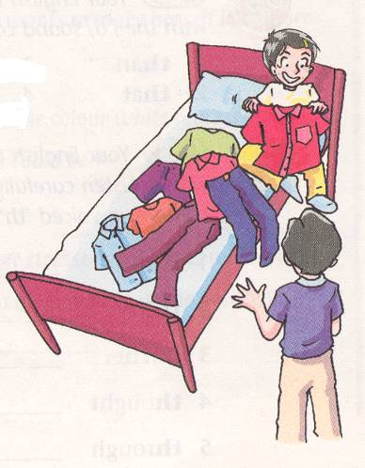
III. 看图完成句子。
Andy doesn't know _____________.
what to wear

Slide 35
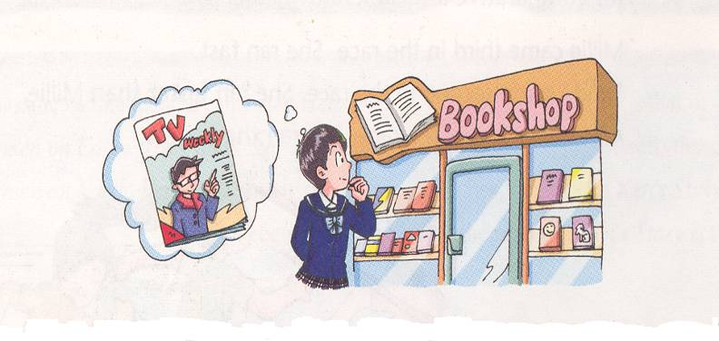
which book to buy
Millie can’t decide _________________.

Slide 36
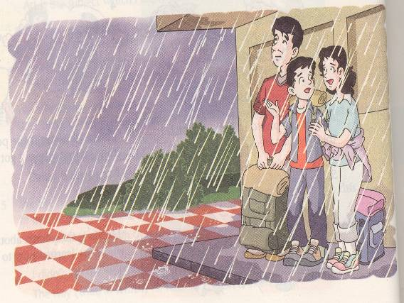
how to go
They don’t know _________ to the station.

Slide 37
to borrow books
I don’t know how _______________ from a library.

Slide 38
IV. 翻译下列句子。
how to spend
1. Have you decided _____________
____________ (怎样度假)?
2. I don’t know ______________________
(在会上说什么).
3. Can you tell me ___________________
(在哪里能买到这本书)?
your holiday
what to say at the meeting
where to buy this book

Slide 39
must wear seat belts
4. Drivers ___________________ (必须系
安全带) while their cars are running on
the road.
5. — _____ (必须) I finish my homework
now?
— No, ________________ (你没必要).
Your work is over today.
Must
you don't have to

