Slide 1
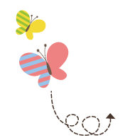
1111111111111111111111111111111111111111111111111111111111111111
Unit 4 Did You Have a Nice Trip ?
五年级下册
Lesson 19 Li Ming Comes Home
WWW.PPT818.COM

Slide 2
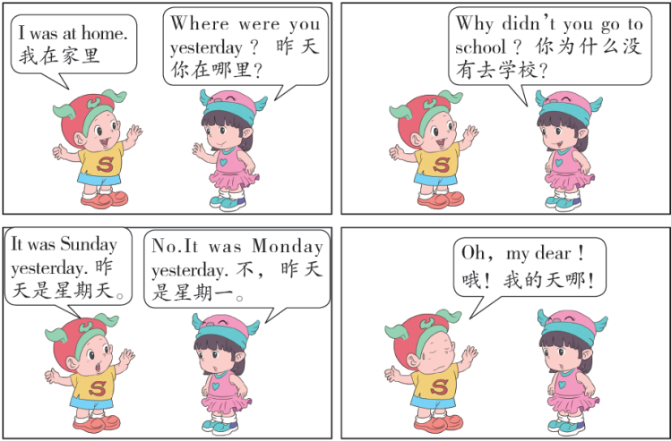

Slide 3
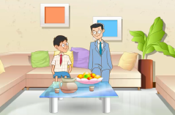
1. Li Ming’s story.
Mr. Li: Hello, Li Ming! You are back. I missed you!
Li Ming: I missed you, too.
Mr. Li: Did you have a nice trip ?
Li Ming: Yes ! I had a great trip!
Mr. Li: What did you do yesterday ?
Li Ming: We walked to Wangfujing Street. We shopped
there. I wanted to buy a gift for you. I looked in
many shops. I liked this. Here, it’s for you!
Mr. Li: Thank you! Oh !It’s a T shirt!
Li Ming: I have one, too !

Slide 4
知识点1
I missed you，too. 我也想你了。
结构：主语+ 动词过去式+ 其他.
一般过去时的句子，通常用来表示过去某个时间
里发生的动作或存在的状态，也表示过去经常或反复发生的动作。用动词的过去式表示，常和表示过去的时间状语连用，如：yesterday，last night，in + 过去的年份，two days ago 等。
含义：

Slide 5
（ 1）肯定句：主语+ 动词的过去式+ 其他．
例句：
He played basketball yesterday. 他昨天打篮球。
Liu Ying was in the US last year.刘英去年在美国。
（2）否定句：主语+ did + not + 动词（短语）原形+ 其他。
（did not 缩写为didn’t）
例句：
He didn’t play basketball yesterday.
他昨天没打篮球。
They didn’t go to school last week.
他们上周没有去学校。

Slide 6
动词过去式的构成［培优点］
（ 1）规则变化：
①一般直接在动词词尾加ed。
例如：watch—watched，play—played。
②以不发音的字母e 结尾的动词，直接在词尾加d。
例如：dance—danced，like—liked。

Slide 7
③以“辅音字母+y”结尾的动词，先变y 为i，再加ed。
例如：study—studied，try—tried。
④以单个辅音字母结尾的重读闭音节动词，先双写末 尾的辅音字母，再加ed。
例如：stop—stopped，plan—planned。。

Slide 8
动词过去式的构成［培优点］
（ 2）不规则变化：需要单独记忆。
例如：is/am—was，are—were，do/does—did，
have/has—had，make—made，get—got，
go—went，fly—flew，forget—forgot。

Slide 9
—Did you have a nice trip? 你旅行愉快吗？
—Yes ! I had a great trip !是的！我旅行很愉快！
知识点 2
did /dɪd/ 做，干；助动词（do 的过去式）
例句：
I did my homework yesterday.
我昨天做了我的家庭作业。
Did he like that place ?
他喜欢那个地方吗？
词形变化：
did（过去式）→ do（原形）→ does（第三人称单数形式）

Slide 10
一般过去时的一般疑问句：Did ＋主语＋动词（短语）
原形＋其他？
肯定回答：
Yes，主语相应的人称代词主格+ did.
否定回答：
No，主语相应的人称代词主格+ didn’t.
例句：
—Did Tom go to the zoo yesterday ？
昨天汤姆去动物园了吗？
—Yes，he did./ No，he didn’t.
是的，他去了。/ 不，他没有去。

Slide 11
补全对话。
A： ______ you listen to music ？
B：No，I didn’t.
典例
Did

Slide 12
知识点 3
What did you do yesterday?
你们昨天做了什么？
一般过去时的特殊疑问句：特殊疑问词＋ did ＋主语
＋动词原形＋其他？
例句：
—What did you do last night ？
昨天晚上你做什么了？
—I did my homework.
我做我的家庭作业了。

Slide 13
魔法记忆：
一般过去时并不难，过去动作、状态记心间。动词要用过去式，时间状语句末站。否定句很简单，didn’t 站在动原前，其他部分不要变。一般疑问句也好变，did 放在句子前，主语、动原、其他部分依次站。特殊疑问句也简单，疑问词加一般疑问句记心间。

Slide 14
yesterday / jestədeɪ/ adv. 昨天
I went to the Beijing Zoo yesterday.
我昨天去了北京动物园。
例句：
yesterday morning 昨天上午
the day before yesterday 前天
短语：
联想记忆法：
yesterday 昨天 today 今天
tomorrow 明天

Slide 15
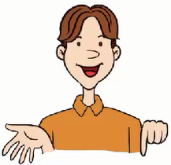
2. Walk and walked
Let’s find the differences ！
1. I often walk to school.
I walked to the park yesterday.
2. I often watch TV at home.
I watched a film last night .

Slide 16
知识点 4
night /naɪt/ n. 夜晚，晚上
I read books at night. 我晚上看书。
例句：
light 光，right 正确的
形近词：
day 白天
对应词：
at night 在晚上 day and night 夜以继日
短语：

Slide 17
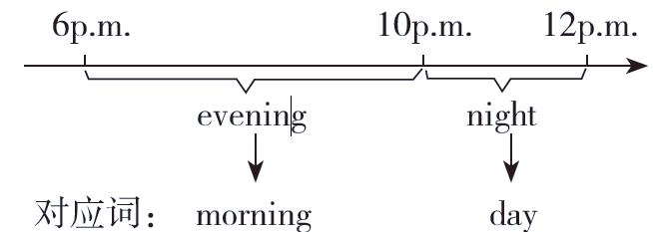
图示辨析法：
evening 和night

Slide 18
3. Let’s do it!
1. Tell Li Ming’s story.
had fun missed wanted to
walked to Wangfujing looked in
Li Ming had fun in Beijing. He...

Slide 19
3. Let’s do it!
2. Ask and answer. Then write.
Li Ming：What did you do yesterday ？
Jenny：I called my friend.
call my friend help my parents
watch TV wash the clothes
What did you do yesterday? _______________________
_______________________ _______________________
_______________________ _______________________ _______________________ _______________________
I called my friend.
What did you do yesterday? I helped my parents.
What did you do yesterday? I watched TV.
What did you do yesterday? I washed the clothes.

Slide 20
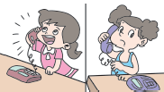
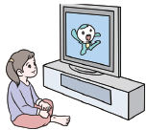
一、看图完成句子。
（ 1）I ________ my friend yesterday.
（ 2）She ________ TV last night.
called
watched

Slide 21
二、用括号中所给单词的适当形式填空。
（ 1）Did you ________（have）a nice trip ？
（ 2）Li Ming ________ （have）fun in Beijing last week.
（ 3）We ________ （shop）yesterday.
have
had
shopped

Slide 22
三、就画线部分提问。
（ 1）I washed the clothes yesterday.
_______________________________
（2）I went to Beijing last year.
_______________________________
What did you do yesterday?
Where did you go last year?

Slide 23
四、Jim 昨晚去看电影了，他是和谁一起去的呢？选择合适的选项补全对话。
Susan：Where did you go last night?
Jim： 1_______
Susan： 2_______
Jim：I watched a film with my friend.
Susan：Why didn’t you call me?
Jim：Sorry， 3_______
Susan：It doesn’t matter. 4_______
Jim： 5_______
A. What did you do?
B. I went to the cinema.
C. Don’t forget to call me next time.
D. I forgot.
E. All right.
B
A
D
C
E

Slide 24
本节课我们学习了以下知识，请同学们一定加强巩固，以便能和同学们进行灵活交流哦！
重点词汇：yesterday， night➢
重点句式：I missed you，too.
—Did you have a nice trip?
—Yes ！ I had a great trip !
What did you do yesterday?

Slide 25
1 熟记本节课所学的句型和单词，必须会听、说、读、写。
2 将Li Ming’s story的内容朗读流利。
3 完成配套的课后作业。

