Slide 1
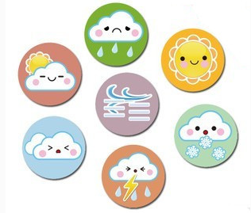
Unit5 What’s the weather like today?
陕旅版
五年级下册
第二课时
WWW.PPT818.COM

Slide 2
>>Review
Magic fingers
weather report sunny
windy cloudy rainy
snowy moon star

Slide 3
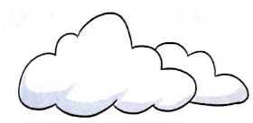
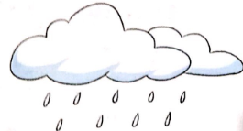
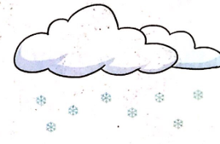
>>Lead-in
Look and circle
What’s the weather like today?

Slide 4
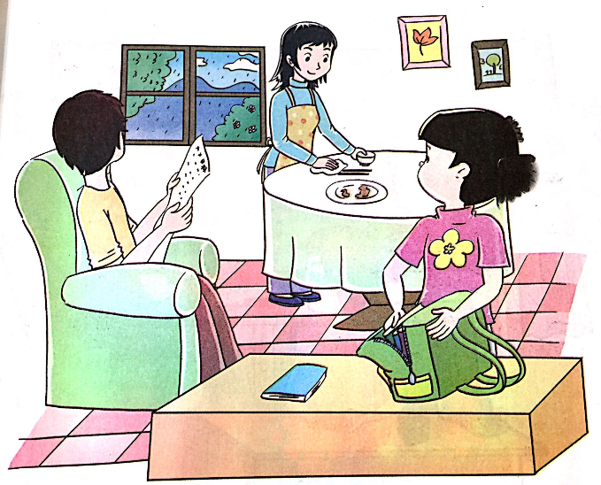
>>Presentation
Look and imagine
What are they talking about?

Slide 5
>>Presentation
Listen, then ask and answer
What’s the weather like today?
It’s cloudy.
Is it raining in this dialogue?
Yes, it is.
Does Wu Chen take the umbrella?
Yes, he does.
答案

Slide 6
>>Presentation
Let’s talk
Wu Chen: What’s the weather like today, Mom?
Mom: It’s cloudy.
Dad: No. It’s not cloudy. It’s rainy.
Wu Chen: Oh, look! It’s raining now.
Mom: Take your umbrella with you.
Wu Chen: OK. See you, Mom and Dad!
Mom&Dad: See you, dear!
点击小喇叭或文本框都可以播放音频

Slide 7
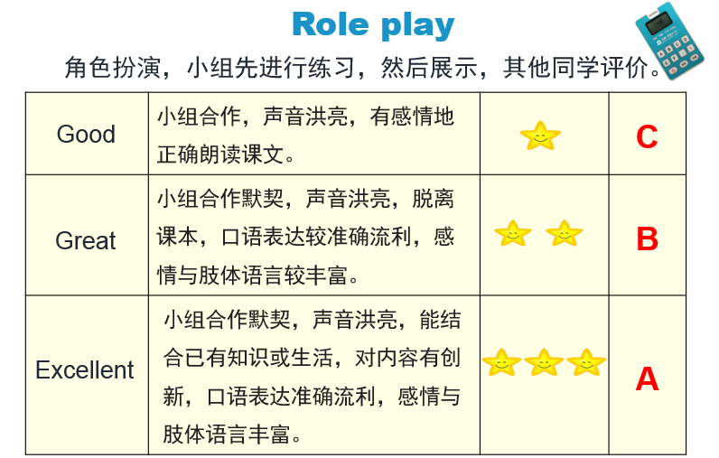
>>Practice

Slide 8
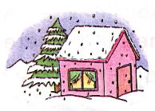
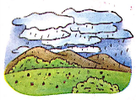
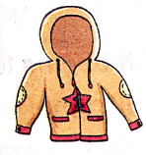
>>Practice
Match and say
A: What’s the weather like/How is the weather today?
B: It’s rainy. You’d better take your umbrella.
rainy
sunny
snowy

Slide 9
>>Practice
Ask and answer
What’s your favorite season?
spring
summer
My favorite season is…
autumn
winter
What’s the weather like in…
spring/summer/autumn/winter?
It’s…
warm/cold/hot/cool.

Slide 10
>>Summary
本课所学的重点句型：
-What’s the weather like …?
-It’s …
e.g.
-What’s the weather like today?
-It’s sunny.

Slide 11
>>Homework
1.听课文录音并跟读，按照正确的语音、语调朗读并表演课文对话。 2.请学生回家观察晚间的天气预报，并用英语记录北京、上海、广州、兰州和成都5个城市的天气状况。
3.预习B Let’s learn more。
close

