Slide 1
Unit 2 What’s your hobby?
WWW.PPT818.COM

Slide 3
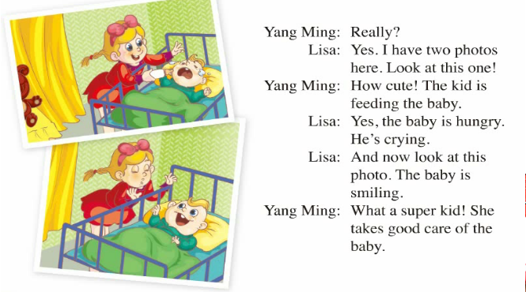

Slide 4
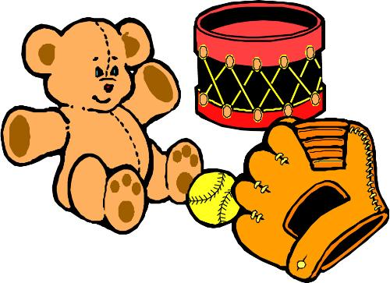
make dolls
making dolls.
I’m interested in making dolls.
我对做布娃娃感兴趣。

Slide 5
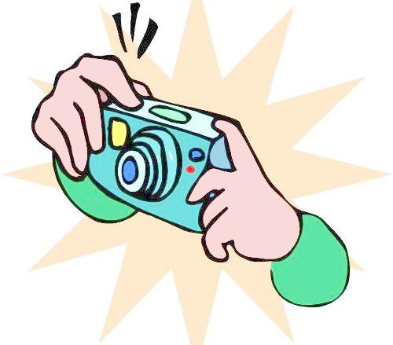
take photos
taking photos.
I’m interested in taking photos.
我对照相感兴趣。

Slide 6
Tips
His hobby is fishing.
He is interested in fishing.
be interested in+名词或动名词形式
对某事物感兴趣。

Slide 7
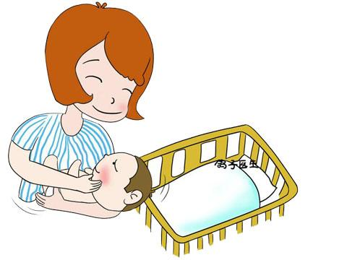
What’s the baby doing?
He is hungry . He is crying.
What’s the kid doing?
She is feeding the baby.

Slide 8
Look at this photo,
the baby is smiling.

Slide 9
感叹句
What an interesting book!
What a super car!
What a beautiful girl!
构成：What +a/an+形容词+名词

Slide 10
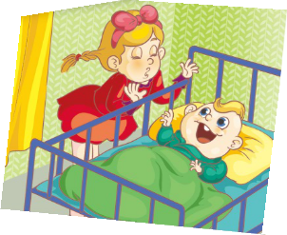
take good care of sb.好好照顾某人
She takes good care of the baby.

Slide 11
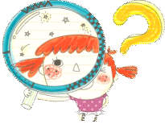
What are their hobbies?
making dolls
Zhou Pei------ __________
Zhou Pei is interested in making dolls
Yang Ming--- ___________
Yang Ming is interested in playing computer games.
Lisa----- _______________
Lisa is interested in taking photos.
playing computer games
taking photos

Slide 12
His
_____(he) hobby is singing.
_____(he)is interested in singing.
_____(he) is doing ______(he)homework.
_____(he) grandpa’s hobby is drinking.
He
He
his
His

Slide 13
sing singing sings
singing
Lucy is interested in _________.
Lucy’s hobby is ____________.
She often__________ at home.
She can___________very well.
What’s she doing? She is________.
singing
sings
sing
singing

Slide 14
I can say
I am interested in…
My mother is interested in…
My father is interested in…
My sister is interested in…

