Slide 1
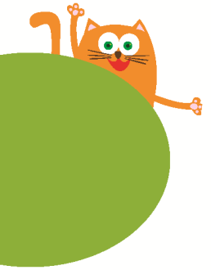
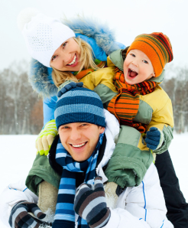
My parents
6
WWW.PPT818.COM

Slide 2
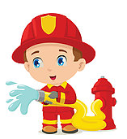
Look and read
firemen
a fireman

Slide 3
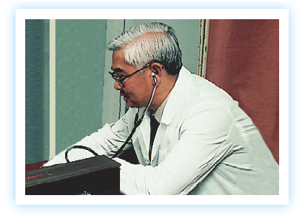
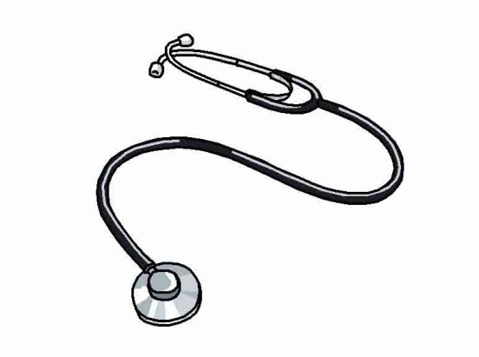
Guess the job
doctor

Slide 4
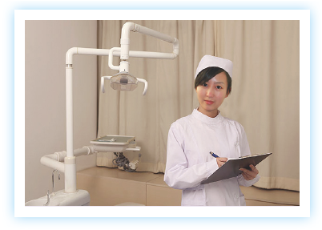
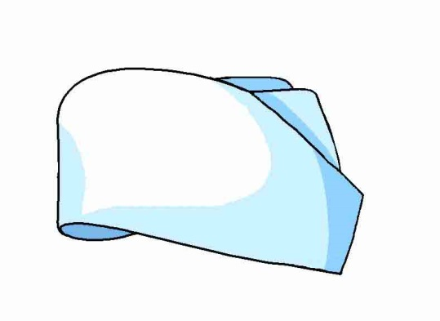
Guess the job
nurse

Slide 5
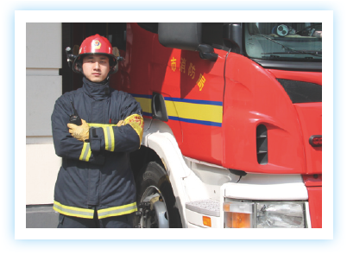
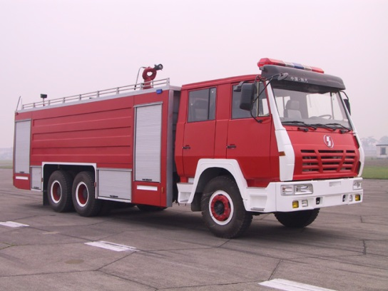
Guess the job
fireman

Slide 6
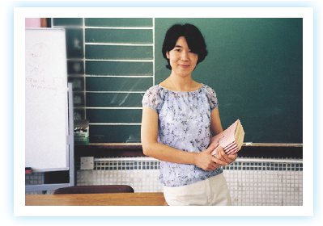
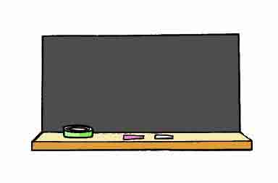
Guess the job
teacher

Slide 7
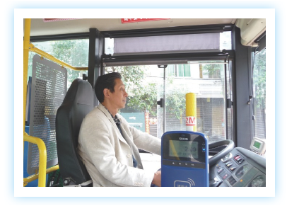
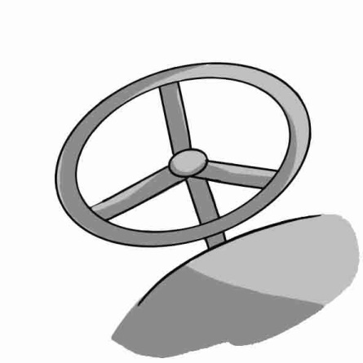
Guess the job
bus
driver

Slide 8
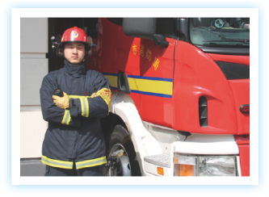
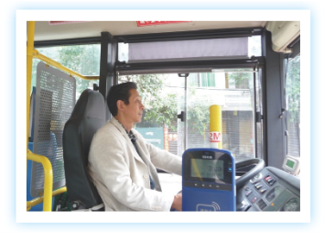
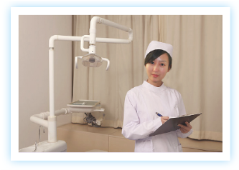
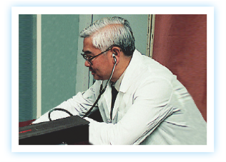
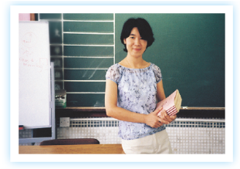
Look and say
4
1
2
5
3

Slide 9
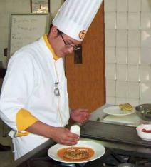
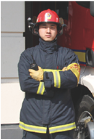
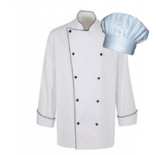
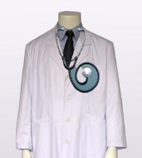
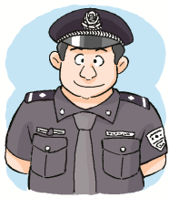
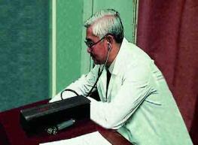
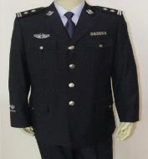
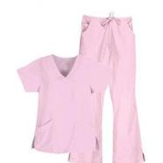
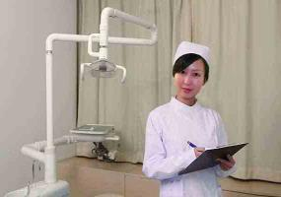
Look and guess
1
2
Number 2.
He is a fireman.
Number ...
He/She is a …
cook
fireman
4
3
5
doctor
policeman
nurse

Slide 10
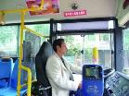
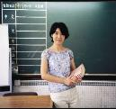
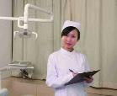
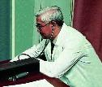
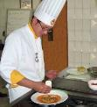
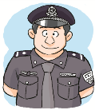
Read and match
1
2
( ) Miss Lin is an English teacher.
( ) Mary’s cousin is a fireman.
( ) My uncle drives his bus every day.
( ) Alex is a good cook. He cooks well.
( ) My father is a policeman.
( ) Doctor White helps the sick people.
( ) The nurse takes care of the old people.
( ) I am a student in Rainbow School.
4
3
2
3
4
7
8
6
5
6
5
1
7
8

Slide 11
Guess!
Look at the man. He is putting out the fire. He is not afraid. He is a ________.
fireman
The man works in a restaurant. He cooks nice food. He is a ______.
cook
Look! A police car is coming. I see a tall and strong man. He is a ___________.
policeman
The woman works in a school. Her students like her. She is a ________.
teacher
The woman works in a hospital. She helps sick people. She is kind. She is a ___________.
doctor/nurse

Slide 12
Can you fill the blanks？
Ben: Good morning, Susie.
Susie: Good morning, Ben. Is that your father?
Ben: Yes, he’s my father.
Susie: Is he a d______?
Ben:No, he’s a f______. He can put out(扑灭) the fire.
Susie: What does your mother do?
Ben: My mother is a n______. She is nice and kind.
What does your father do?
Susie: He is a bus d______. He drives his bus every
day. And my mother is a c______. She cooks
yummy food!
octor
ireman
urse
river
ook

Slide 13
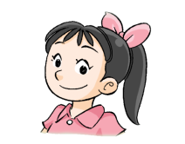
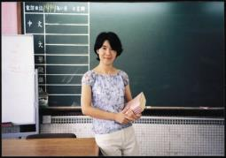
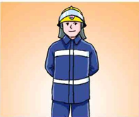
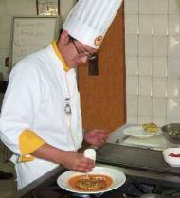
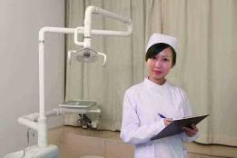
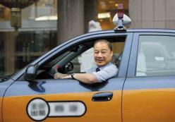
Ask and answer
What does your father/mother do?
He/She is a … .
What does your father do?
He is a doctor.

Slide 14
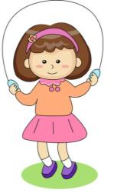
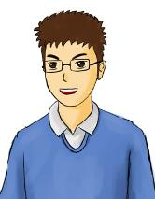
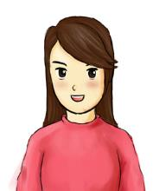
Listen and answer
Mary
father
mother
My … | He/She is … | He/She likes … | He/She is a …
father
tall, strong
reading
teacher
mother
tall, thin
cooking
cook

Slide 15
Ask and answer
What does your mother/father do?
How is your father/mother?
3. What does he/she like doing?
My … | He/She is … (tall/ thin/ …) | He/She likes … | He/She is a …
father
mother

Slide 16
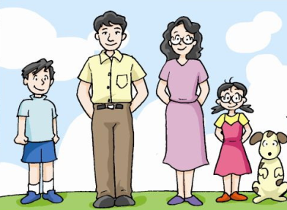
Make a story
I’m …
I like …
I’m a …
My father is …
He likes …
He’s a …
My mother …
She likes …
…

Slide 17
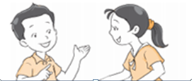
Let’s learn more
I have a super mum…
Tim
Lucy

Slide 18
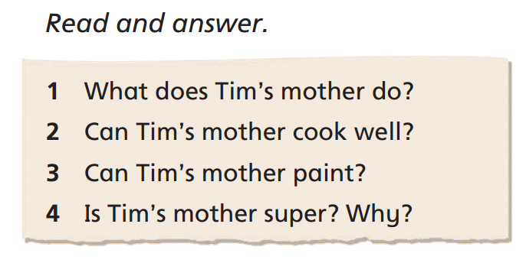
Let’s learn more

Slide 19
Homework
抄写（1号本）：
bus driver, doctor, fireman, nurse, teacher, cook, policeman
共7个职业，写一个中文意思，并背诵、默写。

