Slide 1
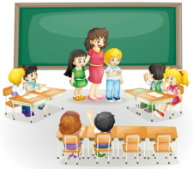
Unit1 I go to school at 8:00.
人教精通版六年级上册
WWW.PPT818.COM

Slide 2
Welcome back to school!

Slide 3
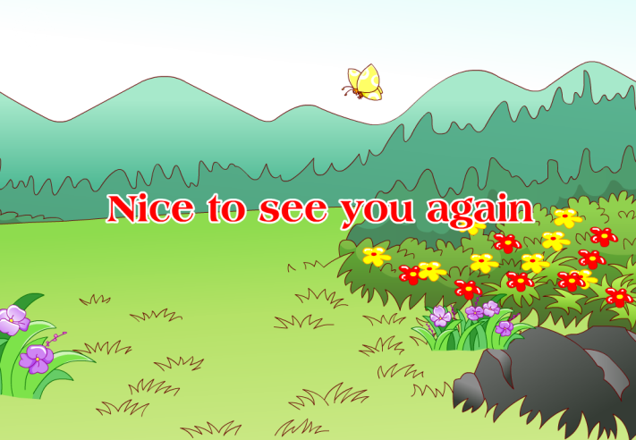
>>Warm-up
Let’s sing

Slide 4
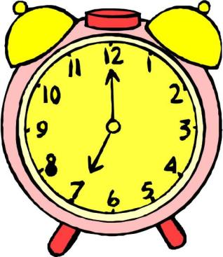
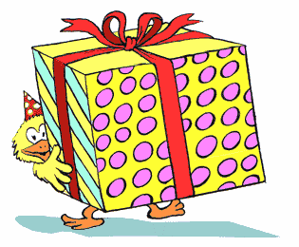
>>Lead-in
Look and say
The present is for you.
Guess, What’s this?
It’s seven o’clock.
What time is it?

Slide 5
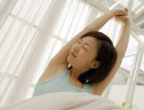
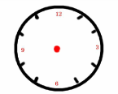
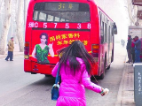
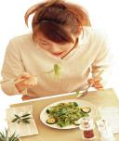
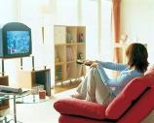
>>Presentation
My daily life
I get up at seven in the morning.
I go to work at eight.
I have lunch at half past eleven.
I watch TV at ten in the evening.

Slide 6
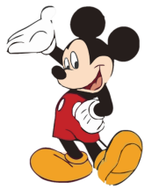
>>Presentation
Free talk
Talk about your daily life
1
What do you usually do at seven in the morning?
1
When do you go to school?
1
How many classes do you have today?
1
What subject do you like?
1
What do you do after school?

Slide 7
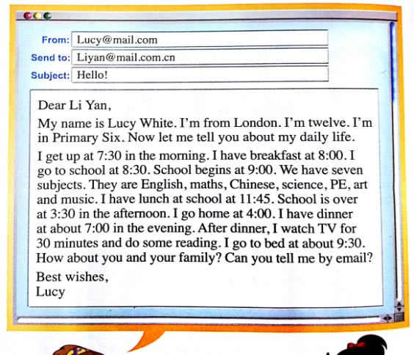
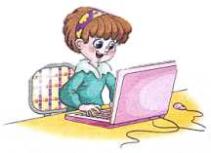
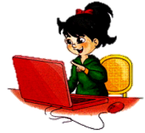
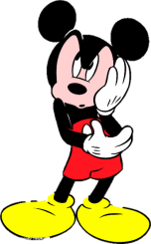
>>Presentation
Lucy is Li Yan’s new friend. They became friends through the Internet.
Who is the letter sent to?
Who is it from?
Lucy
Li Yan

Slide 8
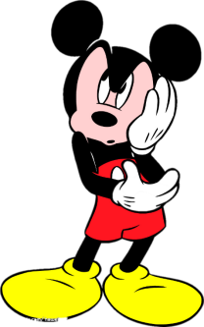
>>Presentation
Just read and talk
Task1: Listen and say
What’s the e-mail about?
It’s about Lucy’s daily life.

Slide 9
>>Presentation
Just read and talk
Task3: Read and say
2. How old is Lucy?
She is twelve.
3. What grade is Lucy in?
Primary Six
= Grade Six
She is in Grade Six.

Slide 10
>>Presentation
Just read and talk
Task4: Read and circle
What activities do you know about Lucy?
I get up at 7:30 in the morning. I have breakfast at 8:00. I go to school at 8:30. School begins at 9:00. We have seven subjects. They are English, maths, Chinese, science, PE, art and music. I have lunch at school at 11:45. School is over at 3:30 in the afternoon. I go home at 4:00. I have dinner at about 7:00 in the evening. After dinner, I watch TV for 30 minutes and do some reading. I go to bed at about 9:30.
get up
have breakfast
go
to school
School begins
have lunch
School is over
go home
have dinner
watch TV
do some reading
go to bed

Slide 11
>>Presentation
Just read and talk
Task5: Read and say
Lucy’s Daily Life
Activities | Time
get up | 7:30 in the morning
have breakfast
go to school
School begins.
have lunch
School is over.
go home
have dinner
go to bed
8:00
8:30
9:00
11:45
3:30 in the afternoon
4:00
7:00 in the evening
About 9:30 in the evening

Slide 12
>>Presentation
Just read and talk
Task6: Read and judge
1. Lucy gets up at 7:30 in the afternoon.
2. Lucy is in Grade Six.
3. School begins at 8:30.
4. They have seven classes a day.
5. After dinner, Lucy watches TV for 30 minutes.
6. After dinner, she often read some books.
in the morning
9:00.
subjects.

Slide 13
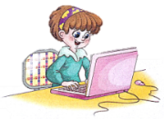
>>Practice
Just read and talk
Listen and imitate

Slide 14
>>Practice
Let’s do survey
Do a survey about our daily life in groups of four and fill in the form.
 | get up | have breakfast | go home | watch TV | go to bed
…
…
…
Activity
Time
People
Two
I
7:00

Slide 15
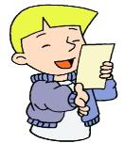
>>Practice
Let’s report
I get up at 7:00.
I have breakfast at ...
 | get up | have breakfast | go home | watch TV | go to bed
I | 7:00
…
…
…
Activity
Time
People
Two

Slide 16
>>Presentation
The format of a letter
Dear XX,
…………………………………
…… …………………………………
…….
I’m looking forward to hearing
from you.
Best wishes,
XX

Slide 17
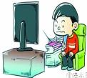
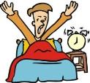
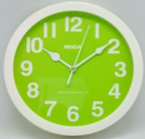
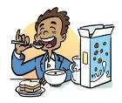
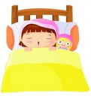
>>Practice
Write and say
My daily life
Dear ××,
My name is ____. I come from… Now let me tell you about my daily life.
I get up at _____. I have breakfast at ________.
……
I really have a busy day! How is your life?
Best wishes,
××
？
…

Slide 18
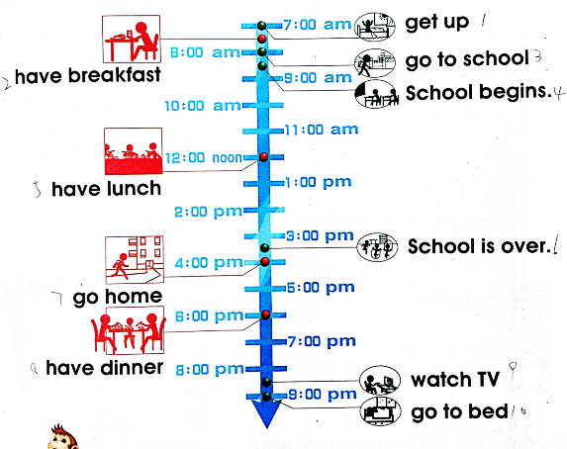
>>Consolidation
Let’s retell

Slide 19
>>Summary
如何介绍自己的日常生活及作息时间呢？
I get up at 7:30 in the morning.
I have breakfast at …
I go to school at ….

Slide 20
>>Homework
1.观看课文动画，按照正确的语音、语调朗读课文对话。 2.模仿本课的书信格式，给自己的好朋友写一封信，介绍一下自己的日常生活和作息时间。
3.预习 Lesson 2。

