Slide 1
Module1 Wonders of the world
Unit 1 It’s more than 2,000 years old.
WWW.PPT818.COM

Slide 2
学习目标
1. To learn and understand the topic words through talking and listening;
2. To know something about The Terracotta Army, The Three Gorges Dam, The Giant’s Causeway and Victoria Falls;
3. To understand conversations involving different tenses.

Slide 3
Free talk
Where did you go during the summer holiday?
Do you know where the Great Wall is?
How long the Great Wall in China?
长城（ The Great Wall），又称万里长城，是中国古代军事防御工程。 2012年6月5日，国家文物局在北京居庸关长城宣布，历经近5年的调查认定，中国历代长城总长度为21196.18公里。起建于春秋战国时代，有两千多年的历史 。万里长城是世界十大奇迹之一。

Slide 4
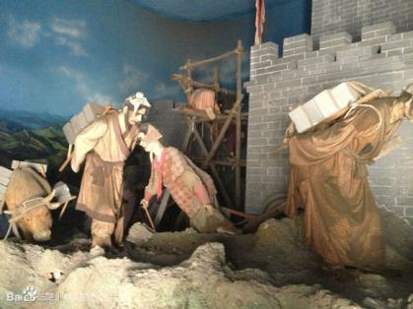
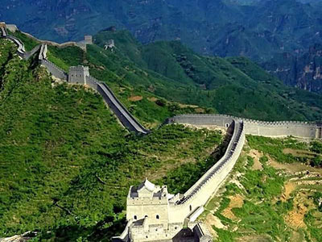
Is the Great Wall a great wonder in the world ?
ancient or modern
natural or man-made
The Great Wall is an ancient man-made wonder in the world.

Slide 5
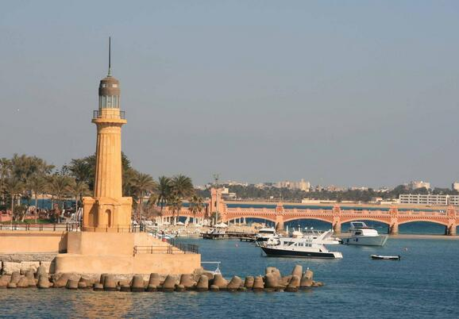
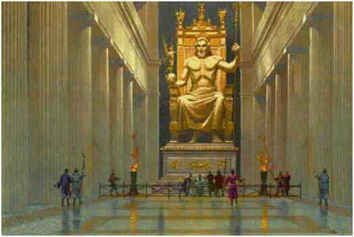
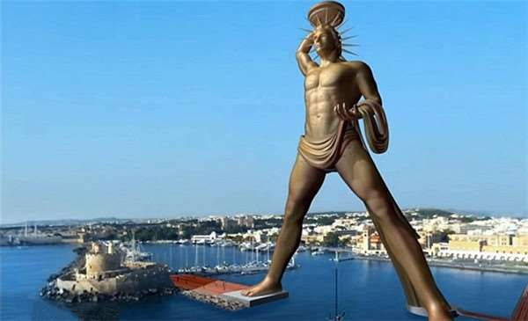
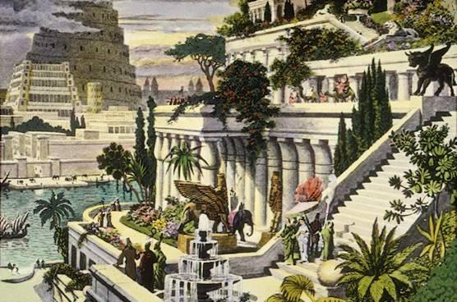
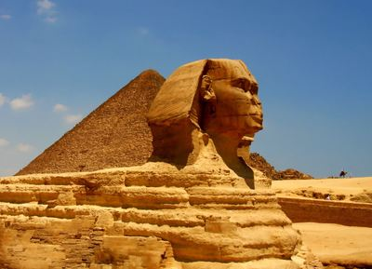
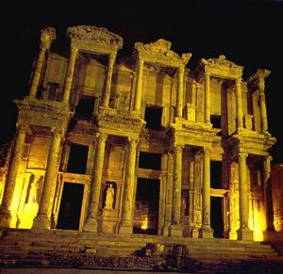
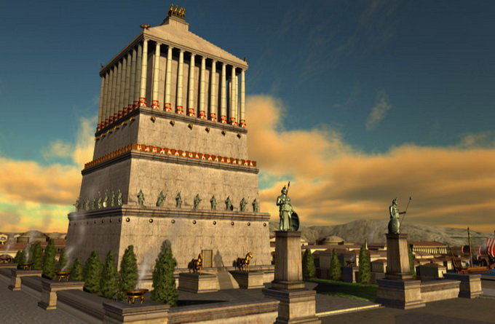
Enjoy some pictures
Seven Wonders of the World
The Lighthouse of Alexandria
埃及的亚历山大灯塔
The Statue of Zeus (Jupiter) at Olympia
希腊奥林匹亚的宙斯神像
The Hanging Gardens of Babylon
巴比伦空中花园
The Mausoleum at Halicarnassus
土耳其的摩索拉斯王陵墓
The Pyramids of Egypt
埃及金字塔
The Colossus of Rhodes
地中海的罗得岛太阳神铜像
The Temple of Artemis at Ephesus
土耳其以弗所的亚底米神庙

Slide 6
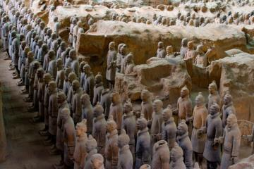
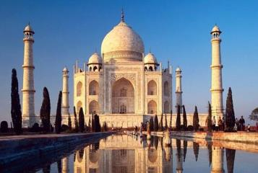
More wonders
The Terracotta Amy, China
中国秦始皇兵马俑
The Taj Mahal, India
印度泰姬陵

Slide 7
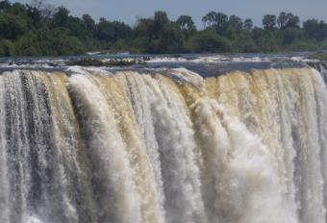
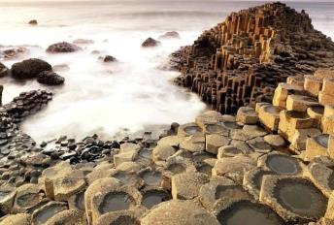
Victoria Falls
维多利亚瀑布
The Giant’s Causeway
巨人之路
Can you say some others?

Slide 8
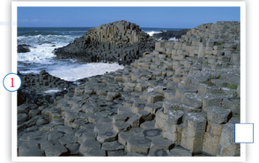
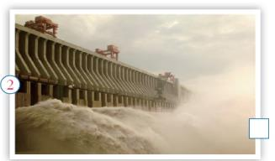
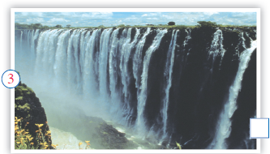
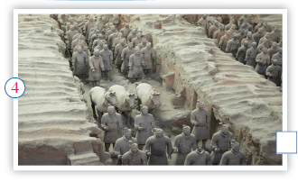
Presentation
Listening and vocabulary
1
Match the names of the wonders with the pictures.
c
b
d
a) The Terracotta Army
b) The Three Gorges Dam
c) The Giant’s Causeway
d) The Victoria Falls
a

Slide 9
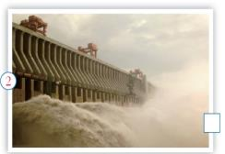
2
Look at the pictures and answer the questions.
ancient man-made modern natural wonder
Which two are natural wonders?
1
3
2. Which two are man-made wonders?
2
4
3. Which is an ancient wonder?
4
4. Which is a modern wonder?
2

Slide 10
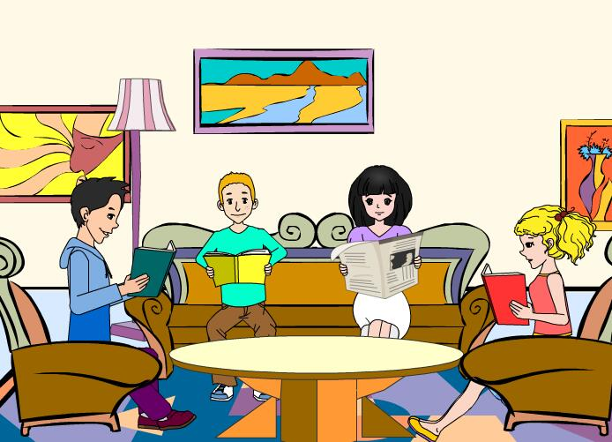
Watch and answer.

Slide 11
Task1: Check (√) the true sentences.
1. Tony thinks the Giant’s Causeway is the
largest natural wonder.
2. Lingling thinks the Victoria Falls is more fantastic than the Giant’s Causeway.
3. Betty and Daming are more interested in
man-made wonders.
4. For Daming, the Three Gorges Dam is more fantastic than the Terracotta Army.

Slide 12
Task2: Listen and answer.
1. Where is the Giant’s Causeway?
_______________________________________
2. How wide are Victoria Falls?
_______________________________________
3. What wonders does Betty think are more exciting?
_______________________________________
4. How old is the Terracotta Army?
_______________________________________
On the eastern coast of Northern Ireland.
About 1,700 metres wide.
She thinks man-made wonders are more exciting.
It’s more than 2,000 years old.

Slide 13
Task3: Listen and fill in the chart.
Wonders | Where | How long/wide/high | How old
The Giant’s Causeway |  |  | _______
Victoria Falls |  |  | _______
The Terracotta Army |  | _______
The Three Gorges Dam |  |  | _______
on the eastern coast of North Ireland
runs for several hundred metres
about 1,700 metres wide and100 metres high
in Africa
more than 2,000 years old
Shanxi, China
about 2,300 metres
long , 185 metres high
and 15 metres wide
Hubei, China

Slide 14
5
Complete the sentences with the words in the box.
discussion, eastern, huge, opinion ,though
In my________ , natural wonders are more interesting than man-made ones.
2. The Victoria Falls, about 1,700 metres wide and 100 metres high, is_______.
opinion
huge

Slide 15
3. Let’s join in the__________ about the wonders of the world.
4. I think the Giant’s Causeway on the_______ coast of Northern Ireland is a fantastic natural wonder.
5. To some degree, Lingling agrees with Tony about the Giant’s Causeway, ________she thinks the Victoria Falls are more fantastic.
discussion
eastern
though
从某种程度上说

Slide 16
Pronunciation and speaking
Listen and mark the pause.
I’ve never seen it, so I’m not sure I agree with you.
2. That sounds great, though I think the
Victoria Falls in Africa is even more
fantastic.
3. In my opinion, man-made wonders are more exciting than natural ones.

Slide 17
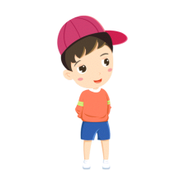
Pair work
Work in pairs. Make a list of wonders of the world. Say which one you would like to visit and why.
Which wonder of the world would you like to visit?
I’d like to visit …
Because I ....

Slide 18
Language points
1. Let’s call Wonders of the World and join in the discussion.
join in的意思是“参加某种活动，加入到”。
辨析：join，join in， take part in
1)join指加入某个党派，团体组织等，成为其成员之一，意为 “参军、入团、入党等”。和某人一起做某事，其结构为：join sb. in (doing) sth.，根据上下文，in (doing) sth. 也可以省去。

Slide 19
2) join in多指参加小规模的活动如“球赛、游戏”等，常用于日常口语。
3) take part in 指参加会议或群众性活动等，着重说明句子主语参加该项活动并在活动中发挥作用。
如：We’ll _____________the English evening tonight.
When did your brother _____________the army?
Will you _______________ us in the discussion?
take part in
join
join

Slide 20
2. I think natural wonders are more interesting than man-made ones.
1) I think 为主句，后面是省略了连接词that的宾语从句。如：I think maths is more difficult than English.
2) ones 作代词，指代wonders。 ones 指代复数名词，同类不同物。

Slide 21
3. Hmm, I’ve never seen it, so I’m not sure I agree with you.
1) be sure that/ be sure of 确信... ，对...有把握。
2) agree with表示“同意某人的意见、想法、解释”等（对象是人或人的观点）; agree to表示 “同意/赞成……”，后面跟表示计划、建议、安排等的名词、代词，或接动词原形。

Slide 22
agree on用于表示“（双方或多方）在某事或某方面取得一致意见”。
如： Her parents both agree _______her decision.
We all agree _______ you.
to
with

Slide 23
Summary
Unit 1
Key words
Key phrases
交际用语
man-made,
natural, wonder
discussion
eastern, though
loud, wow, opinion
in one’s opinion
more than
millions of
I’m not sure ...
In my opinion…
Look at …
Who’d like to …

Slide 24
Homework
1. Which wonder of the world would you like to visit? Write some sentences about it.
2. Preview Unit 2.

