Slide 1
陕旅版英语五年级上册
Unit3
My Favorite Food Is Hamburgers
第4课时
WWW.PPT818.COM

Slide 2
教学目标：
1. 能听懂、理解Read and discuss部分的小故事Where Are His Hamburgers?并能和同学合作为该故事加入对话内容，进行合作表演。
2. 能在教师的引导下完成Listen and tick or cross部分、Think, match and say部分及Look, think and write部分的练习。

Slide 3
Let’s sing

Slide 4
Good morning, boys and girls. I’m thirsty now. How can I do? Do you know what’s my favorite drink?

Slide 5
Free talk
What’s your father/ mother/ brother/sister/ grandpa/ grandma’s favorite drink/ food?

Slide 6
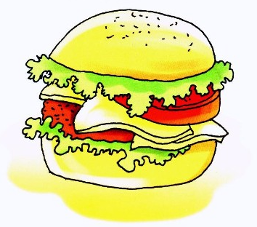
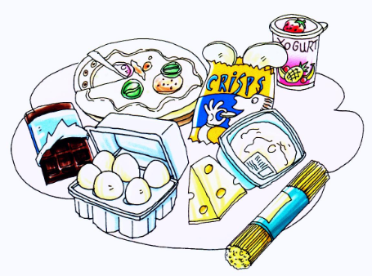
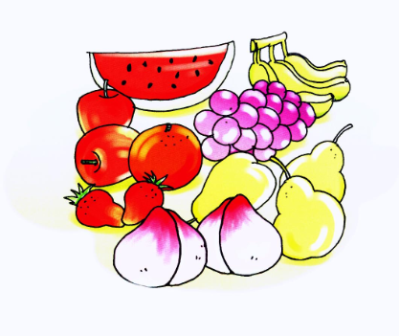
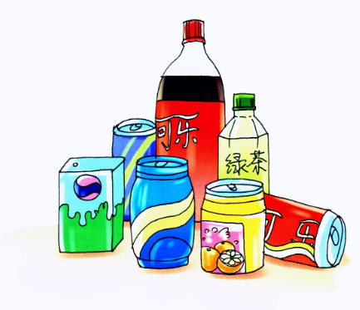
Review

Slide 7
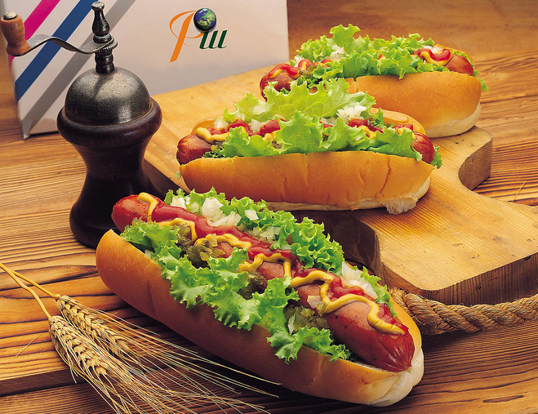
What are these?

Slide 8
There’s a very funny thing about the food. Let’s go and have a look, OK?

Slide 9
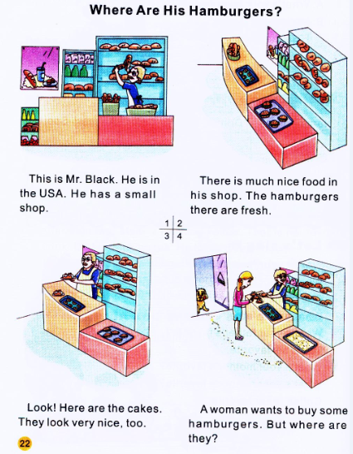
Read and discuss

Slide 10
Role play
同学们四人一组为他们的面包店起名字，一人读旁白，一个扮演Mr. Black，一人扮演顾客，两外一个人演小狗。 用学过的语言编排对话，编的好的可到台上展示哦！

Slide 11
×
√
√
√

Slide 12
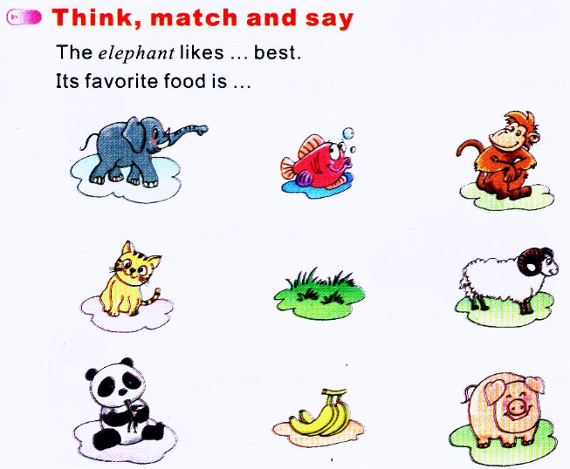

Slide 13
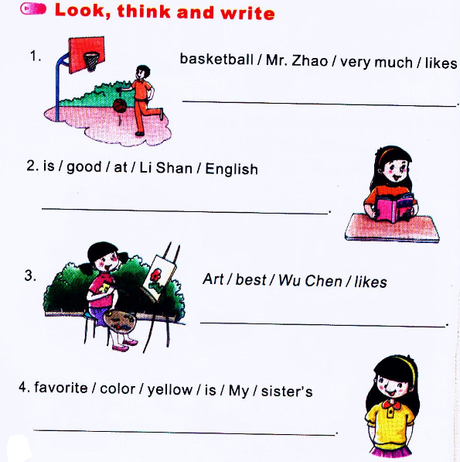
Mr. Zhao likes basketball very much.
Li Shan is good at English.
Wu Chen likes Art best.
My sister’s favorite color is yellow.

