Slide 1
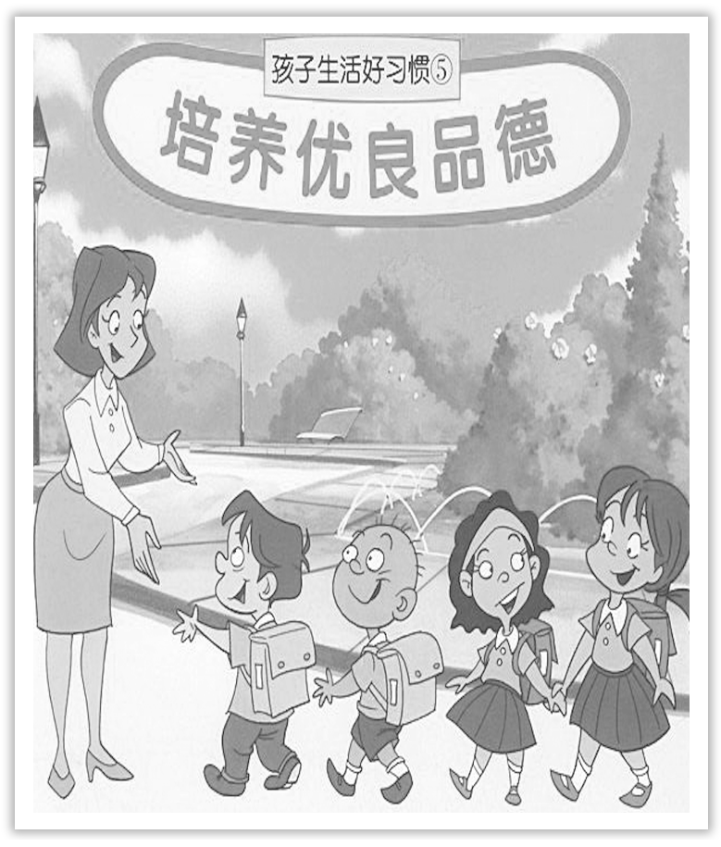
Unit 2 Morals and Virtues
Section Ⅷ Assessing Your Progress
WWW.PPT818.COM

Slide 2
Ⅰ.单词拼写
1.An awful ____________(事故) has happened.
2.This has been the hottest summer within my ____________(记忆).
3.He ____________(低声说) that he had got a new job.
4.The new law will be brought into force by ____________(午夜) tomorrow.
5.The country is ____________(引进) a broad range of skilled personnel.
6.Many raw materials are ____________(出口) to foreign countries.
7.The woman’s arm was ____________(咬) off by an alligator.
8.He acted as ____________(主席) of the meeting.
accident
memory
whispered
midnight
importing
exported
bitten
chairman

Slide 3
Ⅱ.单句语法填空
1.The doctor advised an immediate ____________(operate).
2.We have been greatly ____________(assist) by individuals and organizations.
3.This is a book that displays the considerable ____________(scholar) of its author.
4.The men voted by a four-to-one ____________(major) to accept the pay offer.
5.How long do you think it’ll be before this illness passes ____________？
6.He founded the charity in memory ____________ his late wife.
7.I don’t feel ____________(energy) enough to rush about，so I’ll sit down.
8.The world’s population has doubled during the last four ____________(decade).
operation
assisted
scholarship
majority
away
of
energetic
decades

Slide 4
Ⅲ.补全句子
1._________________________________________________，he made a promise that he wouldn’t make the same mistake.
因粗鲁行为向老师道歉后，他承诺以后不再犯同样的错误。
2.________________________，he didn’t want to argue with him.
因为尊重他的父亲，所以他不想和他争论。
3.He was caught in the rain，thus ________________________________.
被雨淋后他感冒了。
4.Mary sat by the window of the classroom，________________________.
玛丽坐在教室的窗边读一本书。
Having apologized to his teacher for his rude manners
Respecting his father
making himself catch a cold
reading a book

Slide 5
Having lived in the village for years
5.____________________________________________，I know everyone quite well.
因为在这个村里住了很多年，所以我熟悉每个人。
6.The peasants ________________________ day and night at the harvest time.
农忙时，农民们让拖拉机夜以继日地干活。
7.He _____________________ in a café.
有人看见他坐在一家咖啡馆里。
8.You could ______________________________________ there.
你可以听到那里正在谈论五花八门的问题。
had the tractor working
was seen sitting
hear all kinds of things being discussed

