Slide 1
Unit 2 Topic 1
Pollution has caused too many problems.
Section A
WWW.PPT818.COM

Slide 2
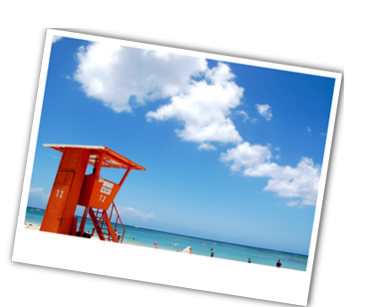
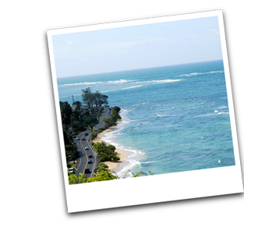
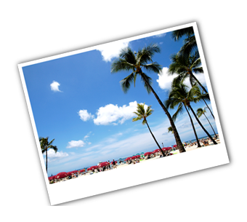
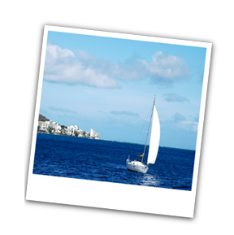
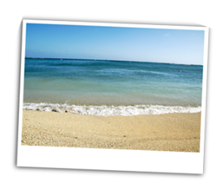
A: Where have you been/traveled?
B: I have been/traveled to ...

Slide 3
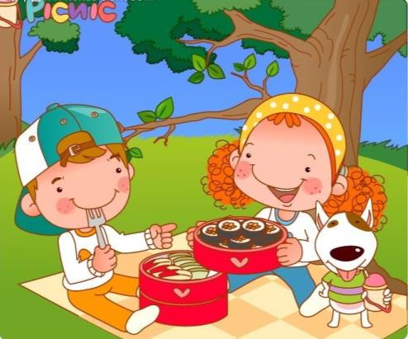
Have you ever had a picnic?
Kangkang, Jane, Maria and Michael are planning a picnic for Sunday.
They will go to the West Hill.

Slide 4
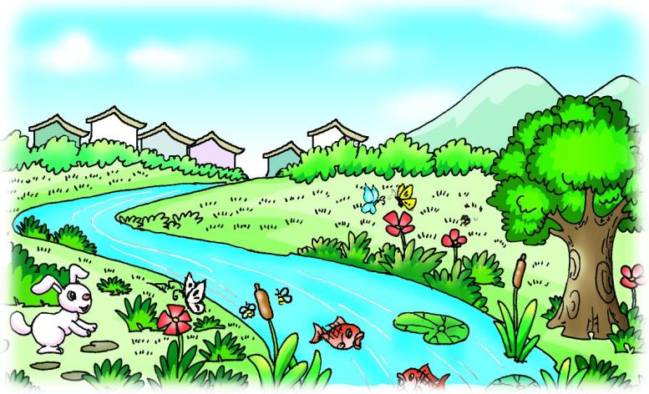
Is the West Hill beautiful?
butterfly
Guess
bee
What can you see there?
We can see bees and butterflies dancing.

Slide 5
Brainstorm
What a shame/mess!
The flowers and grass have gone!
beautiful flowers
a place with
many hills
green trees

Slide 6
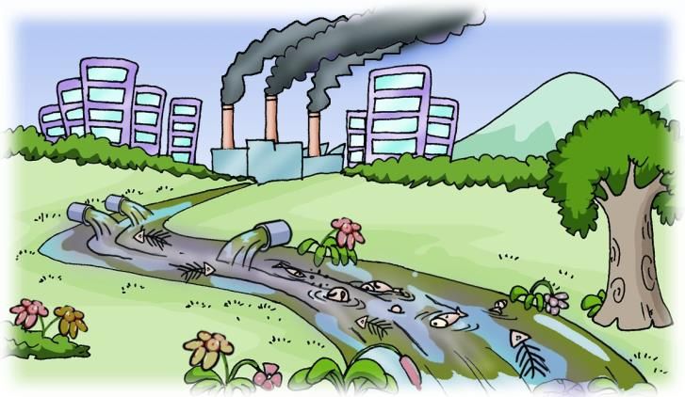
Is it beautiful now?
What has happened there?
Oh, my goodness. What a mess!
Look! There are several chemical factories pouring waste water into the stream.
The flowers and grass have gone!
= have disappeared.

Slide 7
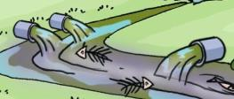
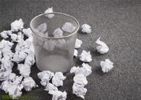
waste water
waste paper
Waste water. 浪费水。
Don’t waste paper. 不要浪费纸。
adj.
v.
waste

Slide 8
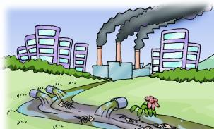
There are several chemical
factories pouring waste water
into the stream.有几家化工厂正在往小溪里排放废水。
There be…doing sth…
……有……在做某事
e.g. There are some people waiting for the bus at the bus stop.

Slide 9
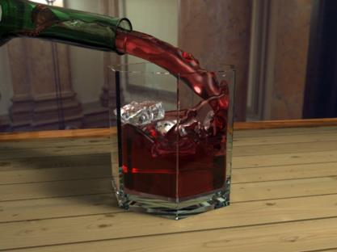
倒出；倾泻
pour… into… 把……倒入……
e.g. Pour red wine into the glass.

Slide 10
1b Listen to 1a and mark the words with P (Past) or N (Now).
____ beautiful ____ butterflies ____ dirty
____ grass ____ terrible ____ factory
____ bees ____ fresh ____ clean
____waste water
P
P
N
P
N
N
P
P
P
N

Slide 11
1c Read 1a and complete the sentences in the table. Then retell 1a to your partner.
Two years ago | Now
1. It was a _______________. 2. There were _______________________. 3. The air was _______________________ and you could see _______________________. | 1. ___________________ have gone. 2. The water is ________and smells ___________. 3. There are several ________________ pouring _______________ into the stream. 4. _____________has changed.
beautiful place
The flowers and grass
lots of flowers and grass
so dirty
terrible
fresh and the water was clean
chemical factories
bees and butterflies dancing
waste water
Everything

Slide 12
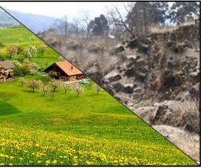
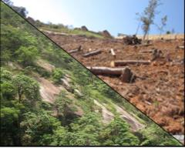
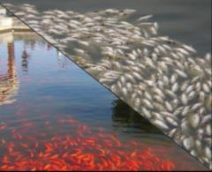
2 Work in pairs. Look at the pictures and make up conversations similar to the example with your partner.
Example:
A: There were lots of flowers and grass
when I visited the village last year.
B: But now the flowers and grass have
gone.
A: What has happened here?
B: The villagers have destroyed them.
village/flowers and grass
villagers/destroy
lake/fish
factory/
pollute
hill/ trees
farmers/cut down

Slide 13
4 Work in groups and talk about pollution in a place you are familiar with. The following sentences may help you.
…ago, it was… Now, … have/ has gone. What has happened? Everything has changed. Oh, my goodness!

Slide 14
3 A. Listen to the sentences and number the pictures.
6
4
1
2
3
5

Slide 15
B. Listen again and complete the sentences.
have cut down
1. People _____ _____ _____ too many trees, so
I don’t have enough leaves to eat.
2. I live in trees but now many trees _____ _____.
3. I like leaves and grass, but now they _____
____________.
4. I _____ _____ hungry for months because of
less bamboo.
5. Human polluted the sea, so I _____ _____ _____.
6. The water _____ _____ many years ago. But it
_____ _____ _____ for me to live in now.
have gone
have
disappeared
have been
don’t live happily
was clean
is too dirty

Slide 16
Exercises
单项选择
( ) 1. Look! There are some boys ________ on the playground.
A. play football B. are playing football
C. playing football D. plays football
( ) 2. — I’m sorry I can’t go shopping with you. I am ill.
— ________
A. What a mess! B. What a shame!
C. What a pity! D. B and C
( ) 3. — Don’t ________ water. We must save every drop of it.
— Sorry, I won’t do it again.
A. waste B. throw
C. play D. leave
C
D
A

Slide 17
Exercises
用所给动词的适当形式填空。
1. When I entered the room, I saw Maria ________ (read) a
Chinese book.
2. What a shame! The flowers and trees in the park _________
(go).
3. Everything _____________ (change) in the past few years.
4. Pandas don’t have enough bamboos ________ (eat) now
because of the pollution.
5. — Where have they been?
— They __________ (be) to the Great Wall. They _______
(have) a good time there the day before yesterday.
reading
have gone
has changed
to eat
have been
had

Slide 18
summary
We learn:
1. Some words:
bee, butterfly, mess, shame, several, pour, waste,
destroy, pollute, goodness
2. Some phrases:
see sb. doing sth. pour…into..
3. Some sentences:
There are…doing…
We can:
1. Express exclamation:
What a mess! What a shame! Oh, my goodness!
2. Know the differences between Simple Past
and Present perfect.
It was a beautiful place.
Everything has changed.

Slide 19
Homework
1. Read 1a.
2. Write a passage according to Part 4.
3. Finish Section A in your workbook.
4. Preview Section B.

