Slide 1
Unit 1 They don't sit in rows
WWW.PPT818.COM

Slide 2
Lead in
How many subjects do you have?
geography
PE
biology
地理学
体育，体育课
生物学

Slide 3
New words
ours
tie
row
pool
我们的
领带
一排；一行；一列
水池；游泳池

Slide 4
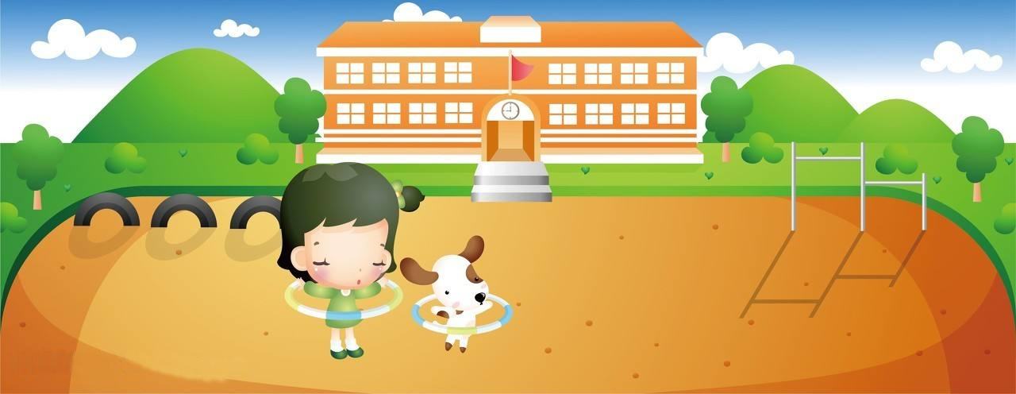
Work in pairs and talk about your school.
There are five white buildings and a very large sports ground in our school.

Slide 5
Listen and complete the sentences.
1. The weather was ________ when Tony was in
London.
2. Tony played football with _________________.
3. Daming is surprised to hear that Tony
__________________________.
4. Tony didn’t go to lessons. He was ____________.
nice
Susie’s classmates
went to school on his holiday
just visiting

Slide 6
Listen and complete the Susie's school column in the table.
 | Susie's school | Your school
Number of pupils in the school
Number of pupils in a class
Arrangement of seats in the classroom
Sports areas
700
30
sitting around tables
swimming pool; sports ground
Now, complete the column about your school.

Slide 7
Answer the questions.
1 Who did Tony visit in London?
His friend Susie.
2. How did Tony get the photos of Susie's school?
He took them himself.
3. Which class is a bit bigger, Susie's or Daming's?
Daming's.
4. What does Betty hope to do one day?
To visit Susie's school.

Slide 8
Complete the passage with the correct form of the words in the box.
enjoy pool row tie wear
Pupils in England do not sit in (1)________ in the classroom. They sit around tables. Everyone (2)_________ a jacket and (3)______. Most schools have sports grounds and English children (4)_________ playing football, just as pupils in China do. Some English schools have swimming (5)_________, but not all of them do.
rows
wears
tie
enjoy
pools

Slide 9
Language points
1. enjoy oneself 玩的开心 = have fun / have a good time
2. a few + 可数名词复数，意思是“一点儿”
few + 可数名词复数，意思是“几乎没有”
a little + 不可数名词，意思是“一点儿”
little + 不可数名词，意思是“几乎没有”
e.g. I have ________ grammar books besides this.
He read many novels but _______ poems.
We still have _________ water to drink.
Hurry up, there's ________ time left.
a few
few
a little
little

Slide 10
3. have a look 看一看
4. a bit bigger 大一点儿 = a little bigger
5. wear school clothes 穿校服
wear “穿着；戴着”，表示状态，宾语是衣帽、饰物、奖章等
put on “穿上、戴上”，强调动作，后接衣服、鞋帽等
dress的宾语通常是人，意思是“给……穿衣服”
(be) in +表示衣服或颜色的词，着重于服装的款式或颜色
have on“穿着，戴着”，表示状态，无进行时

Slide 11
e.g. Who is the young man _______________ a black coat.
Why does he often _______________ sunglasses?
My son is now able to ______________ himself.
___________ your heavy winter coat if you go out.
6. sit around tables 围着桌子坐
7. sit in rows 坐成一排
8. enjoy playing football 喜欢踢足球
enjoy + v.-ing
9. have a match with 和……比赛
10. one day 有一天
11. play with sb. 和……一起玩
play with sth. 玩弄……
in / wearing
wear / have on
dress
Put on

Slide 12
Important sentences
1. What are English schools like? 英国的学校什么样？
句中like为介词, 意思为“像……”，如：
What’s the weather like today? 今天天气如何？
What’s your Chinese teacher like? 你们语文老师人怎么样？

Slide 13
2. Let’s have a look. 让我们看一看。
let sb. do sth. 意思为“让某人做某事”。如：
Let’s go shopping, OK? 我们去购物吧，好吗？
注意：let’s 开头的反意疑问句的附加疑问部分为：shall we?

Slide 14
3. I hope we can have a match with them.
我希望我们能和他们比赛。
hope的用法：
hope to do sth.
e.g. I hope to have a beautiful wife.
hope+that 宾语从句
I hope that we will all pass the exam.

Slide 15
当堂小练
一、根据句意及汉语提示完成单词。
1．There is a swimming _____(游泳池) in his new house.
2．I plan to buy a ___(领带) as a present for my father.
pool
tie
3．They often don’t sit in ______(一排；一行) when they have lessons.
4． Your school is so beautiful，but we think _____(我们的) is even more
beautiful.
rows
ours

Slide 16
当堂小练
二、根据中文提示完成句子， 词数不限。
1. 你们的学校很漂亮，但是我们的学校更大更漂亮。
Your school is beautiful， but __________________________________.
ours is bigger and more beautiful

Slide 17
2. 我听说你明天要去伦敦度假，祝你玩得开心！
I heard that you are going to London for holiday.____________________________________.
3. 他的房子很大，有游泳池。
His house is very big ___________________.
Enjoy yourself/Have fun/Have a good time
with a swimming pool
4. 很多小学生站成一排，等待老师。
Many pupils _____________ and waited for their teacher.
5.这儿有一些花，它们是谁的？
Here __________________.Whose are they?
stood in a row
are some flowers

Slide 18
当堂小练
三、单项填空。
( )1. I don’t like _______ watch.I like _______.
A.me；your B.my；your
C.me；yours D.my；yours
( )2. Mike enjoys _______ old coins and stamps.
A.collect B.collecting C.to collect D.collects
D
B

Slide 19
当堂小练
( )3. Nobody wants to make friends with her， so she had
_______ friends in China.
A.a few B.few C.a little D.little
( )4. John is fond of playing football.His hobby is different
from _______.
A.I B.me C.my D.mine
B
D

Slide 20
当堂小练
( )5. I hope her dream _______ true one day.
A.comes B.is coming
C.will come D.came
( )6. The little kid is just two years old.He’s too young to take
care of _______.
A.his B.him C.himself D.he
C
C

Slide 21
当堂小练
( )7. The box was _______ than I had expected.I was out of
breath when I got home.
A.more heavier B.much heavier
C.little heavier D.very heavier
B
( )8. —_______ people travel every year?
—Perhaps when we are talking about it， more than
100 planes have taken off around the world.
A.How many B.How much
C.How long D.How often
A

Slide 22
当堂小练
( )9. —_______ Lily _______ Lucy has joined the swimming
club because they have no time.
—It’s a pity!
A.Both；and B.Either；or
C.Neither；or D.Neither；nor
D
( )10. It’s very friendly _______ him to help me when I’m in
trouble.
A.of B.with C.to D.in
A

Slide 23
当堂小练
四、完形填空。
My beautiful school is in the center of the city.When you step into 1 school， you can see a broad road in the middle.On 2 sides of the road， many green trees and beautiful flowers wave their hands to welcome you.The 6-floor teaching building stands on the 3 side of the road.There are about 24 classrooms in the teaching building, including two computer rooms

Slide 24
当堂小练
and an art room.Among the rooms， I like 4 rooms best.We sometimes can surf the Internet and play computer games， and sometimes we can also write 5 to our friends there.In front of the teaching building， there is a lake.It’s not very wide， but we can see a small boat on it.The cleaners often 6 the rubbish in the lake by using it.Around the lake，

Slide 25
当堂小练
a number of butterflies and other insects are 7 in the flowers and trees.On the right side of the road， there is a 8 .Many kinds of books are placed in the library.You can go to the library to find some interesting books， such as animal books， storybooks and so on.
If you go along this road and walk 9 the end， you can see a standard playground.There are 20 basketball courts and a big grass football field in it.

Slide 26
当堂小练
A lot of students play sports here every day.And my school sports meeting is 10 here every year. It’s a great place for the students to relax and do sports.
That’s my beautiful school. Do you like it?

Slide 27
当堂小练
( )1. A.my B.your C.his D.her
( )2. A.either B.each C.both D.all
( )3. A.right B.left C.above D.down
( )4. A.art B.computer C.music D.reading
( )5. A.letters B.reports
C.articles D.emails
A
C
B
B
D

Slide 28
当堂小练
( )6. A.stay up B.look up
C.pick up D.put up
( )7. A.dancing B.sleeping
C.eating D.drinking
( )8. A.classroom B.lab
C.library D.bookshop
( )9. A.in B.to C.by D.at
( )10. A.carried B.played C.joined D.held
C
A
C
B
D

Slide 29
课堂小结
归 纳
Unit 1 They don’t sit in rows.
New words and phrases: ours, tie, row, pool, be surprised to do sth. ,
in rows, play with, hope to do sth.
2. Structures:
① What are English schools like?
② How many pupils are there in a class in England?
③ So ours is a bit bigger.
④ Kids there really enjoy playing football.

