Slide 1
Unit 5 What will you do this weekend?
WWW.PPT818.COM

Slide 2
go swimming

Slide 3
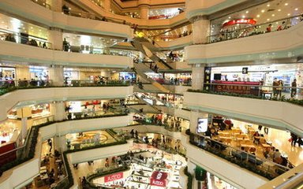
go shopping

Slide 4
What will you do this Sunday?
I will go swimming.
Cool, cool, cool.

Slide 5
What will you do this sunday?
I will go shoping.
Great!

Slide 6
Tomorrow is Sunday, would you like to go swimming with me?
Sorry, I can not go with you.
What will you do tomorrow?
I will go shopping with my mom.

Slide 7
新单词
go swimming 游泳
go shopping 购物
go fishing 钓鱼

Slide 8
重点句型
What will you do this Sunday?
你这个星期天要做什么？

Slide 9
小练习
一、翻译下列句子
1.What will you do this Sunday?
2.I will go swimming.
3.太酷了
4.我将要去购物

Slide 10
小练习
二、翻译下列句子
1.明天是星期日
2.你想和我一起去游泳吗？
3.This is Peter.
4.What will you do tomorrow?
5.I can’t go with you.

Slide 11
答案
一、1.这个星期六你要做什么？
2.我要去游泳。
3.cool
4.I will go shopping.
二、1.Tomorrow is Sunday.
2. Would you like to go swimming with me?
3.这是皮特。
4.你明天要做什么？
5.我不能和你一起去了。

