Slide 1
Lesson 2
Don't shout, please.
WWW.PPT818.COM

Slide 2
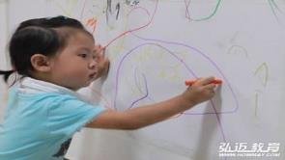
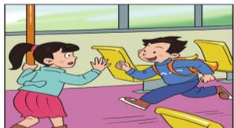
Let's follow the rules!
让我们遵守规章制度!
Don’t
sing
in the
Don’t
draw
on the
Don’t
run
on the

Slide 3
shout

Slide 4
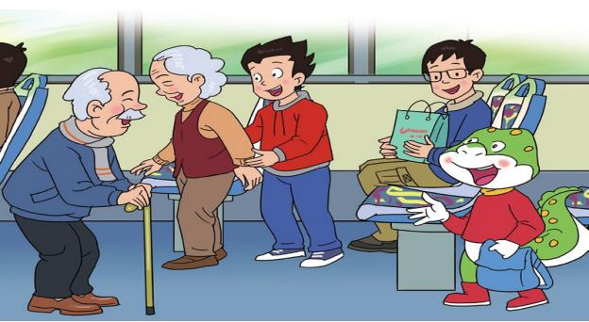
On the bus
Don’t shout, please!

Slide 5
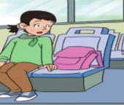
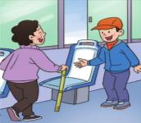
Watch and finish
What else dose Danny do on the bus?
1. Shout .
2. Put the bag on the seat.
2. Put …
3. “Take my/ this seat.”
3. “Take …”

Slide 6
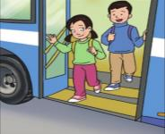
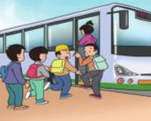
Watch and answer
1. Is the zoo far？
远的
No, it’s near.
2. Where will they get off ?
They’ll get off at the next stop.
get on
下一站

Slide 7
Tips
Listen and repeat. Pay attention to your pronunciation and intonation.
(听录音，指读课文，注意语音语调。)

Slide 8
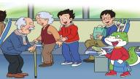
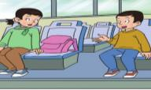
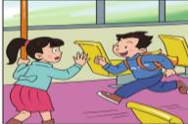
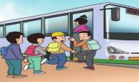
Let's talk
On the bus
Don’t shout.
Don’t put your bag on the seat.
Don’t run.
Wait in line, please.

Slide 9
Do you know?

Slide 10
Do you know?
Talk about.
Don't...
Rules in public（公共场所）
Don’t…
Don’t…
Don’t…
…
…

Slide 11
Talk about.
Please follow the rules!
Let's work together！
Make rules in classroom.
Don’t …
Let’s …
请遵守规章制度！
我们一起努力！

Slide 12
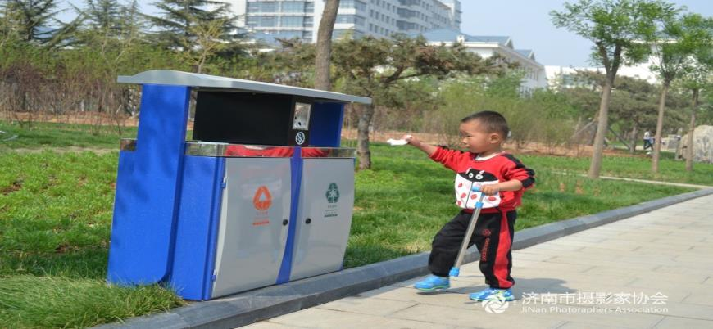
Judge: good behaviour or bad behaviour

Slide 13
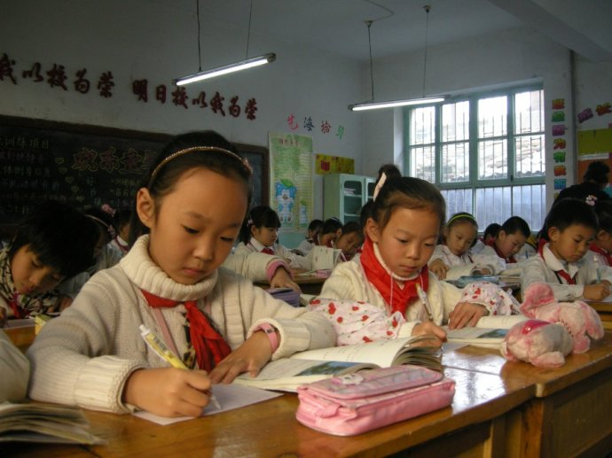
Let's judge: good behaviour or behaviour

Slide 14
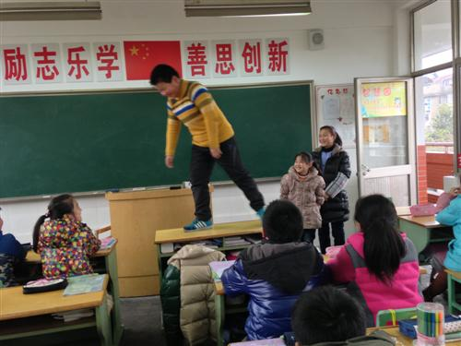
Let's judge: good behaviour or behaviour

Slide 15
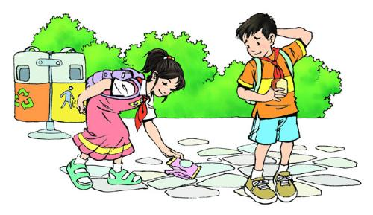
Let's judge: good behaviour or behaviour

Slide 16
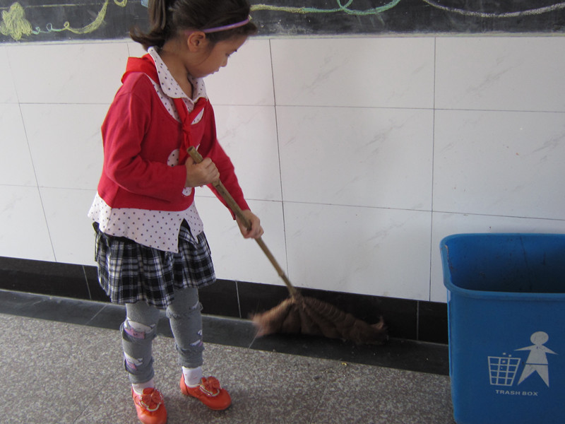
Let's judge: good behaviour or behaviour

Slide 17
Let's judge: good behaviour or behaviour

Slide 18
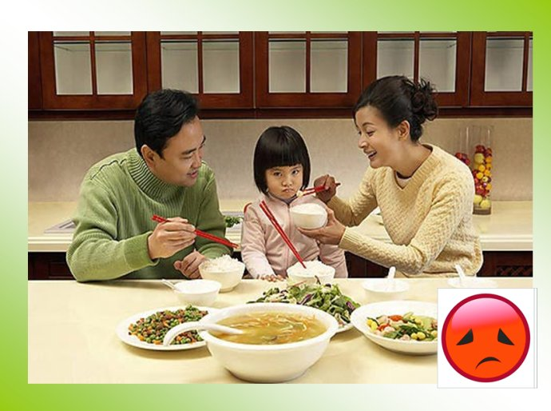
Let's judge: good behaviour or behaviour

Slide 19
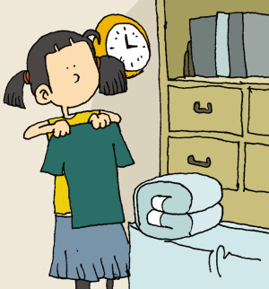
Let's judge: good behaviour or behaviour

Slide 20
Homework
1.
Talk about your behaviour.
2. Learn to know “Rules in classroom”.
Don’t …
… …
Let’s…
… …

