Slide 1
Welcome to our school!
WWW.PPT818.COM

Slide 2
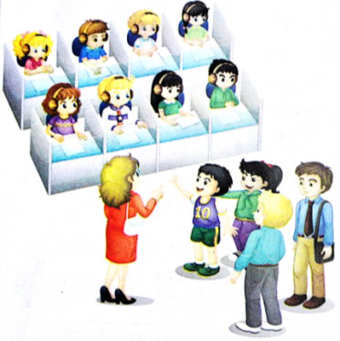
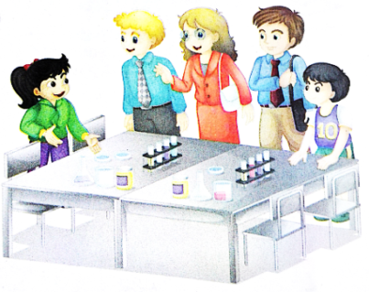
Let’s review
This is our … We often ... in it. We have …
lessons in a week.

Slide 3
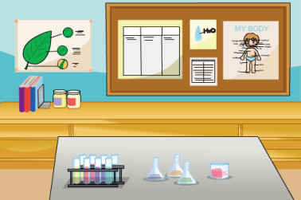
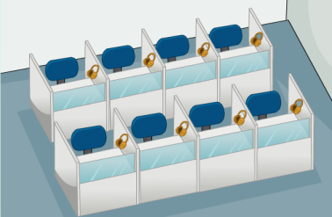
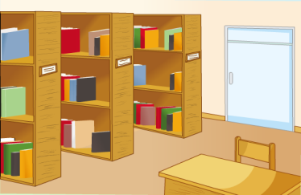
Guessing game
What place is it?

Slide 4
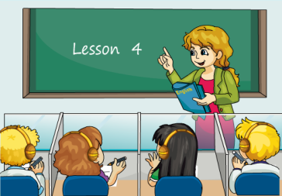
Look and say
We often have English lessons in the language lab.
language lab
English lesson

Slide 5
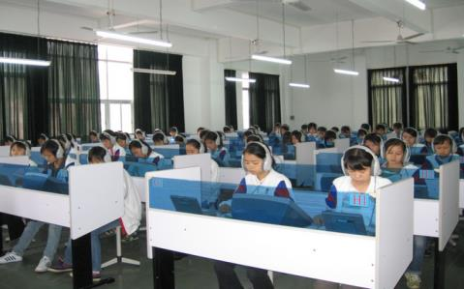
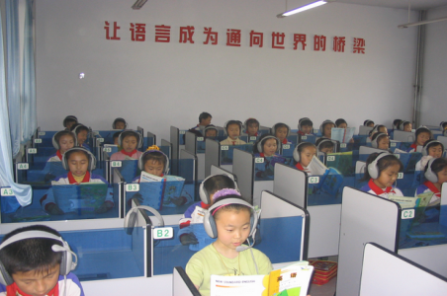
Look and say
What do you often do in the language lab?
We often …
listen to English
speak English

Slide 6
Ask and answer
How many English lessons do you have in a week?
We have …

Slide 7
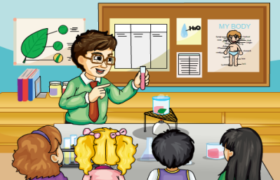
Look and say
We often have science lessons in the science lab.
science lab
science lesson

Slide 8
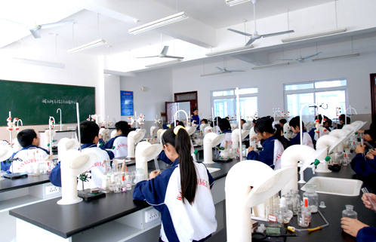
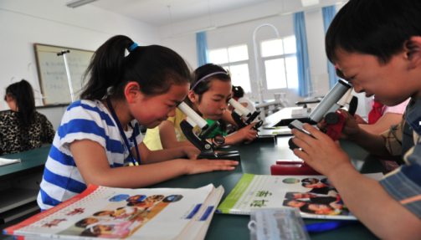
Look and say
What do you often do in the science lab?
We often …
do experiments
observe things

Slide 9
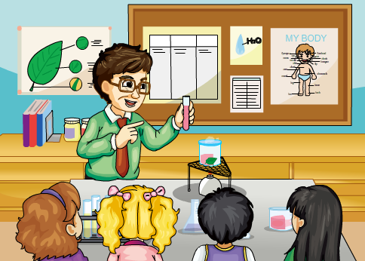
Ask and answer
How many science lessons do you have in a week?
We have …

Slide 10
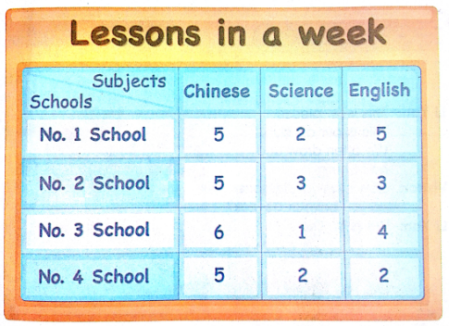
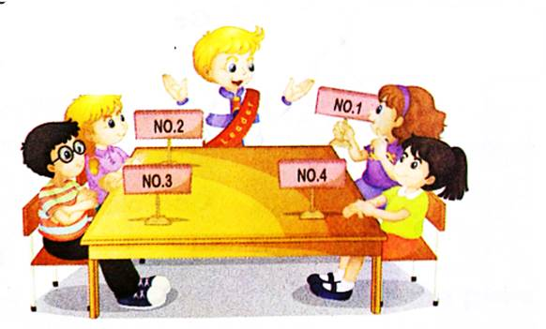
Let’s talk
How many science lessons do you have in a week?
We have two.

Slide 11
活动1
制作四格漫画
language
lab
English
lesson
three
lessons
listen and
speak

Slide 12
活动2
介绍自己的漫画
lab
lesson
three
listen

Slide 13
How many… lessons do you have in a week?
We have… in the … lab.

