Slide 1
Module
11
Way of life
Unit 3 Language in use
WWW.PPT818.COM

Slide 2
Language practice
You must say Mr. or Mrs. when you meet
someone for the first time.
You can take it away.
You mustn’t break anything.
You needn’t wait!

Slide 3

Learning to learn
Try to make a face book about cultures of English- speaking countries. Write down the interesting things you find. Look for some pictures to go with them.

Slide 4
1 Complete the conversations with
can or can’t.
1 A: Can you drive a car at the age of seventeen in
England?
B: Yes, we . How about China?
A: No, we .
2 A: Can you open a gift immediately after you
receive it in England?
B: .What about China?
A: No, we usually don’t.
can
can’t
Yes, we can

Slide 5
3 A: Can you push your way onto a bus in
England?
B: .How about China?
A: No, we either.
4 A: Can you drive on the right-hand side of
the road in England?
B: .What about China?
A: Yes, we must.
No, we can’t
can’t
No, we can’t

Slide 6
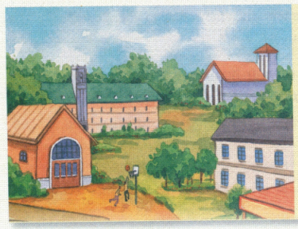
2 Complete the sentences with must
or must not.
School rules
1 You be late for school.
2 You eat in the library.
3 You ride your bike in
the playground.
4 You do your homework.
5 You listen to the teacher.
mustn’t
mustn’t
mustn’t
must
must

Slide 7
3 Underline the correct words.
It is important to know what you must and must not do when you meet people from a different country.
You (1) may / must not ask Westerners “How old are you?” because it is not polite. You (2) might / can know someone well, but (3) you must / need not ask “How much money do you make?” He (4) may / can never speak to you again!

Slide 8
In public places, you (5) must / can ask people before you take photos of them, and you (6) must not / might not eat or drink in shops or museums.
In some countries you (7) cannot / can go into someone’s house with your shoes on. You (8) need not / must not take them off. But in some other countries you (9) might / must not wear shoes in the house.

Slide 9

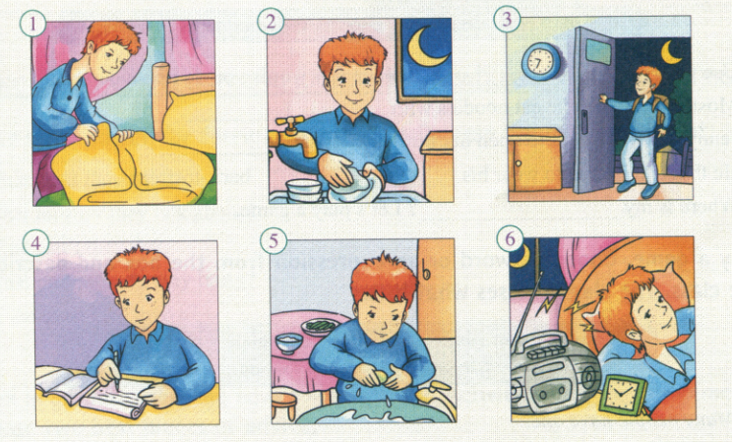
4 Listen to a teenager talking about his life. Check (√) the things he must or mustn’t do.

Slide 10
 | must | mustn’t
1 clean up bedroom once a week
2 wash up after dinner
3 stay out after 9 pm
4 do homework before going out
5 wash hands before dinner
6 play music loudly after 10 pm
√
√
√
√
√
√

Slide 11
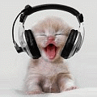
5 Listen again. What two things does he say
he can do?
1_______________________________________
2_______________________________________
_______________________________________
He can go out with his friends at weekends.
He can play music loudly before ten o’clock
at night.

Slide 12
6 Write some things you can, must and
must not do at home.
I can… I must… I must not…
Now work in pairs. Tell each other three things you must do at home and three things you mustn’t do. Are you home rules different or the same?
e.g. —I must visit my grandparents once a week.
I mustn’t stay up late in the evening.
— ...

Slide 13
7 Complete the sentences with the words and
expressions in the box.
baseball cap chess set chopsticks
dictionary present
1 Use your to look up any words
you do not understand.
2 Most Chinese people eat noodles with
_____________.
dictionary
chopsticks

Slide 14
3 Jenny could not wait to open her birthday
__________.
4 He thinks it is cool to wear his _____________
back-to-front.
5 Where is my____________? Let’s play a game.
presents
baseball cap
chess set

Slide 15
8 Play a game.Choose a word or an expression from the box and describe it to the class. The class guesses what it is.
baseball cap bike chess set chocolate chopsticks dictionary fish and chips litter photo video game

Slide 16
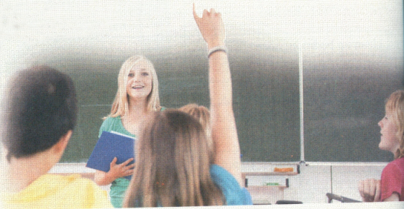
A: Many people have one.
B: Is it a chess set?
A: No, You use it to get
to places.
C: Is it a bike?
A: Yes.

Slide 17
Around the world
Traditional presents
In the West, people often take flowers when they visit someone. Different flowers have different meanings. For example, people often give red roses to someone they love. In Greece you must not give white flowers because that means that someone is dead.

Slide 18

When you go to a foreign country, it is always best to check what people usually do, so you do not make mistakes.

Slide 19
9 Write some advice for foreign visitors to a Chinese family. Think about:
What must they wear?
What mustn’t they talk about?
What can’t they do?
What presents can they bring?
When must they arrive?
…

Slide 20

10 Work in pairs. Show the advice you wrote in Activity 9 to your group members. Choose two best pieces of advice.

Slide 21

11 Show the advice your group chose in Activity 10 to the whole class. Put the pieces of advice together to form your class advice.
Then Send your advice to your foreign friends or post it on your class blog.

Slide 22
Language points
When you go to a foreign country, it is always best to check what people usually do so you do not make mistakes.
当你去国外时，你最好打探好人们的日常行为习惯，那样就不会犯错。
make a mistake “ 犯错
It's careless of her to make such mistake.
她犯这样的错误真是太粗心了。
This is all new to me , so let me know if I make a mistake .
这是我的第一次,所以错了请告诉我。

Slide 23
Exercise
D
1. He said that you _____ watch TV all the
evening if you wished.
A. may B. must C. can D. might
2. -Is John coming by train?
-He should, but he __________ not. He likes
driving his car.
A. must B. can C. need D. may
3. Michael ____ be a policeman, for he's much
too short.
A. needn't B. can't C. shouldn't D. won't
D
B

Slide 24
4. I thought you ____be hungry, so I have
brought you some cakes.
A. may B. might C. can D. could
5. Come on! We __________ hurry because
there isn't much time left.
A. may B. must C. can D. need
6. ___ I take this one?
A. May B. Will C. Are D. Do
7 You'd better ___ late next time.
A. not to be B. not be C. won't be D. don't be
B
B
A
B

Slide 25
Homework
Read more materials about foreign culture
and customs.
Try to recite all the new words in this unit.

Slide 26



