Slide 1
Unit 2 How often do you exercise?
Section B (1a - 1e)
WWW.PPT818.COM

Slide 2
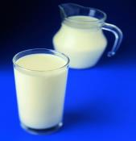
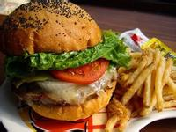
1a. Match the words with the pictures.
1. junk food_____ 3. fruit _____ 5. sleep _____
2. milk _____ 4. vegetables _____ 6. coffee _____
b
e
f
a
c
d
a
c
b
d
e
f

Slide 3
Role-play the conversation.
A: How often do you drink milk, Liu Fang?
B: I drink milk every day.
A: Do you like it？
B: No. But my mother wants me to drink
it. She says it's good for my health.

Slide 4
1c. Listen to the interview about eating habits. Circle your answer to each question.
Is Bill healthy? | Yes | No | I don't know
Is Tina healthy? | Yes | No | I don't know
1d. Listen again. Fill the blanks in the survey.
Question Tina Bill
1. How often do you exercise? ________ ________
2. How often do you eat fruit? ________ ________
3. How many hours do you sleep every night? ________ ________
4. How often do you drink milk? ________ ________
5. How often do you eat junk food? ________ ________
6. How often do you drink coffee? ________ ________
every day
hardly ever
every day
never
nine
nine
every day
never
two or three times a week
three or four times a week
never
four times a day

Slide 5
Role-play
A: How often do you exercise?
B: I exercise every day.
A: And how often do you ...?
B: ......
......

Slide 6
小结训练
对划线部分提问。
1) I hardly ever drink milk for breakfast.
______________________________________________
2) They sleep nine hours every night.
______________________________________________
3) I went to Beijing twice last year.
______________________________________________
4) He watches TV for two hours every day.
______________________________________________
How often do you drink milk for breskfast?
How many hours do they sleep every night?
How many times did you go to Beijing last year?
How long does he watch TV every day?

