Slide 1
Reusing things
第一课时
WWW.PPT818.COM

Slide 2
Revision
Let’s read these sentences:
1. Can I throw away these bottles and cans?
2. We should keep them.
3. Because we can reuse them.
4. Let me show you.
5.We can reuse other old things too.

Slide 3
Excellent !

Slide 4
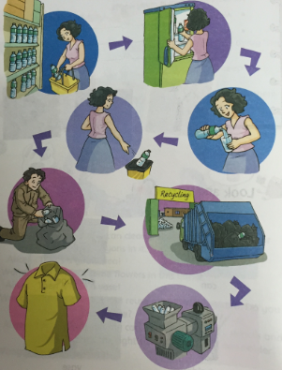
The journey of a plastic bottle

Slide 5
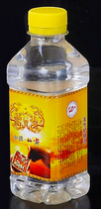
New words
plastic bottle
It’s a plastic bottle.

Slide 6
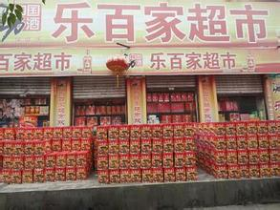
New words
supermarket
It’s a supermarket.

Slide 7
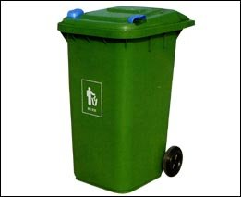
New words
rubbish bin
It’s a rubbish bin.

Slide 8
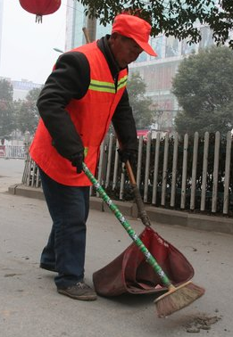
New words
street cleaner
He is a street cleaner.

Slide 9
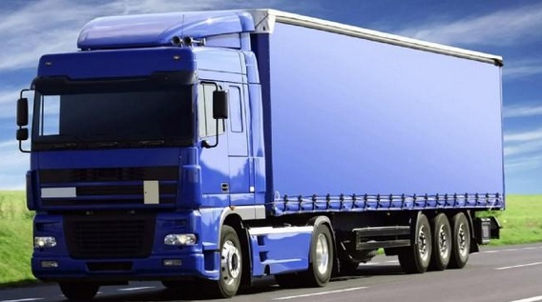
New words
truck
It’s a truck.

Slide 10
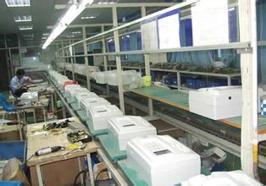
New words
factory
This is a factory.

Slide 11
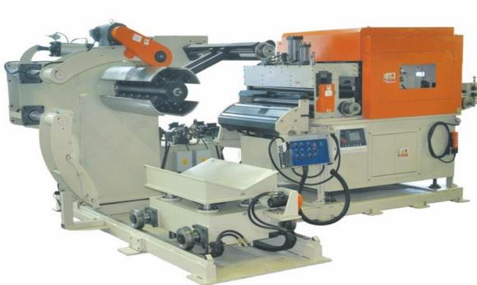
New words
machine
It’s a big machine.

Slide 12
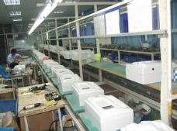
Look and say
plastic bottle
machine
supermarket
factory

Slide 13
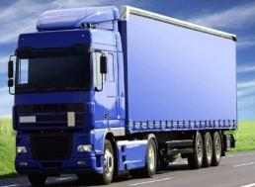
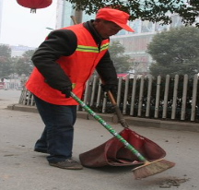
truck
rubbish bin
street cleaner

Slide 15
Let’s read
I’m a plastic bottle. A week ago, I’m full of water. Then a woman bought me at the supermarket and took me home.

Slide 16
Let’s read
The next morning, the woman drank the water and threw me into a rubbish bin.

Slide 17
Let’s read
A street cleaner found me. He put me into a truck. There were a lot of other bottles in the truck.

Slide 18
Let’s read
The truck took us to a factory. Some people cleaned us and put us into a big machine. We became small pieces. Finally, they made us into a piece of cloth. Look at your T-shirt. Does it look like a plastic bottle?

Slide 19
After reading
Do you know the journey of a plastic bottle?
home
supermarket
factory
truck
rubbish bin

Slide 20
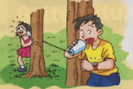
Listen
Save some paper cups,
And find a little piece of sting.
Use them to make toy phones,
And you can talk and sing!

Slide 21
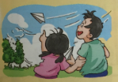
Listen
When you find waste paper,
Don’t throw it away.
Use it to make paper planes,
Then take them outside to play.

Slide 22
Learn the sound
Peter is my friend.
In summer, it is hot.
There is a bird in the tree.
It’s red and white.
What did you see?
When’s your birthday?

Slide 23
Listen
It’s an interesting film.
What’s your name?
These animals are in danger.
How was your winter holiday?

Slide 24
Summary
我们读完了《The journey of a plastic bottle》故事， 认识了plastic bottle, supermarket, rubbish bin, street cleaner, truck , factory, machine等单词和词组,了解到一个塑料瓶具体是如何被回收利用的。

Slide 25
Homework
Do the exercise on page 58.(How can you reuse paper?).
Try to reuse some more things around you.

Slide 26
The End

