Slide 1
Unit 4 Seasons
鲁科版小学英语四年级上册
It’s spring.
WWW.PPT818.COM

Slide 2
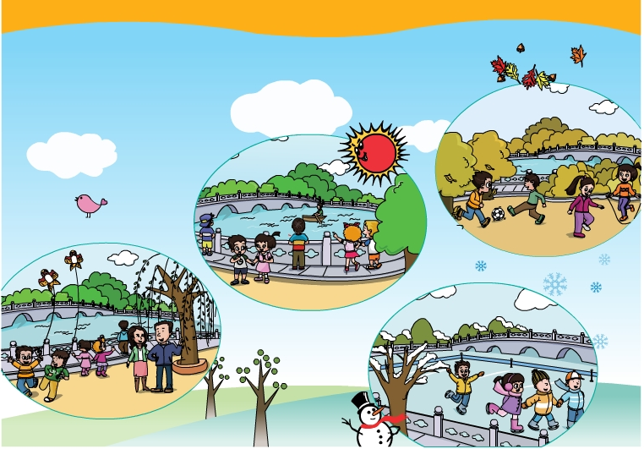
Seasons

Slide 3
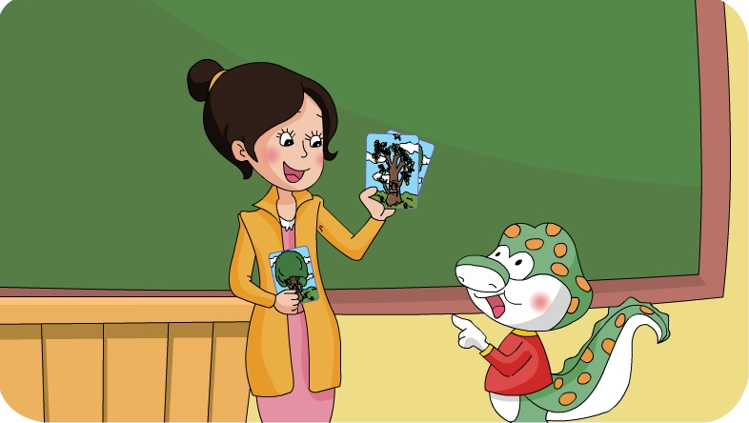
Grandpa tree changes in different seasons. Watch the flash and underline the four seasons.

Slide 4
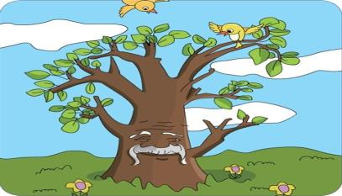
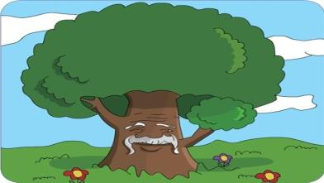
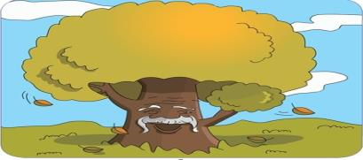
1
2
It’s spring.
It’s summer.
3
4
It’s autumn.
It’s winter.

Slide 5
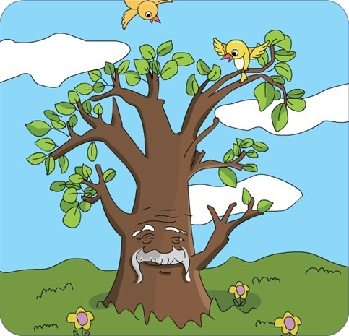
What season is it?
It’s spring.

Slide 6
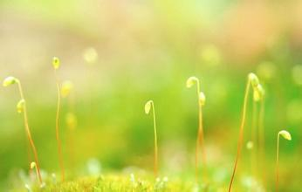
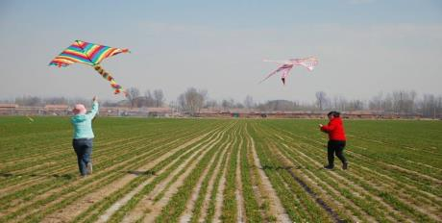
green

Slide 7
What season is it?
?
It’s summer.

Slide 8
colourful

Slide 9
What season is it?
autumn
It’s _______.

Slide 10
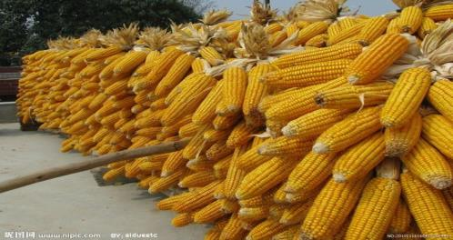
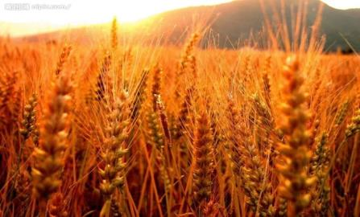
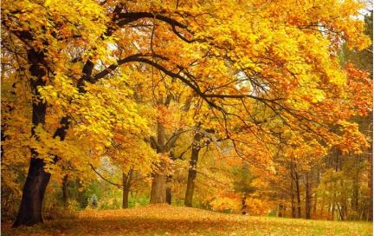
golden

Slide 11
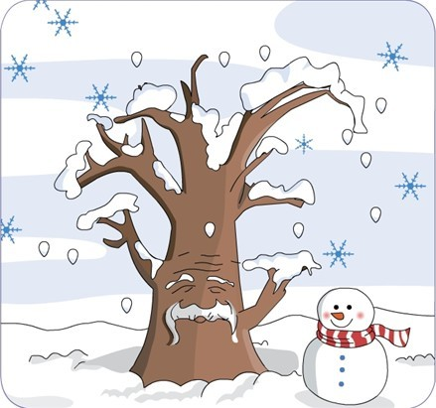
What season is it?
It’s winter.

Slide 12
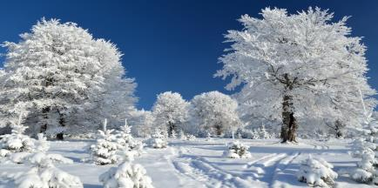
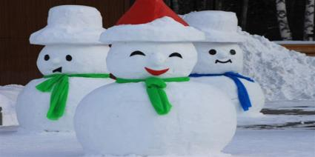
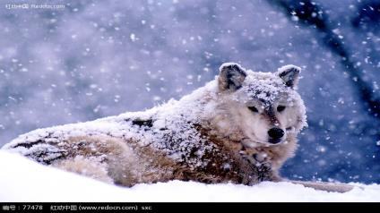
white

Slide 13
Seasons come and seasons go.
They change all the time.
春去秋来，四季变换。

Slide 14
Follow the flash
and imitate! 听录音跟读模仿

Slide 15
Read the dialogue
in roles.
与同桌分角色读一读课文。

Slide 16
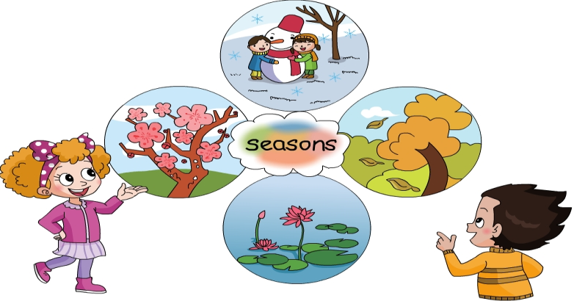
4
1
3
2

Slide 17
Sharp eyes
比眼力

Slide 18
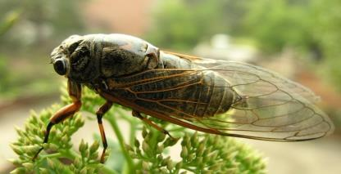
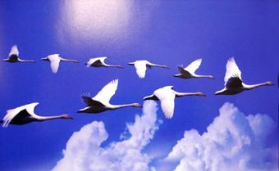
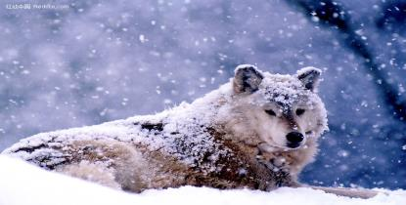
What season is it?
It’s spring.

Slide 19
What season is it?
It’s autumn.

Slide 20
What season is it?
It’s summer.

Slide 21
What season is it?
It’s winter.

Slide 22
Draw your favourite season. 画一画你最喜欢的季节。

Slide 23
Talk about your favourite season in groups of four.
四人一组谈论下自己喜欢的季节。
My favourite season
It’s ______.
It’s ______.
I like ______.
I can ______.

Slide 24
Check it
spring
summer
seasons
a year
autumn
winter

Slide 25
Check it
What season is it? It’s spring. It’s summer. It’s autumn. It’s winter.

Slide 26
Homework:
1、Repeat the text 3 times. （跟读课文3遍）
2、Take some pictures of summer and introduce them to your friends.
（拍摄一些夏天的图片，介绍给你的朋友。）

