Slide 1
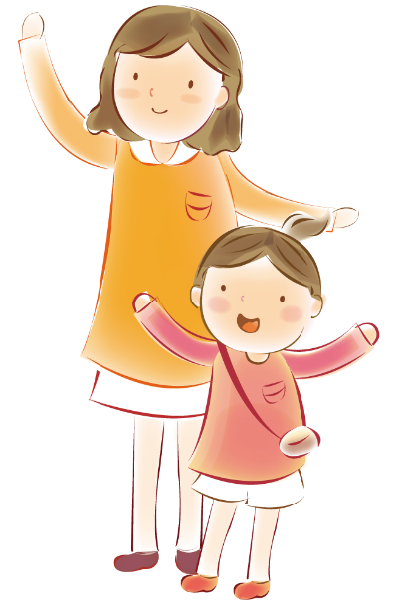

Slide 2
目 录
TITTLE HERE
TITTLE HERE
TITTLE HERE
TITTLE HERE
Just for today I will try to live through this day only and not tackle my whole life problem at once.
Just for today I will try to live through this day only and not tackle my whole life problem at once.
Just for today I will try to live through this day only and not tackle my whole life problem at once
Just for today I will try to live through this day only and not tackle my whole life problem at once.

Slide 3
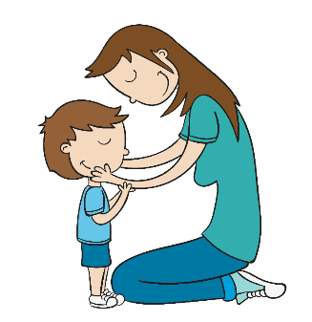
0 1 YOUR TITLE HERE
hours that Just for today I will try to live through this day only and not. hours that Just for today I will try to live through this day only and not.

Slide 4
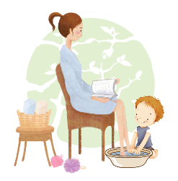
Just for today I will try to live through this day only and not tackle my whole life problem at once. Just for today I will try to live through this day only and not tackle my whole life problem at once.
ADD YOUR TITTLE HERE
ADD YOUR TITTLE HERE
ADD YOUR TITTLE HERE
Just for today I will try to live through this day only and not tackle my whole life problem at once. only and not tackle my whole life problem at once.
Just for today I will try to live through this day only and not tackle my whole life problem at once. only and not tackle my whole life problem at once.

Slide 5
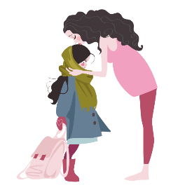
Just for today I will try to live through this day only and not tackle my whole life problem at once. Just for today I will try to live through this day only and not tackle my whole life problem at once.
Just for today I will try to live through this day only and not tackle my whole life problem at once. Just for today I will try to live through this day only and not tackle my whole life problem at once.

Slide 6
ADD YOUR TITTLE HERE
Just for today I will try to live through this day only and not tackle my whole life problem at once. only and not tackle my whole life problem at once.
ADD YOUR TITTLE HERE
Just for today I will try to live through this day only and not tackle my whole life problem at once. only and not tackle my whole life problem at once.

Slide 7
ADD YOUR TITTLE
Just for today I will exercise my soul in three ways. I will do somebody a good turn
ADD YOUR TITTLE
Just for today I will exercise my soul in three ways. I will do somebody a good turn

Slide 8
0 2 YOUR TITLE HERE
hours that Just for today I will try to live through this day only and not. hours that Just for today I will try to live through this day only and not.

Slide 9
TITTLE HERE
TITTLE HERE
Just for today I will try to live through this day only and not tackle my whole life problem at once. Just for today I will try to live through this day only and not tackle my whole life problem at once.
Just for today I will try to live through this day only and not tackle my whole life problem at once. Just for today I will try to live through this day only and not tackle my whole life problem at once.
TITTLE HERE
Just for today I will try to live through this day only and not tackle my whole life problem at once. Just for today I will try to live through this day only and not tackle my whole life problem at once.

Slide 10
Just for today I will try to live through this day only and not tackle my whole life problem at once. only and not tackle my whole life problem at once. Just for today I will try to live
ADD YOUR TITTLE HERE
Just for today I will try to live through this day only and not tackle my whole life problem at once. only and not tackle my whole life problem at once. Just for today I will try to live
ADD YOUR TITTLE HERE
Just for today I will try to live through this day only and not tackle my whole life problem at once. only and not tackle my whole life problem at once. Just for today I will try to live
ADD YOUR TITTLE HERE

Slide 11
0 3 YOUR TITLE HERE
hours that Just for today I will try to live through this day only and not. hours that Just for today I will try to live through this day only and not.

Slide 12
01
TITTLE HERE
Just for today I will try to live through this day only and not tackle my whole life problem at once. Just for today I will try to live through this day only and not tackle my whole life problem at once.
02
TITTLE HERE
Just for today I will try to live through this day only and not tackle my whole life problem at once. Just for today I will try to live through this day only and not tackle my whole life problem at once.

Slide 13
0 4 YOUR TITLE HERE
hours that Just for today I will try to live through this day only and not. hours that Just for today I will try to live through this day only and not.

Slide 14
ADD YOUR TITTLE
ADD YOUR TITTLE
Just for today I will exercise my soul in three ways. I will do somebody a good turn
Just for today I will exercise my soul in three ways. I will do somebody a good turn
ADD YOUR TITTLE
ADD YOUR TITTLE
Just for today I will exercise my soul in three ways. I will do somebody a good turn
Just for today I will exercise my soul in three ways. I will do somebody a good turn

