Slide 1
Unit 4 Seeing the doctor
五年级(下)
WWW.PPT818.COM

Slide 2
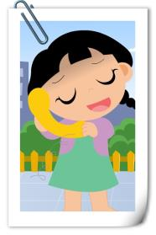
Ask and answer
What’s wrong with her?
What should she do?

Slide 3
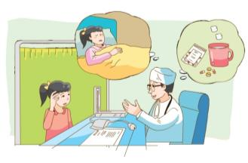
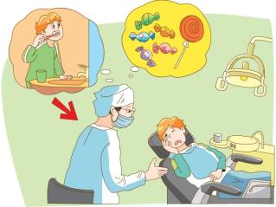
Try to review
What’s wrong with them?
What should they do?

Slide 4
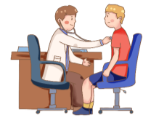
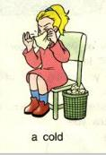
Outpatient Service
(门诊)
病人
Patient 1
Cold
watch TV
drink warm water
have a rest
Discuss: Do you have any other advice(建议)?

Slide 5
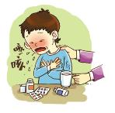
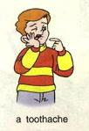
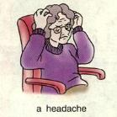
Do a role-play
Patient 3
Tips: Play with action and emotions.
(有动作、感情地表演)。
Give more advice.
(给予更多建议)。
Cough
eat ice creams
drink warm water
take some medicine
Patient 2
Patient 4
Toothache
Headache
eat sweets
eat before bedtime
brush teeth before bedtime
watch TV
have a rest
take some medicine

Slide 6
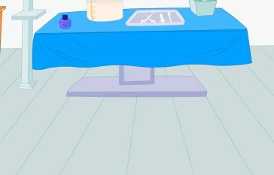
Cartoon time
Bobby helps in Dr Wu’s hospital.

Slide 7
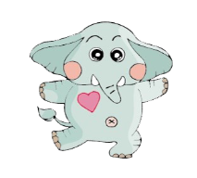
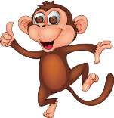
Try to guess
Who are they?
neck
giraffe

Slide 8
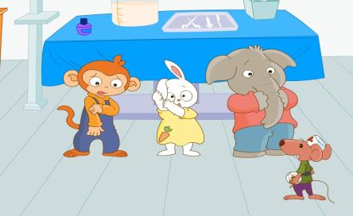
Try to guess
What’s wrong with them?
point at
Who helps them?

Slide 9
Let’s watch
Let’s read
Who What’s wrong? After treatment
(治疗)
arm
can’t write
ear
can’t hear
nose
can’t eat or drink
neck
?

Slide 10
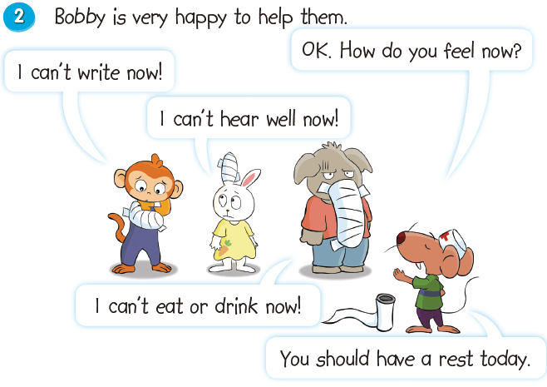
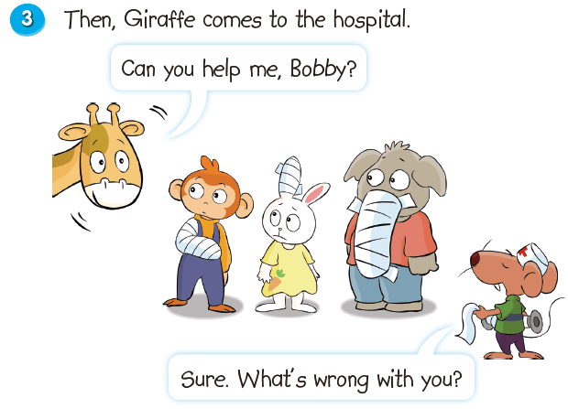
Reading time

Slide 11
Reading time
Choose one way and read in groups of 6.
Read together.
(齐读)
Read in roles.
(分角色读)
Read after one.
(跟一个学生读)
…

Slide 12
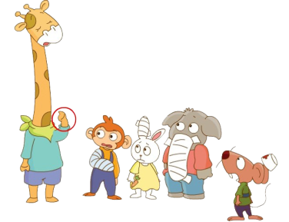
Discuss
What should they do?

Slide 13
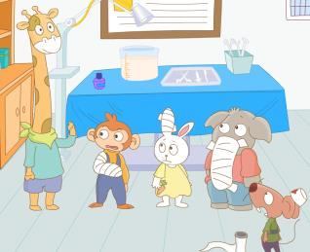
Let’s act
Tips for actors
(演员考核标准)
Tips for actors
Read fluently
流利地朗读
Act fluently
流利地表演
Act with emotions
有感情的表演
Act with creation
有创造性的表演

Slide 14
Homework
1. Read Cartoon time and try to retell the story.
2. Make 4 dialogues according to Fun time.

