Slide 1
Unit 3 Restaurant
Would you like something to drink?
WWW.PPT818.COM

Slide 2
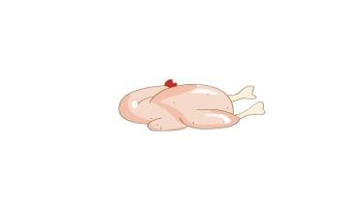
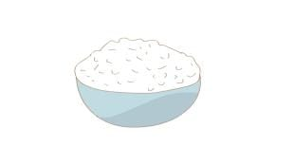
Free Talk
1. What would you like?
I’d like...
2. Would you like some...?
Yes, ... please.

Slide 3
What would they like?

Slide 4
What would you like?
A big pizza,
please.

Slide 5
pizza

Slide 6
a fruit pizza

Slide 7
a big pizza

Slide 8
What would you like?
A big pizza,
please.
And two small cakes.

Slide 9
a beautiful cake

Slide 10
a small cake

Slide 11
Would you like something
to drink?
Yes. I’d like some
pear juice.

Slide 12
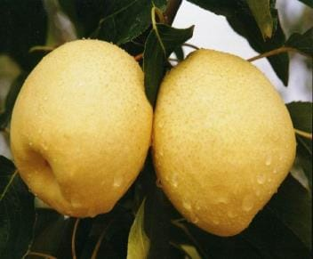
pear
pear juice

Slide 13
Would you like something
to drink?
Me, too.
Yes. I’d like some
pear juice.

Slide 14
Have some fruit, please.
OK! I like bananas.
I like oranges.

Slide 15
What fruit do you like?
I like...

Slide 17
Thank You

