Slide 1
Unit 6 Topic 1
I would rather watch sports shows than those ones.
Section C
WWW.PPT818.COM

Slide 2
Oscars Academy Awards
奥斯卡金像奖

Slide 3
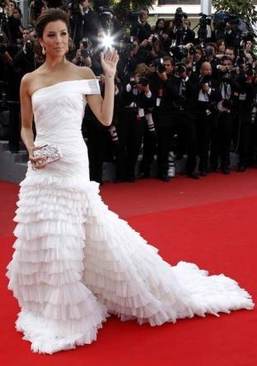
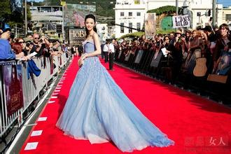
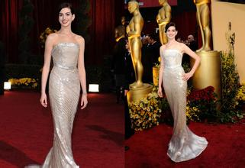
the red carpet

Slide 4
Pre-reading questions:
Times Post is most probably the name of a (book / website).
The three pieces of news are all about (arts / entertainment).

Slide 5
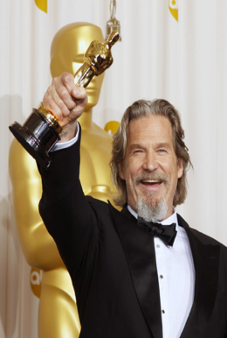
The 82nd Oscars Academy Awards
1.When and where was it held?
2.What did the Oscars include?
3.Who became the first woman to win the award?
It was held on Sunday ,March 7 ,2010, at the Kodak Theatre in Hollywood.
The Oscars included best motion picture , best actor ,best actress, best director.
Kathryn became the first woman to win the award.

Slide 6
Picasso’s Works Show in New York Museum
1.How many paintings and drawings will the show present?
2.What did the exhibition want to tell people?
Three hundred .
The exhibition wants to tell people: Pablo Picasso never gets old .

Slide 7
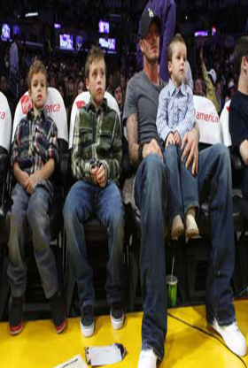
Beckham Wants Football Star Sons
1.What did David Beckham do?
2.What would he like his son to do?
3.Why did he want his son to take up sports?
He is a famous football star.
He would like his son to follow in his footsteps.
Because it’s such a great thing.

Slide 8
1b. Read 1a and mark T (True) or F (False).
1. The news about the 82nd Academy Awards was reported on March 7. ( )
2. The director of the motion picture, The Hurt Locker,
is a woman. ( )
3. The paintings and drawings on Picasso’s Works Show
are shown in Spain. ( )
4. The purpose of the show is to tell people that Pablo
Picasso never gets old. ( )
5. David Beckham wants his sons to take up sports
because he thinks he could be their coach. ( )
F
T
F
T
F

Slide 9
1c. Read 1a again and match the words with their meanings.
1.winner A. a conversation in which you can talk
to somebody to find out more about him
2.present B. to show something to somebody formally
3.general C. someone who wins
4.interview D. describing only the main features rather
than details
adj. 大体的
录音P31-1a

Slide 10
Key points
1. in general 大体上，总的来说
2. take up 继续；占据；从事
3. coach n. 教练
4. Whatever they want to do, it doesn’t matter...
5. But it would be great for them to take up sports, because it’s such a great thing.

Slide 11
1a Read and understand. 视频P31-1a

Slide 12
Make a survey
3. Survey your classmates about their favorite kinds of movies. Then write a report about it.
You may begin like this:
I asked over fifty classmates about their favorite kinds of films. Here are the results…

Slide 13
I asked over fifty classmates about their favorite kinds of films. Here are the results. It won’t come to any surprise to learn that most of them said that they love fiction movies. Action movies are popular with the boys while some of those surveyed said that documentary movies are also their favorite, and as many as three out of ten students like cartoons most. Surprisingly, only two out of ten said they love tragedies. All in all, we all have our own favorite movies. It is really good for us to see a film to relax ourselves in our spare time.

Slide 14
Summary
1. in general 大体上，总的来说
2. take up 继续；占据；从事
But it would be great for them to take up sports, because it’s such a great thing.
3. coach n. 教练
4. Whatever they want to do, it doesn’t matter...

Slide 15
Homework
Search for more information and pictures about TV.

Slide 16
Thank you! Bye!

