Slide 1
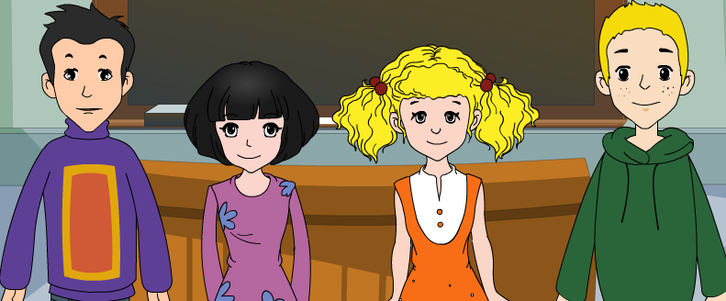
Module 9 People and places
Unit 3 Language in use
WWW.PPT818.COM

Slide 2
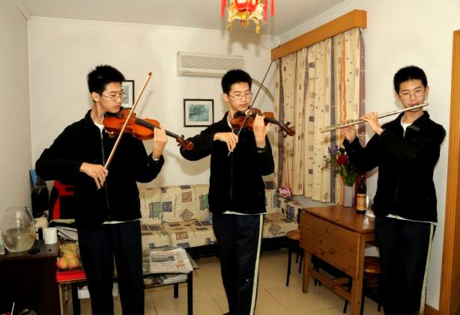
Review
根据提示，用现在进行时完成。
What are they doing?
play the piano, play the flu
are playing
Two students ___ ______ the piano, another __ ______ the flu.
is playing

Slide 3
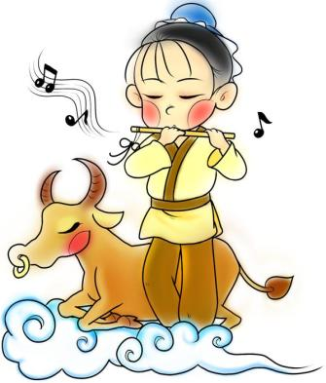
What is Chinese buffalo(水牛) doing?
It is ______.
sitting
sit

Slide 4
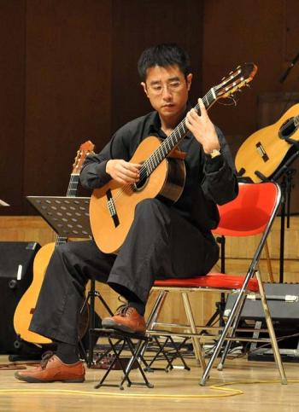
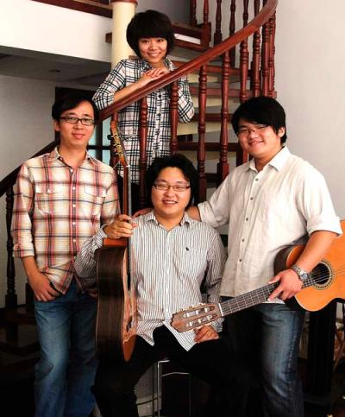
teacher
students
What is the teacher doing?
have a guitar lesson
The teacher __ ______ a guitar lesson.
is having

Slide 5
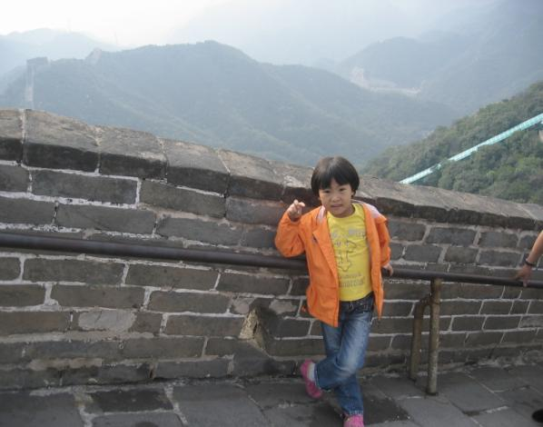
What are you doing?
stand on the Great Wall
I__ _______ on the Great Wall.
’m standing

Slide 6
Objectives:
To learn to use present continuous tense.

Slide 7
Language practice
1. I’m standing on the Great Wall
of China and talking to you.
2. Tony is eating a delicious
ice cream.
3. They’re working.
4. People aren’t having dinner.

Slide 8
Grammar
现在进行时态(I)
1.定义:表示现在(说话瞬间)正在进行的动作。
He is watching TV now.
He is drinking a glass of water.
还可以表示当前一段时间内的活动或现阶
段正在进行的动作。
We are working on a farm these days. I am writing a book this year.

Slide 9
2. 谓语动词的构成: 助动词be + V-ing。
请大家注意观察，其中的be 随着人称、数的变化而变化(am, is, are三种形式) 。
I’m visiting my friend.
He is eating an ice cream.
We’re preparing for Spring Festival.
They are lying in the sun.
注: 不加助动词be的V.-ing 或 be+V原形不能构成现在进行时。如：
He visiting his friend. （×）
He is visit his friend.（×）

Slide 10
3. 动词-ing的构词规律:
V-ing的组成形式有如下几种：
1) 动词后面直接加ing
doing buying playing
2) 动词去掉e加ing:
having taking giving writing
3) 重读闭音节、结束只有一个辅音字母
的, 双写动词最后一个字母, 然后加ing。
running swimming sitting
shopping getting beginning putting
4) 特殊形式的变化
lie — lying die -- dying

Slide 11
4. 句型转换: 在变为否定句时, be后加not。
在变为一般疑问句时把be提前到句首,
人称和 be 作相应变化。
1) 将下面的句子变为否定句:
I’m
not
writing the postcard.
2) 将下面的句子变为一般疑问句:
you
?
’m
writing the postcard
I
.
Are
3) 将下面的句子变为一般疑问句：
i
s
having lunch
?
I
Tony
.

Slide 12
【3种句型结构分析】
肯定句
否定句
一般疑问句 (把be提到句首)
注意看转换过程中的变化。
He is writing a postcard.
He is not (=isn’t) writing a postcard.
Is he writing a postcard?
肯定句
一般疑问句 (注意人称的相应变化)
I am lying in the sun with my friends.
Are you lying in the sun with your friends?

Slide 13
5. 现在进行时的标志词有:Look! Listen!
Now it’s 8 o’clock. What are you doing?等。
What are you doing now?
(你在干什么？)
I’m reading now.
(我现在正在读书。)
Listen! She is singing.
(听，她正在唱歌。)
Look! My mother is watering the flowers.
(看，我妈妈正在浇花。)

Slide 14
练习：句型转换。
1. She is watching a ballet. (变否定句)
2. We’re waiting for our teacher.
(变一般疑问句)
She isn’t watching a ballet.
Are you waiting for your teacher?
3. Is Tony calling a friend? (作肯定问答)
4. They are lying in the sun. (划线提问)
Yes, he is.
What are they doing?

Slide 15
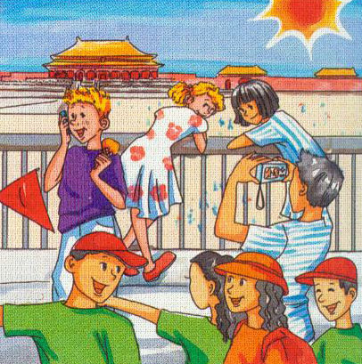
Look at the picture. Say what they are doing.
Tony is calling a friend.

Slide 16
Complete the conversation between Tony and his dad with the correct form of the words in brackets.
Tony: Hi, Dad!
Dad: Hi, Tony. What are you doing now? Tony: We (1) ___________ ( visit ) the Forbidden City. Lingling and Betty
(2) __________ ( write ) postcards.
are visiting
are writing

Slide 17
Dad: What is Daming doing? Tony: He (3) _________ ( take ) photos. There are lots of people here. They (4) ____________ ( enjoy) the sun. Some people (5) ____________ ( look ) at the buildings and some (6) ____________ ( look ) at maps.
is taking
are enjoying
are looking
are looking

Slide 18
Dad: Are you having a good time?
Tony: Yes, we (7) _____________ ( have ) a great time, Dad! See you next Monday.
are having

Slide 19
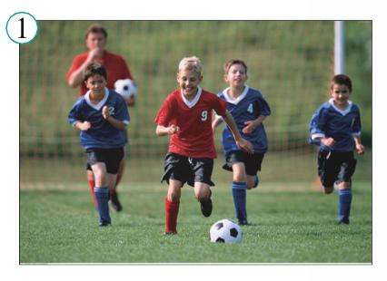
Write about the pictures.
Some boys are playing football.
They aren’t playing basketball.

Slide 20
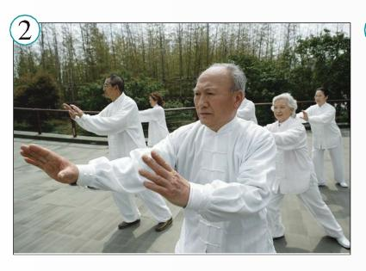
Some old people __________ Taijiquan.
They _____________ Yangge.
are playing
aren’t playing

Slide 21
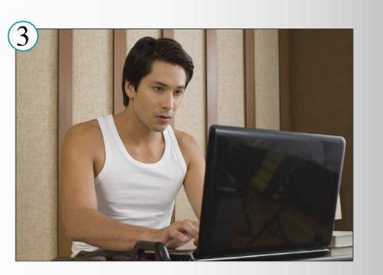
He ________________ TV. He ______________ on a computer.
isn’t watching
is working

Slide 22
Work in pairs
Mime an action for your partner to guess. Use the expressions to help you.
driving a car getting up
going to sleep lying in the sun
playing basketball running for a bus
studying history taking photos
watching TV writing postcards
A: You’re running for a bus!
B: No!
A: You’re playing basketball!
B: Yes!

Slide 23
Learning to learn
When you revise your vocabulary, choose words which are useful for you, and write them in sentences.
postcard: On holiday I usually send four or five postcards to my friends.

Slide 24
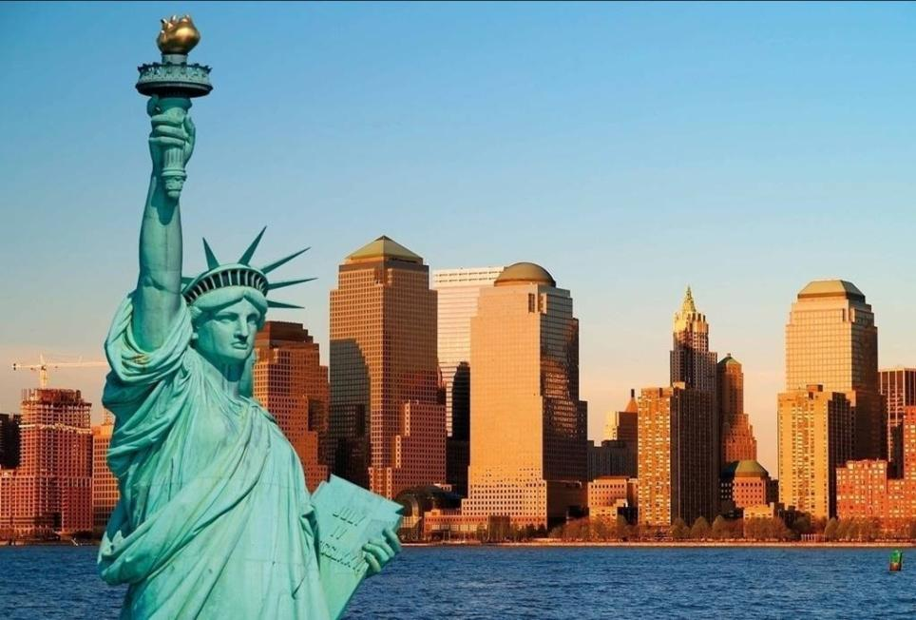
Around the world
Time zones
In the US, from New York to Hawaii, there are several time zones. It’s midday in New York, and people are having lunch. It’s 9:00 am in Los Angeles, and children are starting school. In Hawaii, it’s 7:00 am, and most people are getting up.

Slide 25
Module task: Making a radio report
Work in groups of three or four. Plan a radio report.
Talk about news you would like to report.
List the activities you would like to report.
Make notes about the news.
Write what you are going to say.

Slide 26
Exercises
一、用动词-ing形式填空。
1. Tony (take) photos.
2. They (call) their teacher.
3. Lucy (wait) for a bus.
4. We (shop) with mother.
5. Daming (lie) on the bed.
6. Lily and Tom (have) a good
time.
is taking
are calling
is waiting
are shopping
is lying
are having

Slide 27
二、根据中文提示, 完成下面的短文。
It’s eight now. Some people are _______ (洗) dishes in a _________ (饭馆). Some are going to the _____ (歌剧). Some are watching a ______ (芭蕾舞). Some are writing _________ (明信片).
washing
restaurant
opera
ballet
postcards

Slide 28
三、按要求完成句子。
1. They are having lunch now. (划线提问)
What are they doing now?
2. 三班的学生正在做作业。
The students of Class Three ___ _____
their homework. （汉译英）
3. What are you doing now? (go to school)
(用所给词组回答)
I am going to school now.
4. Lucy is talking to Lily. (划线提问)
Who is talking to Lily?
5. 他们正在游泳。(汉译英)
They are swimming.
are doing

Slide 29
四、汉译英。
1. 现在是 7:20。 他们在上语文课。
It’s 7:20 now. They are having Chinese.
2. 他们正在扫地。
They are sweeping the floor.
3. 谁正在和莉莉说话？
Who is talking to Lily?
4. 他们正在拍照。
They are taking photos.

Slide 30
五、按要求完成下列句子。
1. They are taking photos.(对划线部分提问)
______ are they ______?
2. 此刻，吉姆正在打篮球。(汉译英)
Jim is playing basketball______________.
3. My dog is at home.（对划线部分提问）
______ ___ your dog?
4. He lies in the bed. （用 now 改写句子）
He __ ______ in the bed now.
5. 我们正在度假旅游。(汉译英)
We’re __ _ _____ ____.
What
doing
at this moment
Where is
is lying
on a holiday trip
(traveling on vacation)

Slide 31
六、把下列动词改为v-ing形式。
sit swim run
put get see
jump read clean
eat listen write
have take play
ting
ming
ning
ting
ting
ing
ing
ing
ing
ing
ing
ing
ing
ing
ing

Slide 32
七、用be (is, am, are)动词的适当形式填空。
1. Tony buying some fruits.
2. Lucy and Lily doing their homework.
3. I singing in the washroom.
4. They playing football.
5. She enjoying her visit.
is
are
am
are
is

Slide 33
Homework
Try to remember some of the things that people do at different times and different places.

Slide 34
Good bye!

