Slide 1
Module 7 Computers
Unit 3 Language in use
WWW.PPT818.COM

Slide 2
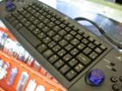
How do you do your homework on the computer?
open a new document.
First,
Use the mouse and click “new document”.
use the keyboard and write your homework.
Next,

Slide 3
save the document.
Then,
Click “save” and write the name, click “save” again.
print the document.
Finally,
Click “print” and “OK”.

Slide 4
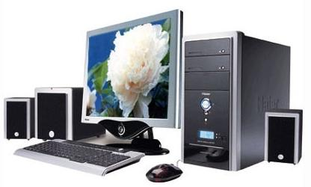
Discuss the question in pairs.
What can we use a computer for?

Slide 5
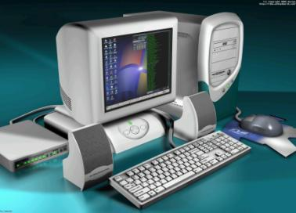
download music
?
check the times of train
visit websites
send e-mails
make
travel plans
buy tickets
go online
play games
use the Internet
get information

Slide 6
Match the questions with the answers.
Where do you save your homework?
When do you use a computer?
How many emails do you write every week?
Who do you write to?
I write to my friends.
I save my homework in a document.
I use my computer after school.
I write three or four emails.

Slide 7
行为动词的一般现在时
含有行为动词的一般现在时的陈述句变特殊疑问句时,首先要根据询问的对象确定疑问词,疑问词有who (谁), what (什么东西), where (什么地方), which (哪一个), when / what time (什么时间), how (如何), how many (多少)等。一般来说，特殊疑问句的结构为“疑问词+ 一般疑问句？”。如：

Slide 8
1. —Where does Kate write her homework? —In the school library.
2. —What do you do on Saturday? —Play computer games.
3. —When do they visit the website? —On Saturday evening.
4. —How do I print the document? —Click “print” and “OK”.
5. —How many emails do you get today? —Two.

Slide 9
—Who writes the email to you? —Li Ming.
[注意]
此句中的特殊疑问词who同时又是句子的主语, 且常被看作第三人称单数, 所以它的后面直接加行为动词的第三人称单数即可。

Slide 10
Complete the conversations.
--- Where do your grandparents live？
--- They live in Australia.
How do I
--- ____________________ save my document?
--- Click “save” and “OK”.
What does he do
2. --- ________________ with his computer?
--- He sends emails.

Slide 11
3. --- __________________ her computer?
--- She uses her computer every Sunday.
When does she use
4. --- ___________________ emails to?
--- I write emails to my friends.
Who do you write
5. --- __________________________ every day?
--- They send ten emails every day.
How many emails do they send / What do they send

Slide 12
Fill in the blanks with the correct form of the words.
1. Tony __________ (not see) his uncle, but he ________ (send) emails.
2. We ______ (use) the Internet on our computer, but we __________ (not play) games.
doesn’t see
sends
use
don’t play

Slide 13
3. Daming ______________ (not use) a computer to do his homework, but he uses it to __________ (play) music.
4. She ____________ (make) travel plans on the Internet, but she ____________ (not buy) tickets.
5. We _____________ (not have) a computer at home, but we _________ (use) the computer at school.
doesn’t use
play
make
doesn’t buy
doesn’t have
use

Slide 14
Discussion
What are the advantages and disadvantages of using a computer?
advantage
disadvantage
I think that … In my opinion … I believe that … I agree because … I disagree because …
useful
expressions

Slide 15
Let’s discuss the following questions.
1) What can we do with the Internet?
2) Is it good for us?
3) What do we do in the spare time?
make friends
listen to music
study
look for information
Internet
send emails and photos

Slide 16
Good for you:
Computer gives us a lot of fun, but we can’t play computer games too long!
We use computer to study not to play.

Slide 17
Advantage:
I think using a computer gives us a lot of fun. We can download music. … But we can’t play computer games too long!
We use a computer to study …

Slide 18
Module task: Doing a questionnaire about computers.
Do you have a computer at home?
When do you use a computer?
What do you usually do on your computer?
How many emails do you send every week?
Do you often go online?
Do you make travel plans on the Internet?
What games do you play?

Slide 19
Ask the questions in your questionnaire. Make notes of the answers of your classmates.
Talk about the answers to your questionnaire.

Slide 20
Exercises
用所给词的适当形式填空。 1. Mr Li usually ________ (use) a computer
at work.
2. My father _____________ (not write) his
novels on his computer.
3. ______ you ________ (have) a computer
at home?
4. Where _____ they _____ (live)?
5. How many e-mails ________ Li Ming
_____ (send) every week?
uses
doesn’t write
Do
have
do
live
does
send

Slide 21
按要求完成下列句子。 1. They play computer games. (改为否定句)
__________________________
2. He writes letters to me. (对画线部分提问)
__________________________
3. I never check my e-mails on Monday. (对画线部分提问)
__________________________
They don’t play computer games.
Who does he write letters to?
How often do you check your e-mails on Monday?

Slide 22
4. Mary has a computer. Mary doesn’t often use the computer. (合并句子)
________________________________ ________________________________
5. We usually download music on the Internet. (对画线部分提问) _______________________________
6. I use the computer at the weekend. (改为一般疑问句)
________________________________
Mary has a computer but she doesn’t often use it.
What do you usually do on the Internet?
Do you use the computer at the weekend?

Slide 23
find out the names of these pictures and their usage
OICQ
(communicating)
IE
(surfing the Internet)
Thunder
(upload and download)
Media Player
(playing movie & music)

Slide 24
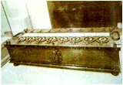
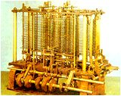
History of computers
1642
calculating machine
1822
Analytical Machine

Slide 25
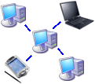
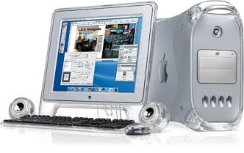
1960s
became smaller
1970s PC
Now Internet

Slide 26
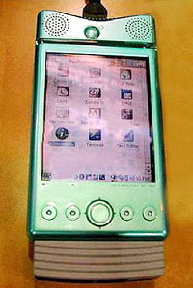
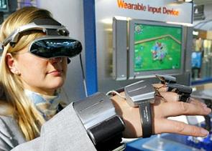
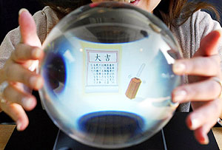
Computers in the future

Slide 27
Discussion
☺
What are the advantages and disadvantages of computers?
☹
advantages
I think that …
In my opinion …
I believe that …
I agree because …
I disagree because …
disadvantages

Slide 28
Ask and answer. Use usually and often.
do your homework/on your computer?
What games/play?
send emails?
who/ write to?
use/a computer at school?
download music?
What kind of music/ download?

Slide 29
Exercises:
单词拼写：
computer case
computer
1. A (电脑) has a (主机)
a (显示器)、a (键盘)
and a (鼠标) .
monitor
keyboard
mouse
2. Bety wants to do her homework on the computer. She (接通)on the computer, opens a new (文件). (然后),she (点击)it ,writes her homework. (最后) she （保存) it.
switches
document
Then
clicks
Finally
saves

Slide 30
Fill in the blanks:
Tony _________(not visit) his uncle, but he often __________(send) emails.
We __________(use) the Internet, but we __________(not play) games on our computer.
Daming _________(not use) a computer to do his homework, but he ______________( download) music.
doesn’t visit
doesn’t send
Don’t use
Don’t play
doesn’t use
doesn’t download

Slide 31
一般现在时的特殊疑问句：
Attention: 不能用yes 或no来回答，要问什么答什么。
1） How do I write my homework on the computer?
2) How do I save the document? 我怎样存储文件？
3） What’s the mouse? 鼠标是什么？
4） What do I do next? 我下一步做什么？
5）Where do I write the name? 我在哪里写名字？
6）Where’s the printer? 打印机在哪里？

Slide 32
就画线部分提问。
1. I use the computer every day.
2. She finishes her homework at ten
o’clock.
3. We do our homework at home.
4. Lucy cleans the blackboard.
How often do you use the computer?
When does she finish her homework?
Where do you do your homework?
Who cleans the blackboard?

Slide 33
将下列句子变否定句和一般疑问句
I often send emails to my friends.
2. She usually makes plans on the Internet.
3. They are from Europe.
I don’t often send emails to my friends.
Do you often send emails to your friends?
She doesn’t usually make plans on the ---.
Does she usually make plans on the ---.
They aren’t from Europe.
Are they from Europe?

Slide 34
1、你通常在电脑里做什么?
___________ you _____________
the computer?
2、你发送多少个邮件?
____________________ do you send?
3、你经常上网吗?
_____ you often ___________?
4、你在电脑上定旅游计划吗?
_____ you ______________
on the computer?
What do usually do on
How many emails
Do go online
Do make travel plans

