Slide 1
Unit 3
Could you please clean your room?
R 八年级下册
第4课时
WWW.PPT818.COM

Slide 2
Discuss
Should parents ask
their children to do chores?

Slide 3
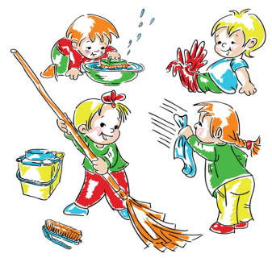
Talk about it.
Do your classmates have any house chores?

Slide 4
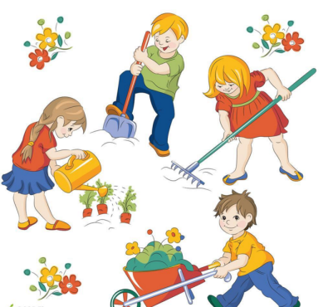
What can you learn from doing chores?

Slide 5
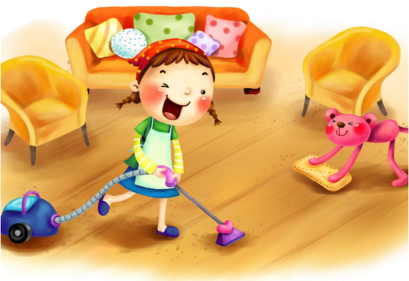
How can you make chores more fun?

Slide 6
2a
Discuss the questions with your partner.
1. What do you often do to help your parents at home?
2. Do you think kids should help out with chores at home?

Slide 7
Read the letters and finish the following tasks.
Task 1: Answer the questions.
1. What is Ms. Miller’s opinion?
She thinks doing chores is parents’ job.
2. What is Mr. Smith’s opinion?
He thinks it’s important for children to do chores and help their parents with housework.

Slide 8
Task 2: Mark true or false.
F
1. Ms. Miller thinks kids should do chores at home.
2. According to Ms. Miller’s letter, she thinks
housework is not a waste of kids’ time.
3. Ms. Miller and Mr. Smith have different ideas on
doing chores.
4. Mr. Smith thinks it is useful to do chores.
F
T
T

Slide 9
2b
The Sunday Mail magazine invited parents to write about whether they think young people should do chores at home. Read the following letters. Which one agrees and which one disagrees?
The letter from Ms. Miller disagrees; the letter from Mr. Smith agrees.

Slide 10
Skimming
This means looking quickly through a piece of writing to find the main idea without reading every word. It is still a good idea to read the first sentence in each paragraph a little more carefully.

Slide 11
Dear Sir,
I do not understand why some parents make their kids help with housework and chores at home. Kids these days already have enough stress from school. They do not have time to study and do housework, too. Housework is a waste of their time. Could we just let them do their job as students? They should spend their time on schoolwork in order to get good grades and get into a good university.

Slide 12
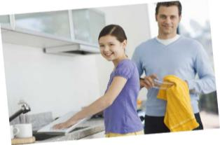
Also, when they get older, they will have to do housework so there is no need for them to do it now. It is the parents’ job to provide a clean and comfortable environment at home for their children. And anyway, I think doing chores is not so difficult. I do not mind doing them.
Ms. Miller

Slide 13
Language points
1.Kids these days already have enough stress from
school.
enough作形容词，修饰名词时，可放在名词前，也可放在名词后，习惯放在名词前。enough作副词时，要放在形容词/副词后，即后置。

Slide 14
enough money
1.We have _____________ (足够的钱)to buy a car.
2.She’s __________ to decide for herself.
(她已到了自己做决定的年龄了。)
3.Little of the existing housing is of good ______
_______.
old enough
enough
quality

Slide 15
2.They should spend their time on schoolwork
in order to get good grades and ...
spend作动词意为“花费”，其主语必须是人，
句式: sb. spends some time/money on sth.
或spend some time/money in doing sth.
其中介词in可以省略。

Slide 16
安迪花了很多钱买书。
Andy has spent a lot of money on books.
我看电视花的时间太多。
I spend too much time watching TV.

Slide 17
3.It is the parents’ job to provide a clean and
comfortable environment at home for their
children.
provide sth. for sb.表示“为某人提供某物”，也可以换成provide sb. with sth.。
我们为饥饿的孩子提供食物。
We provided the hungry children with food.
We provided the food for the hungry children.

Slide 18
【辨析】provide, supply 与 offer
provide
supply
offer
指为应付意外、紧急情况等作好充分准备而“提供；供给”。
通常指定期供应或补充所需物品。常用于结构supply sb. with sth.或supply sth.to sb.。
侧重表示“愿意给予”。常用于结构 offer sb. sth.或 offer to do sth.。

Slide 19
4.I do not mind doing them.
mind表示“介意，反对”，是及物动词，后接名词/动名词/从句，不接不定式。
你介意关上门吗？
Do you mind closing the door?

Slide 20
Dear Sir,
I think it is important for children to learn how to do chores and help their parents with housework. It is not enough to just get good grades at school. Children these days depend on their parents too much. They are always asking,“Could you get this for me?” or “Could you help me with that?” Doing chores helps to develop children’s independence and teaches them how to look after themselves.

Slide 21
It also helps them to understand the idea of fairness. Since they live in one house with their parents, they should know that everyone should do their part in keeping it clean and tidy. Our neighbors’ son got into a good college but during his first year, he had no idea how to take care of himself. As a result, he often fell ill and his grades dropped. The earlier kids learn to be independent, the better it is for their future.
Mr. Smith

Slide 22
5. The earlier kids learn to be independent, the
better it is for their future.
“the+比较级…, the+比较级…”意为“越……，就越……”。
你学习越努力，你的成绩就越好。
The harder you work at your study, the better grades you will have.

Slide 23
According to Ms. Miller and Mr. Smith, what
are the pros and cons about kids doing chores?
2c
Pros | Cons
Doing chores helps to develop children’s independence. | Housework is a waste of children’s time.

Slide 24
Pros | Cons
It teaches them how to look after themselves
Children already have enough stress from school.
They have no time to study and do housework.
It helps them to understand the idea of fairness.
Their job now is to be students. They will do housework in the future.
It is good for their future.
It is the parents’ job to provide a clean and comfortable environment at home for their children.

Slide 25
Write one sentence with each phrase from the letters.
2d
1. a waste of time
2. there is no need for … to
It’s a waste of time to water the garden when it
is raining.
There is no need for you to go to the town.

Slide 26
3. do not mind
4. spend time on
5. in order to
I do not mind sweeping the floor.
I spent half of an hour on my homework.
He worked very hard in order to get the job.

Slide 27
6. it is not enough to
7. the earlier … the better
It is not enough to clean up the parks.
The earlier you give up smoking, the better it is
for your health.

Slide 28
2e
Discuss the questions with a partner.
1. Which letter do you agree with? Why?
2. What would you say to the person who wrote the letter you don’t agree with?

Slide 29
Exercise
用单词或词组的适当形式填空。
chore, make one’s bed, clean, take out, work on, living room, do the laundry
1. Thank you very much for __________ the trash.
2. I like _______________ my room. I don’t want it
to be dirty.
3. Here are some dirty clothes. Could you please
help me ______________?
taking out
cleaning/ to clean
do the laundry

Slide 30
4. Mother asks her son to ____________ after getting up.
5. My mother is talking on the phone in the __________.
6. —Do you often do ______ at home?
—No. I don’t like to do the housework.
7. He is __________ getting ready for his English test
next month.
make his bed
living room
chores
working on

