Slide 1
Unit 8
Our dreams
第一课时
WWW.PPT818.COM

Slide 2
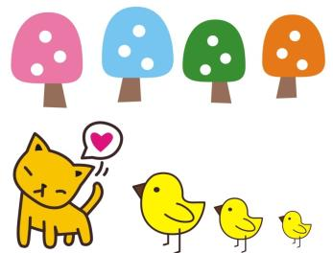
Introduce
T: Do you remember what are Miss Li and their students’ dreams?
T: Who is in the story?
T: Look at the books, Read the sentences.

Slide 3
Words
dancer [ˈdɑ:nsə(r)]
做名词使用，表示舞蹈者，舞蹈家。要区别于其动词dance.
eg:She is a good dancer.
dancing dancer
小练习：She likes ________. She want to be a_______.
拓展：“dancer”是个多义词，它可以指舞蹈家, 舞者（微电影）, 舞蹈演员,舞者（土耳其电影）, 舞者（丹麦电影）, 舞者（电视剧）。
（1）She is a good dancer.她是一个好的舞蹈演员。
（2）I like the film DANCER。（我喜欢电影《舞者》）

Slide 4
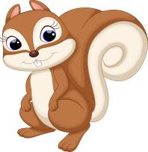
Expressions
I want to be an astronaut.
我想成为一名宇航员
want作为动词的用法，want to后面接名词的形式。
eg： I want to be a teacher. 我想成为一名老师
I want to be a cooker. 我想成为一名厨师
小练习：单项选择：
I want to _____a cooker.
A am B are C be
C

Slide 5
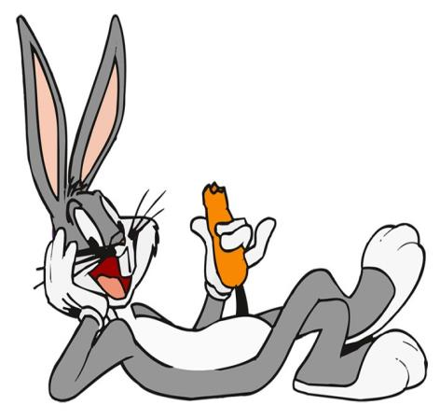
Dialogue
I want to be an astronaut.
我想成为一名宇航员
I want to be a dancer.
我想成为一名舞蹈演员
I want to fly to the moon.
我想登上月球
I want to play in World Cup.
我想踢进世界杯
I want to be a farmer.
我想成为一名农民

Slide 6
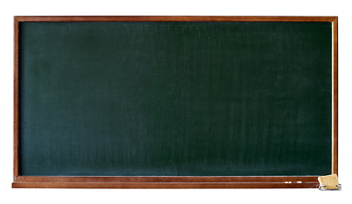
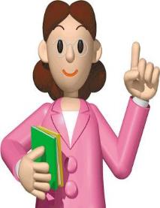
Summary
dancer
I want to be an astronaut
I want to fly to the moon.

Slide 7
Exercise
使用下列句型仿写句子：
I want to be an astronaut. _________________________________
I want to make have a banana.
_________________________________

Slide 8
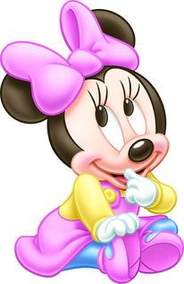
Exercise
英汉互译
1.我想成为一名医生。
__________________________________________
2. 你想成为什么？
__________________________________________
3. 我想飞向月球
___________________________________________
4.我想成为一名厨师
___________________________________________
5我的梦想是当一名教师
___________________________________________
I want to be a doctor.
What do you want to be?
I want to fly to the Moon.
I want to be a cooker.
My dream is to be a teacher.

Slide 9
Homework
What is your dream?

