Slide 1
Unit3 Welcome to our school
Reading (1)
WWW.PPT818.COM

Slide 2
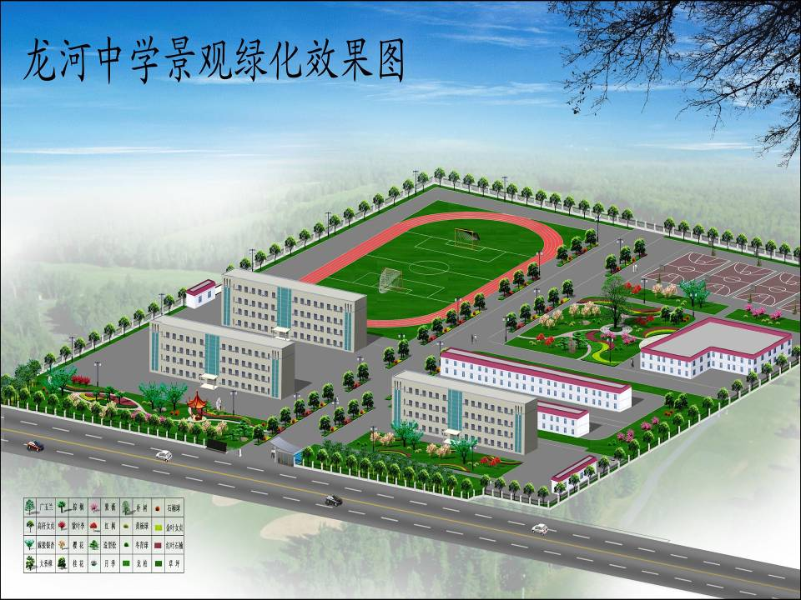
Welcome to our school
Is our school beautiful?
Do you like our school?
We like our school because

Slide 3
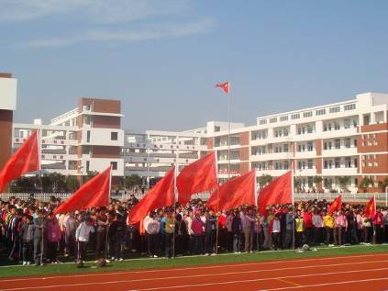
How do you feel about your new life here in the first month?
example:
I feel so ··· in my new school . The school is ····. My classmates are very ···.And all the teachers are …to me.

Slide 4
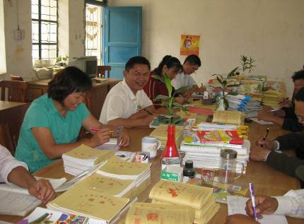
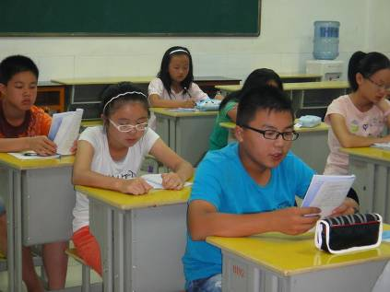
We have good teachers and lovely classmates here.

Slide 5
We can learn lots of subjects here:
Chinese
Maths
English
Music
PE
Art
Biology
Geography
History
Politics
Computer studies

Slide 6
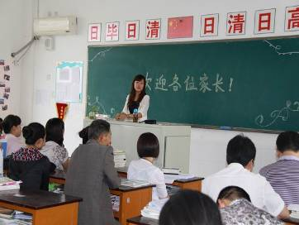
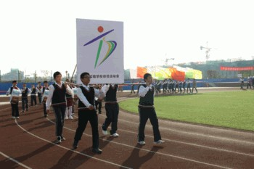
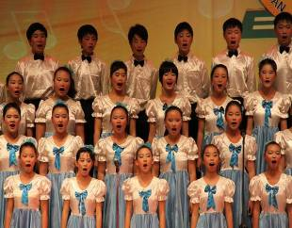
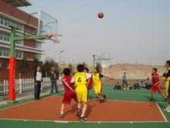
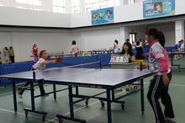
We can have colourful school life.
sports meeting
parents’ meeting
Singing Club
Basketball Club
Table tennis Club

Slide 7
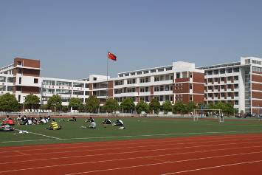
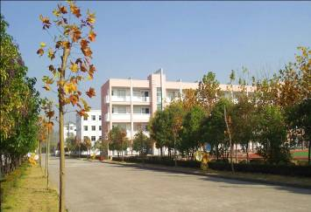
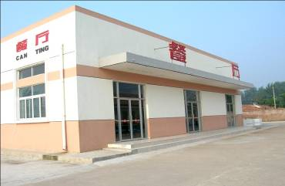
School open day
Let’s show your parents around our school!
playground
classroom building
dining hall

Slide 8
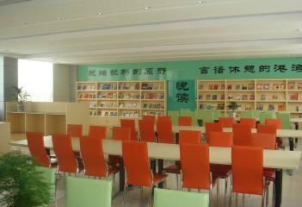
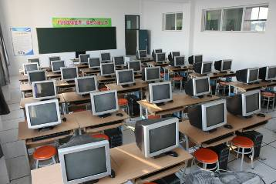
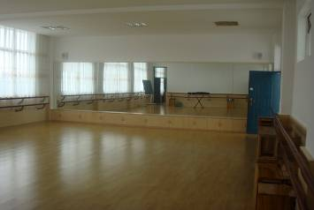
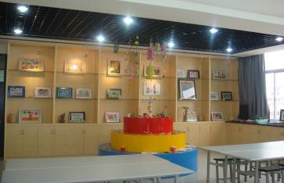
School open day
Let’s show your parents around our school!
reading room
computer room
dancing room
art room

Slide 9
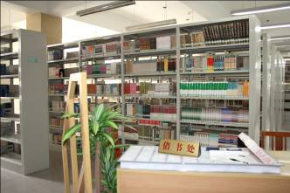
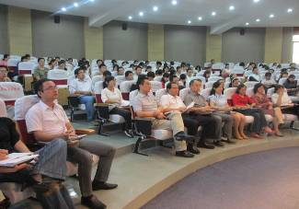
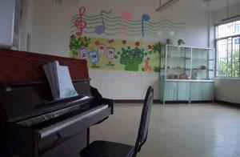
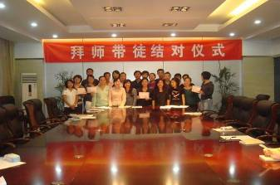
School open day
Let’s show your parents around our school!
library
school hall
music room
meeting room

Slide 10
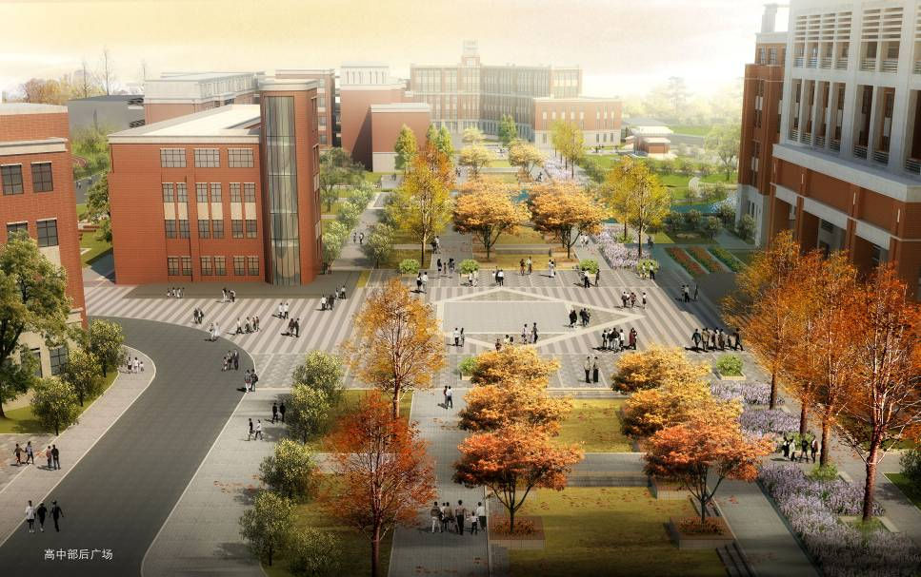
Let’s go to Beijing Sunshine Middle School!

Slide 11
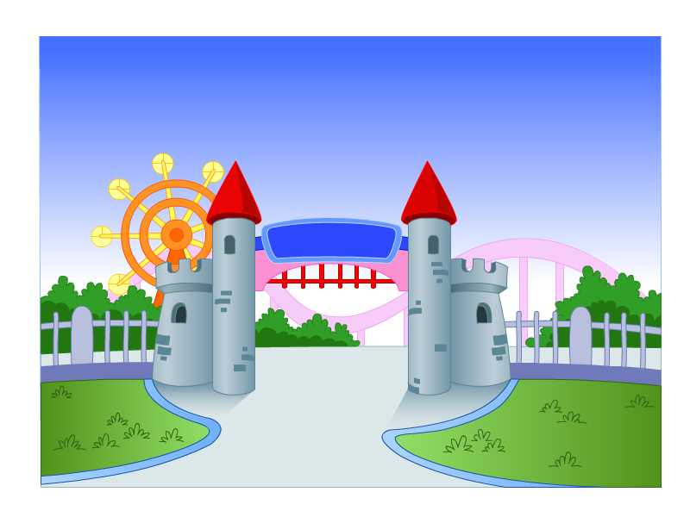
Millie’s school
Today is the Open Day in Millie’s school.

Slide 12
Listen to the tape and answer the two questions:
1.Where are Millie and her mother?
2.Who is Mr Wu?
At the school gate
Millie’s English teacher

Slide 13
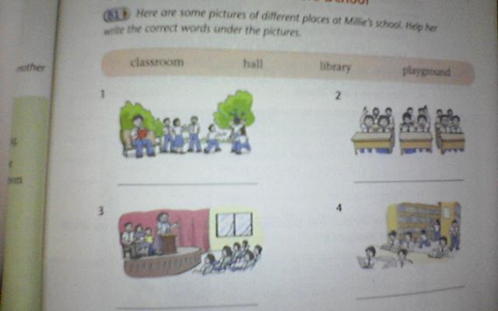
Read the dialogue and finish Part B1:
playground
classroom
library
hall

Slide 14
Read the dialogue in pairs and finish Part B2:
√
Playground: small big
Classroom building: 18 classrooms 80classrooms
Classroom (s): clean and bright big and modern
Art room (s): one two
Music room (s): one two
Computer rooｍ (s): one two
Library: new old
School hall: for meetings for classes
√
√
√
√
√
√
√

Slide 15
Read the dialogue again and write a T if a sentence
is true or an F if it is false
____1.Sunshine Middle School looks beautiful.
____2.Millie and her mum are behind the classroom building.
____3.Millie’s classroom is on the ground floor.
____4.They have a new library.
____5.They have meetings in the library.
____6.They do not have a school hall.
____7.Mr.Wu is in a white shirt on the Open Day.
____8.Mr.Wu is Millie’s Chinese teacher.
T
F
T
T
F
F
T
F

Slide 16
10 October.
Dear Diary,
Today is our Open Day. Our parents come and visit our school on this day.
Our school looks_______. The __________ is very big, and our classrooms are clean and _______.There are 18classrooms in the classroom _________and my classroom is on the ________floor. We also have an______ room, a music room and two _________ rooms.
Our library is new and _______.There are lots of books. We often go there in the afternoon.
We also have a school ______.We have meetings there.
Our school is really nice. We all love it.
beautiful
playground
bright
building
ground
art
computer
modern
hall

Slide 17
Read and answer more questions
How does Millie’s school look?
2. What about the playground?
3. How many classrooms are there
in the school?
4. Where is Millie’s classroom ?
It looks beautiful.
It is so big.
18 classrooms.
On the ground floor.

Slide 18
5. What does Millie’s mother think of her classroom?
6. What else is in her school?
7. Where does her mother have the meeting?
Clean and bright.
An art room ,a music room ,two computer rooms.
The school hall.

Slide 19
Homework:
1.Try to retell the text.
2.Remember the new words.
3.Do Part B1.
4.Read the dialogue.

