Slide 1
Unit 10
I am very fast
WWW.PPT818.COM

Slide 2
What's your favourite sport?
My favourite sport is...
名词
动词ing形式

Slide 3
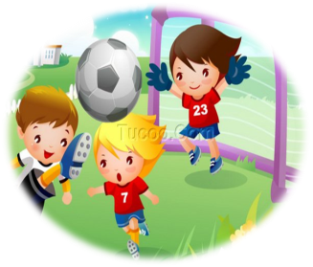
What's your favourite sport?
My favourite sport is football.(名词）
My favourite sport is playing football.（动名词）

Slide 4
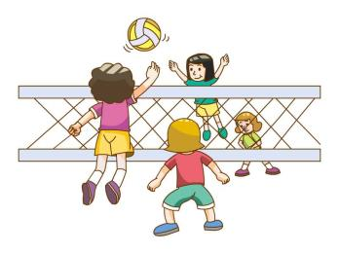
What's your favourite sport?
My favourite sport is volleyball.(名词）
My favourite sport is playing volleyball.（动名词）

Slide 5
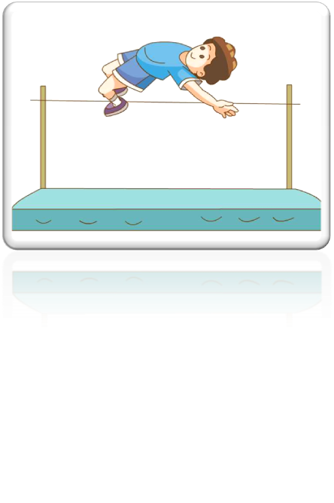
What's your favourite sport?
My favourite sport is the high jump.(名词）
My favourite sport is doing the high jump.（动名词）

Slide 6
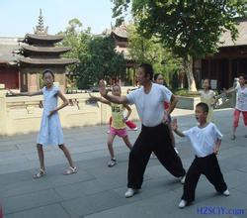
What's your favourite sport?
My favourite sport is kung fu.(名词）
My favourite sport is doing kung fu.（动名词）

Slide 7
What's your favourite sport?
I like playing football.（动名词）

Slide 8
What's your favourite sport?
I like playing volleyball.（动名词）

Slide 9
What's your favourite sport?
I like doing kung fu.（动名词）

Slide 10
What's your favourite sport?
I like doing the high jump.（动名词）

Slide 11
What's your favourite sport?
My favourite sport is...
I like...
名词
动词ing形式

Slide 12
why
tall,short,
strong,fat,
clever,
I am...
I have ...
long arm,
long legs,

Slide 13
What's your favourite sport?
I am tall and I have long arms,so I like playing volleyball.（动名词）

Slide 14
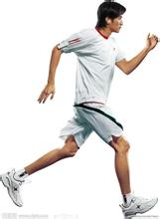
What's your favourite sport?
My favourite sport is running.（动名词） I am very fast.

Slide 15
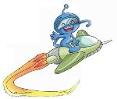
Homework:
1抄写新单词。
2背新单词。

