Slide 1
陕旅版
四年级下册
Unit5 Where Are You Going?
第四课时
WWW.PPT818.COM
0

Slide 2
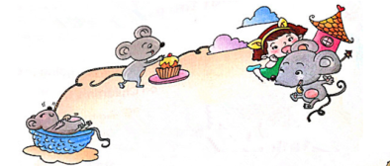
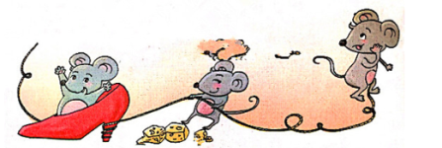
>>Presentation
Let’s sing
Little mouse, little mouse,
Run so fast, run so fast.
Where are you going?
Where are you going?
Little mouse, little mouse,
Run so fast, run so fast.
Where are you going?
Tell me now. Let me know.

Slide 3
>>Practice
我是小小演唱家
Little mouse, little mouse,
Run so fast, run so fast.
Where are you going?
Where are you going?
Little mouse, little mouse,
Run so fast, run so fast.
Where are you going?
Tell me now. Let me know.

Slide 4
>>Presentation
Read the words
你能发现不同吗？
she
these
evening
egg
bed
leg
Try to read more
be
Chinese
even
neck
left
best

Slide 5
>>Presentation
Read the words
/i:/
she
these
evening
/e/
egg
bed
leg
Try to read more
be
Chinese
even
neck
left
best

Slide 6
>>Practice
I can read
she
these
Chinese
even
left
best
bed
leg

Slide 7
>>Practice
Bingo!
she | be | bed
left | egg | nine
best | neck | these
e.g.

Slide 8
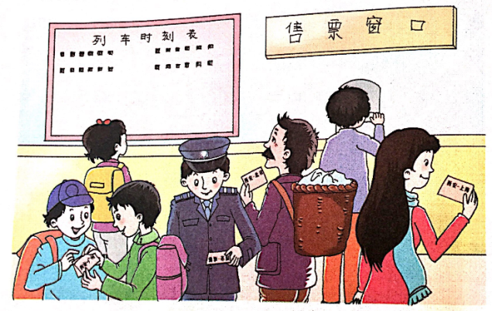
>>Presentation
Ask and answer
①
A: Where are they going?
B: He/She/They …

Slide 9
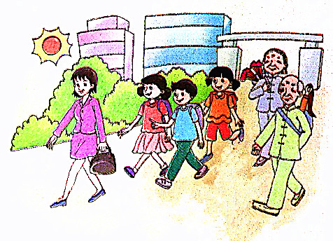
>>Presentation
Ask and answer
②
A: What is he/she going to do?
B: He / She is going to …
A: What are they going to do?
B: They are going to …

Slide 10
>> Summary
了解字母e在单词中的发音：
/i:/
she
these
evening
egg
bed
leg
/e/

Slide 11
>> Homework
1.听课文录音并跟读，按照正确的语音、语调朗读并表演课文对话。 2.用本单元所学的句型同伴之间讨论周末将要做的事情。
3.预习 Unit6 A Let’s talk。
close

