Slide 1
Unit 5 Topic 1
I’m so happy.
Section A
WWW.PPT818.COM

Slide 2
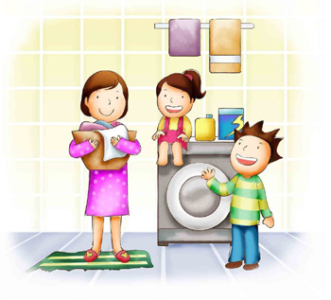
How do they feel?
happy

Slide 3
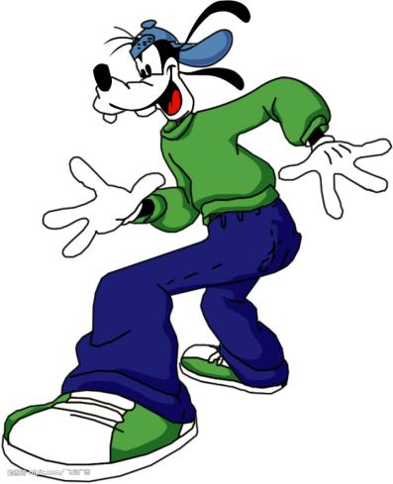
How do they feel?
excited

Slide 4
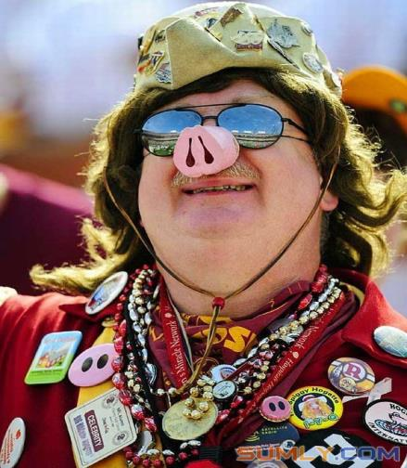
How do they feel?
funny

Slide 5
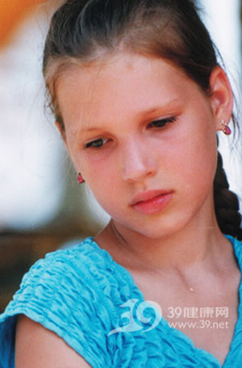
How do they feel?
worried

Slide 6
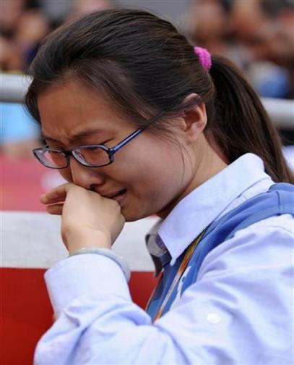
How do they feel?
sad

Slide 7
How do they feel?
angry

Slide 8
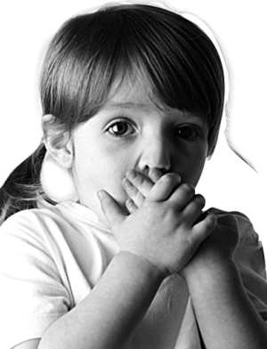
How do they feel?
frightened

Slide 9
Listen and answer.
1. Why does Kangkang feel excited?
Because his father and mother want to
invite Jane’s parents to go to the movie.
2. What movie are they going to see?
The Sound of Music.

Slide 10
3. When are they going to see the movie?
This Saturday.
4. What will Kangkang’s mom do?
She will prepare some delicious food
for them.

Slide 11
Key points
1. How are you doing? 相当于How are you?意为“你最近好吗？”
2. You look so excited.
look是系动词，后接形容词excited 做表语,
构成系表结构。常见的这类动词有: feel,
smell, sound, taste, turn, get, become, go
等。如：
Trees turn green in spring.
树木在春天变绿。

Slide 12
3. Guess what! My father and mother
want to invite your parents to go to the
movie. 猜猜看！我父母想邀请你们的父
母一起去看电影。
Guess what! 用于即将告诉某人令其
惊讶之事时。
2) want 的用法:
want sth. 想要某物
I want a new pen.
我想要一支新钢笔。

Slide 13
want to do sth. 想做某事
He wants to play basketball.
他想打篮球。
want sb to do sth. 想让某人做某事
The teacher wanted his students to
study hard.
那位老师想要他的学生努力学习。

Slide 14
3) invite sb. to do sth. 邀请某人做某事
May I invite you to go shopping with me?
我能邀请你一起去购物吗？
invite sb. to sp 邀请某人去某处
Mr. Wang invited me to his birthday
party.
王先生邀请我去参加他的生日宴会。

Slide 15
4. Oh, it is one of my favorite movies.
啊呀，它是我喜欢的电影之一。
one of ...表示“……之一” , 后面的名词要用复数。如：
The sweater is one of my favorite clothes.
毛衣是我喜欢的衣物之一。
He is one of the tallest boys in his class.
他是他们班最高的男孩之一。

Slide 16
5. And we can spend the evening at my house.
我们可以在我家度过一晚上。
spend 表示“度过，花费”, 主语一定是人,
spend time/money on sth. / (in) doing sth. 花
费时间或金钱做某事。如：
He spent ten yuan on his book.
or He spent ten yuan (in) buying his book.
他花了十元钱买书。

Slide 17
6. Please say thanks to your mom.
请代我谢谢你妈妈。
say thanks to … 意为“向(代我)……表示感谢”。类似的短语还有:
say hello to sb. 向……问好
say goodbye to sb 向……告别

Slide 18
1b. Listen to 1a and match the three parts.
1. The parents
disappointed
couldn’t get a ticket to
the movie
2. The children
excited
will go to see the movie
3. Mr. Brown
happy
can spend the evening
together

Slide 19
1c. Ask and answer questions in pairs based on 1b. Pay attention to the underlined parts.
Example:
A: How do the parents feel?
B: They feel happy.
A: Why do they feel happy?
B: Because they will go to see the movie.

Slide 20
1d. Read 1a and complete the passage.
Kangkang looks ______ because his parents want to ______ other children’s parents to go to see the movie, The Sound of Music, this _______. The children plan to ______ the evening at his house. His parents will prepare some _______ food for them. Jane’s parents will feel ________ about the news. Kangkang saw Mr. Brown on his way. Mr. Brown was disappointed because he couldn’t buy a _______ to the film.
excited
invite
Saturday
spend
delicious
happy
ticket

Slide 21
2. Look at the pictures. Then ask and answer in pairs.
Example:
A: How do the flowers smell?
B: They smell nice.
v. 闻到； n. 气味
smell / nice

Slide 22
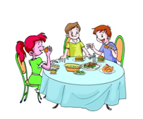
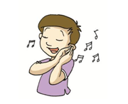
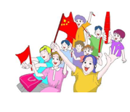
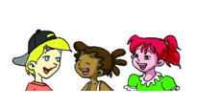
sound / wonderful
taste / delicious
look / happy
feel / excited

Slide 23
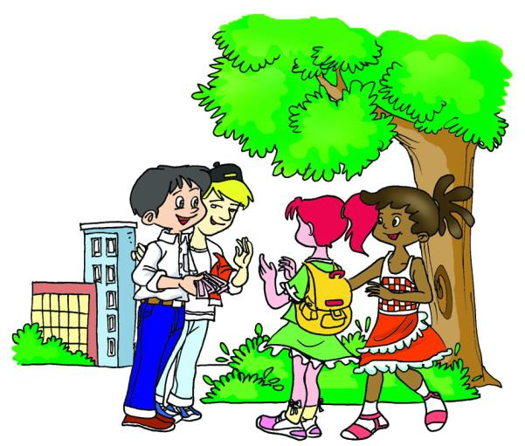
Competition
Act out the conversation in groups of four.

Slide 24
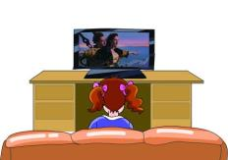
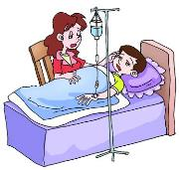
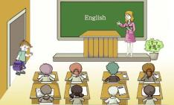
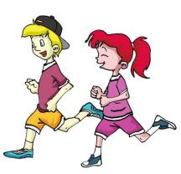
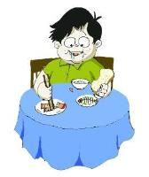
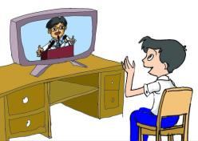
3. A. Listen to the conversations and number the pictures.
3A
4
6
2
3
5
1

Slide 25
4
6
2
feels angry
sounds great
is sad
_______ ________
_________ ________
_______ ________
3
5
1
are active
tastes delicious
looks happy
_______ ________
_______ ___________
_______ ________
B. Listen again and write down the
linking verbs and the adjectives.

Slide 26
4. Work in groups and make
conversations , using the linking verbs
and the adjectives.
A: How are you doing, Mike?
B: Very well, thank you. You look happy.
Why?
C: Because ... What about you, Maria? How
do you feel?
C: I feel...

Slide 27
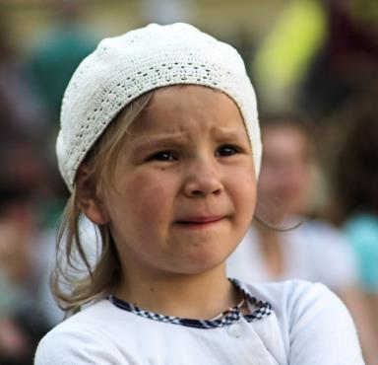
funny
worried

Slide 28
happy
sad

Slide 29
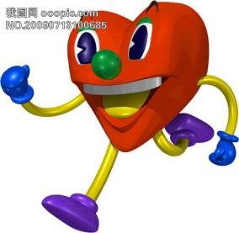
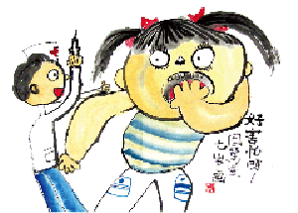
angry
active
frightened

Slide 30
Project
1.Collect as many adjectives about feelings
as you can. 2.Make conversations using the information
on the table.
Name | Feelings | Reasons
Mike | happy | nice weather
Maria | unhappy | can’t find new watch
… | … | …

Slide 31
A: How are you doing, Mike?
B: Very well, thank you. You look happy. Why?
A: Because … What about you, Maria? How
do you feel?
C: I feel…

Slide 32
Summary
We learn
New words:
Linking verbs:
Adjectives about feelings:
Sentence pattern:
We can
Use the structure:
Talk about our feelings.
Use “because” to talk about the reasons.
invite, smell, film, disappointed
be, look, feel, smell, taste, sound
happy, angry, excited,
disappointed, upset, frightened
How are you doing? Very well, thanks.
linking verbs + adjectives

Slide 33
Exercises
- How is your father doing?
- He is very _____ (good/well). Thank you.
English is _____ _____ my favorite _______(最喜欢的学科之一) .
David wants to _______(邀请) some friends to his birthday party this Friday evening.
- Helen, you ______ _______(看起来不高兴) . What’s the matter?
- I can’t find _____ _____ _____(……的票) Han Hong’s concert(音乐会).
You must ______ _____ _____(道谢) him or her if getting one’s help.
The _______ (气味) of roses is very nice.
well
one of
subjects
invite
look unhappy
the ticket to
say thanks to
smell

Slide 34
Complete the following sentences
1. 这个主意听起来很不错。(sound)
2. 学生们看来非常兴奋。 (look)
3. Mr. Brown觉得很失望。 (feel)
4. 这鱼很好吃。(taste)
5. 那些食物闻起来很香。 (smell)
The idea sounds great.
The students look/looked very excited.
Mr. Brown feels/ felt disappointed.
The fish tastes delicious.
The food smells good.

Slide 35
Homework
1. Complete 4 on Page 2.
2. Make more sentences including linking words.

