Slide 1
陕旅版
四年级下册
Unit5 Where Are You Going?
第二课时
WWW.PPT818.COM
0

Slide 2
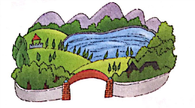
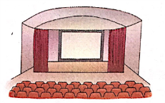
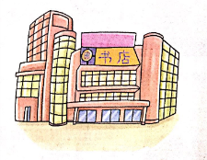
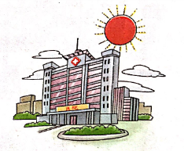
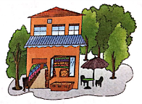
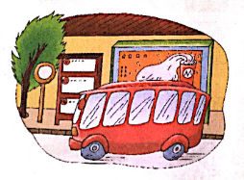
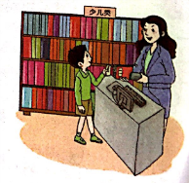
>>Review
Magic fingers

Slide 3
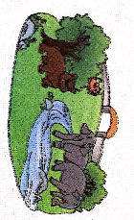
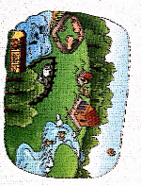
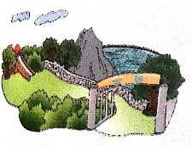
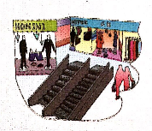
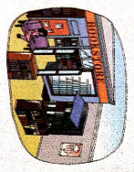
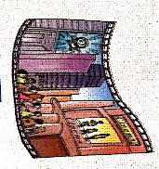
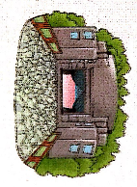
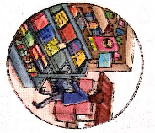
>>Lead-in
Think and tick
What do you want to go?

Slide 4
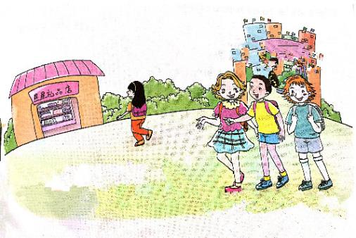
>>Presentation
Ask and answer
Q 1:Is Li Shan going home?
No, she isn’t.
Q 2:Where is she going?
She is going to the shop.
答案

Slide 5
>>Presentation
Let’s talk
We are going home.
Where are you going?
We are going home.
Where is Li Shan going?
Is she going home, too?
No, she isn’t. She is going to the shop.
No, she isn’t. She is going to the shop.

Slide 6
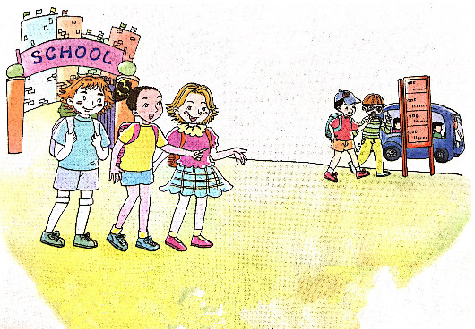
>>Presentation
Ask and answer
Where are they going?
They are going to the bus stop.

Slide 7
>>Presentation
Let’s talk
Are they going to the shop, too?
No, they aren’t. They are going to the bus stop. They are going to the cinema.

Slide 8
>>Presentation
Let’s talk
Alice: Where are you going?
Kitty & Colin: We are going home.
Alice: Where is Li Shan going? Is she
going home, too?
Kitty & Colin: No, she isn't. She is going to the
shop.
Alice: Are they going to the shop, too?
Kitty: No, they aren't. They are going to
the bus stop. They are going to the
cinema.

Slide 9
>>Practice
Read it by yourselves for one minute.
自读对话一分钟。
一分钟倒计时
60
10
50
Tips:
当你自己朗读时，遇到不会读或不明白意思的单词或句子，可以把它圈起来，请教同学或老师！
20
40
30
开始

Slide 10
>>Practice
Super Mary:表演我最棒！
小组合作：
1.3人一小组
2.根据课文分角色练习
3.适当加上一些动作辅助表演
4.课文基础上进行新对话创编
Make a new dialogue 创编新对话

Slide 11
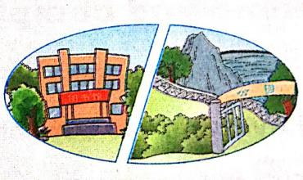
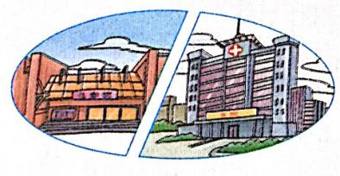
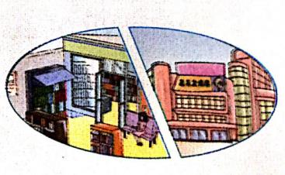
>>Practice
Look and say
hospital
park
shop

Slide 12
>>Practice
Look and read
①
A: Is Liu Zhaoyang going to see a film?
B: No. He is going to the hospital.
A: Where is Su Nan going?
B: He is going to the park.
②
③
A: What’s Wu Chen going to do?
B: She is going to buy a ruler.

Slide 13
>> Summary
本课所学的重点句型：
-Where is he/she going?
-He/She is going to the …
-Where are they/you going?
-They/We are/I am going to the …

Slide 14
>> Summary
本课所学的重点句型：
e.g.
-Where is she going?
-She is going to the cinema
-Where are they going?
-They are going to the hospital.

Slide 15
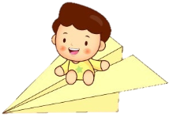
>> Homework
1.听课文录音并跟读，按照正确的语音、语调朗读并表演课文对话。 2.学生2人一组，分角色表演课文Let’s talk.
3.预习 Unit5 B Let’s learn more。
close

