Slide 1
Module 4 Home alone
Unit 2 I became so bored with their orders that I wished they would leave me alone.
WWW.PPT818.COM

Slide 2
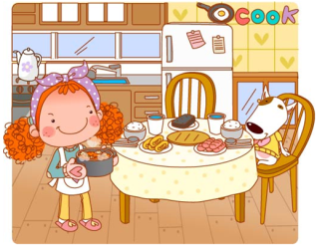
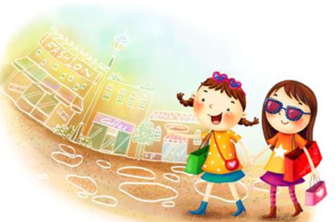
Warm up
Work in pairs. Talk about daily things you do alone and the things your parents do for you.
cook dinner
go shopping

Slide 3
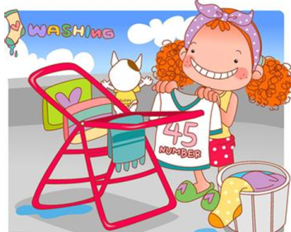
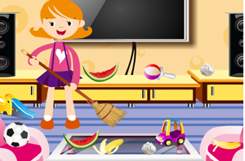
wash clothes
tidy up

Slide 4
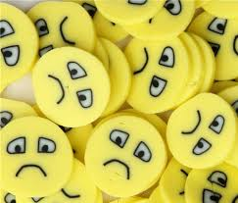
Presentation
unhappy
adj. 不高兴的

Slide 5
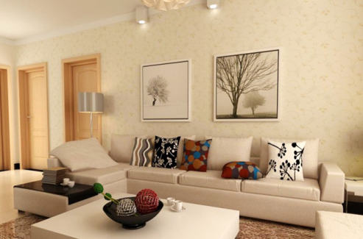
sofa n. (长) 沙发

Slide 6
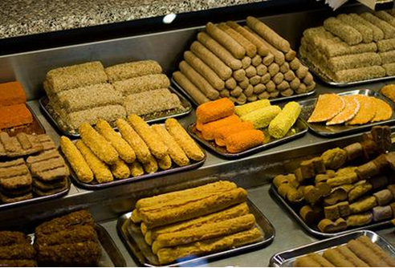
snack n. 点心; 小吃

Slide 7
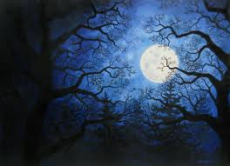
midnight
n. 午夜; 子夜

Slide 8
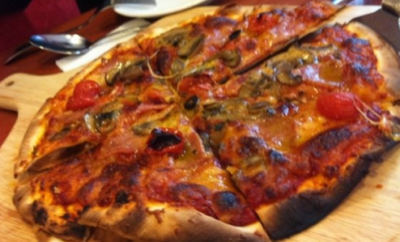
burn (burned, burned; burnt burnt)
v. (使)烧焦; (使)烤糊

Slide 9
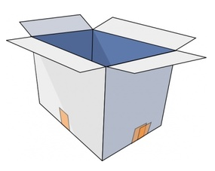

empty
adj. 空的
cup
n. 杯子; 一杯饮料

Slide 10

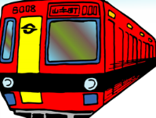

He got up ____ late ____ he missed the bus.
Practice
so that
so
He was _____ excited ______ he couldn’t go to sleep that night.
that

Slide 11
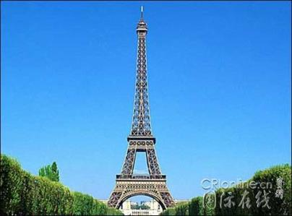
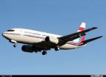
________ she wants to go to Paris, she doesn’t want to fly. (变同义句)
Although
but
She wants to go to Paris, _____
she doesn’t want to fly.
×

Slide 12
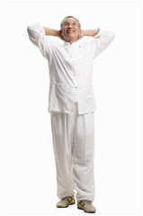
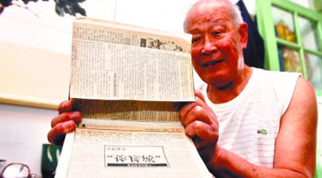
________ he is old, he is very strong.
(同义句)
Although
He is old, ______ he is very strong.
but

Slide 13

Focus on
Words:
actually unhappy manage order business sofa snack midnight empty burn task
Phrases:
turn off on business all day long hand in unable to do sth. have fun
Patterns:
I liked the games so much that I played until midnight.
I had to hurry to school without breakfast, but I was still late.

Slide 14

Lead in
Make a list of things to do daily:
____________________________
____________________________
____________________________
____________________________
____________________________
____________________________
____________________________
____________________________
make bed tidy up
sweep the floor
go to school
clean dishes
have classes
take out the rubbish
do the homework
cook dinner wash clothes

Slide 15


P28
1
Talk about them with your partner.
Which things do you do alone?
Which things do your parents do for you?
I make bed alone.
My mum cook dinner for me every day.

Slide 16

Imagine: Your parents go away on business, and you have to stay at home alone. How do you think of this situation?
Is it a perfect holiday for you?
Or is it a hard time?

Slide 17
Can you
cook simple meals
?
tidy up on your own
?
wake up on time
?
do some washing
?
look after yourself well
?
…

Slide 18

Task 1
2
Read the passage and choose the best summary.
a) Zheng Chenyu found his life more difficult without his parents.
b) Zheng Chenyu depended on his parents to prepare meals for him.
c) Zheng Chenyu had so much homework that he did not have time to look after himself.
d) Zheng Chenyu should learn to cook.

Slide 19
Read Para. 1 and use the words in the box to complete the sentences.
Task 2
happy bored unhappy sad
1. Although my parents loved me, I felt a bit _________ with them.
2. I became so _______ with my parents’ orders.
unhappy
bored

Slide 20
Read Para. paragraph[ ˈpærəgrɑ:f ] 2 and answer the following questions.
1. How did my wish come true?
2. Make a list about what Zheng Chenyu did on the first day.
My parents had to go away on business for a few days.
* threw his schoolbag on the sofa and ate lots of snacks
* enjoy an exciting film on TV
* play computer games until midnight

Slide 21
Read Para. 3 and answer the question below.
What kind of troubles did he meet?
1) wake up late
2) hurry to school without breakfast
3) late for school
4) can’t hand in his homework
5) unable to play basketball because of hunger
6) feel tired and sleepy at school all day long

Slide 22
Read Para. 4 and fill in the blanks.
 | Mum | Dad
Things he/she do for Zheng Chenyu every day
What did he realise?
• cook delicious food
• help him with difficult questions
• make sure he never forget his homework
• tell him funny jokes when he’s unhappy
Being home alone was not always perfect.

Slide 23
3
Look through the passage again and complete the sentences about Zheng Chenyu’s feelings.
Task 3
P29
a bit unhappy
1. Zheng Chenyu felt ________________ with his parents because they did everything for him and managed every minute of his life.
2. After Zheng Chenyu’s parents went away on business, he felt ___________ because he could _______________.
excited
have some fun

Slide 24
3. Zheng Chenyu felt _______________ after the first night.
4. Zheng Chenyu felt _______________ when he found he could not look after himself well.
5. Zheng Chenyu realised being home alone ___________________________.
tired and sleepy
lonely
was not always perfect

Slide 25
4
Complete the passage with the correct form of the words in the box.
Task 4
P29
burn cup empty order simple task
orders
Zheng Chenyu was bored with his parents’ (1) _______. He was happy when his parents went away on business, though he soon found that he could not do (2) _______ things. He forgot his homework. He went to school with a(n) (3) _______ stomach. He (4) _______ his food and broke his father’s (5) ________. Zheng Chenyu had to learn to do (6) ________ like cooking and tidying up. He realised being home alone was not always perfect.
simple
empty
burnt
cup
tasks

Slide 26
Language points
Language points
1. As a boy, like all other boys, I want to be a man.
作为男孩，就像其他所有男孩一样，我想做个男子汉。
man在此处意为“男子汉”。例如：
Don’t cry anymore. Be a man!
别再哭了。要像个男子汉！

Slide 27
2. Actually, they managed every minute of my life.
实际上，他们安排了我生活中的每一分钟.
manage的意思是“安排；管理”，在这里作者用夸张的手法表达了对父母管得太多的不满。
Parents should not manage everything for their children.
父母不应该为孩子安排一切。
I manage my time well.
我把自己的时间安排得很好。

Slide 28
3. I liked the games so much that I played until midnight.
我太喜欢玩游戏了，以至于一直玩到午夜.
(1)“so＋形容词或副词＋that”引导的结果
状语从句意思是“如此……以致于……”。 如：
When the basketball fans saw Jeremy Lin, they got so excited that they cried out.
当球迷们看到林书豪时，他们太激动，喊了起来。

Slide 29
The camera is so expensive that I can’t
afford it.
这架相机太贵了，我买不起。
他非常聪明，很快就算出了这道数学题。
___________________________________
___________________________
He was so clever that he worked out that math problem quickly.

Slide 30
4. …, but I couldn’t hand it in.
……， 但是我交不了（作业）。
hand in指把物品“上交”，反义短语是hand out，把物品“分发”出去 。
We can help the teacher hand out the exam papers.
我们可以帮老师分发试卷。
I want you both to hand in your exercise-book today.
我要你们俩今天把练习本交上来。

Slide 31

Let the words fly
燃烧; 烧着
(使)食物烧焦
(灯)开着,发亮
burn
晒黑
消耗(脂肪)
烫伤

Slide 32
1. (使)食物烧焦
I’d probably watch television and then burn the soup.
我也许会在看电视时把汤给烧焦了。
2. 燃烧; 烧着
A fire was burning in the hearth, our house was warm.
壁炉里面烧着火, 我们的房子是温暖的。
3. (灯)开着; 发亮
Sara left all the lights burning. 萨拉让所有的灯都开着。

Slide 33
4. 消耗(脂肪)
To change your body shape you need to burn calories.
要改变你的体形，你需要消耗热量。
5. 烫伤
The sand was so hot it burnt my feet.
沙子非常热，烫伤了我的脚。
6. 晒黑
Wear a hat so you don’t burn your neck.
戴上帽子，这样你不会把脖子晒黑。

Slide 34

活学活用
从上面给出的例句我们可以看到burn 的含义很丰富, 口语中更是随处可见它的身影。与burn相关的搭配也很丰富, 大家想一想与burn相关的搭配或口语表达, 选择几个进行造句或对话练习。

Slide 35


Writing
Writing
Write a passage about what you can do and what you cannot do when your parents are away.

Slide 36
Step 1: Read the passage again and make lists of what Zheng Chenyu does when his parents are away.
Step 2: Make a list of what you can do and cannot do when your parents are away.
I can wake up on time.
I cannot make breakfast.

Slide 37
Step 3: Now join the sentences with although, but or so… that.
I can wake up on time, although I cannot make breakfast.
Step 4: Write a conclusion to the sentences.
I will miss my parents, but I think I can look after myself very well.
Step 5: Share your passage with your classmates.

Slide 38

Learning to
Learning to learn
When you write your passage, you can start with a question. Think of your first answer to it, and think of an example. Then think of the opposite answer, and think of an example as well. Try to present both answers (试着提出两个答案)and then write a conclusion.

Slide 39

Summary
总结回顾
本课时主要短语和句型
1. on business
2. hand in
3. unable to do sth.
4. I liked the games so much that I played until midnight.
5. Although they loved me, I felt a bit unhappy with them.

Slide 40

Spelling Bee
Consolidation
Now 2 mins to test your spelling.
1. English-Chinese
actually midnight all day long task on business order snack
2. Chinese-English
担心 管理;支配 关掉;关闭 玩得高兴 提交;上交 (使)烧焦/烤糊
When finished, exchange your papers to see who does the best.

Slide 41
I. 从方框内选择合适的词填空。
snack manage midnight order actually
midnight
1. We have to catch the __________ train.
2. I didn’t want to say anything without _________ reading the letter first.
actually

Slide 42
snack manage midnight order actually
orders
3. He gave _______ for the work to be started.
4. Don’t tell me how to _______ my pocket money.
5. I only have time for a _______ at lunch time.
manage
snack

Slide 43
II. 根据句意完成句子。
1. He ______ ______ to find himself alone in the house.
他醒来时发现屋里只有他一个人。
2. I _______ the watch ______ to the police.
我把那块表交给了警察。
3. I tried to contact (联系) him, but _______ _______ _______.
我试着和他联系，却没联系上。
woke up
handed in
was unable to

Slide 44
Homework
Homework
1. Preview the use of adverbial clauses with although, but, so…that.
2. Read the articles in Learning English.

