Slide 1
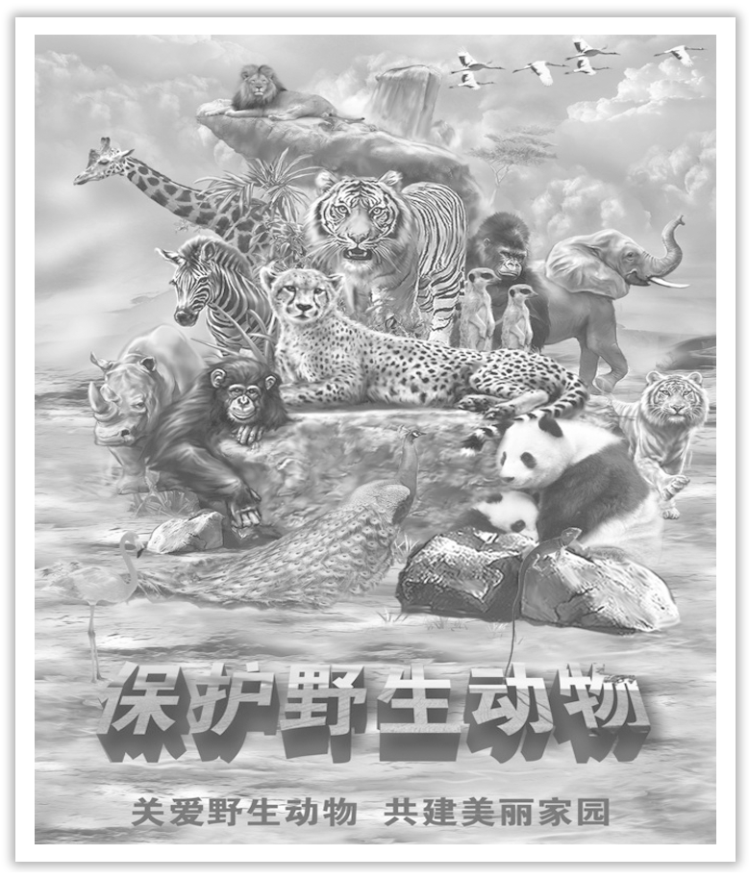
Unit 2 Wildlife Protection
Section Ⅰ Listening and Speaking
WWW.PPT818.COM

Slide 2
主题语境——人与自我之环境保护
本单元的话题内容是“野生动植物保护”，它属于“人与自然”这一主题语境下的“环境保护”。本单元的主要内容包括人与环境、人与动植物、野生动植物保护等。这些内容与学生的社会生活有关，学习它们有助于进一步丰富学生在保护野生动植物方面的语言能力、文化意识、思维品质，促进学生学习能力的提高。
【语境概说】

Slide 3
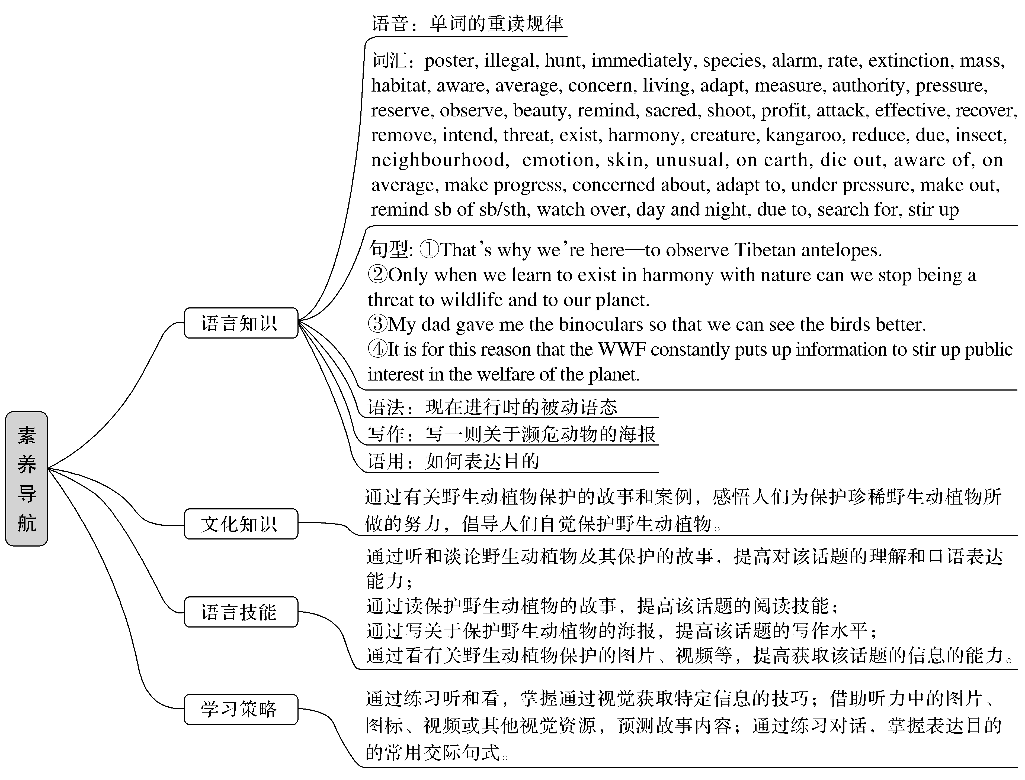

Slide 4
It is everyone’s duty to protect birds and wildlife.
保护鸟类，保护野生动物人人有责。
Protecting wildlife means caring for human beings themselves.保护野生动物，就是关爱人类自己。
The earth without animals is like the blue sky without white clouds.地球没有了动物，就如蓝天没有了白云。

Slide 5
1.Translate the following words and phrases.
①poster n. ____________ ②illegal adj. _________________
③hunt v. ________________ ④immediately adv. ____________
⑤species n. ____________
⑥alarm vt.________________n.____________
⑦rate n.____________vt.____________
海报
不合法的；非法的
打猎；搜寻；追捕
立刻
物种
使惊恐；使害怕
警报；恐慌
速度；(比)率
划分等级

Slide 6
⑧extinction n. ____________
⑨mass adj.________________ n.______________
⑩average n.____________adj.____________
⑪concern vt. ____________
⑫living adj._______________n.____________
⑬measure n.____________vt.____________
⑭authority n. __________________ ⑮die out _______________
⑯aware of ____________ ⑰on average ____________
⑱make progress ____________ ⑲concerned about ____________
⑳adapt to ____________
灭绝
大量的；广泛的
大量；堆；群
平均数
平均的
涉及
居住的；活的
生活；生计
措施；方法
测量
官方；当权；权威
灭亡；逐渐消失
意识到
平均
取得进步
对……关切的
适应

Slide 7
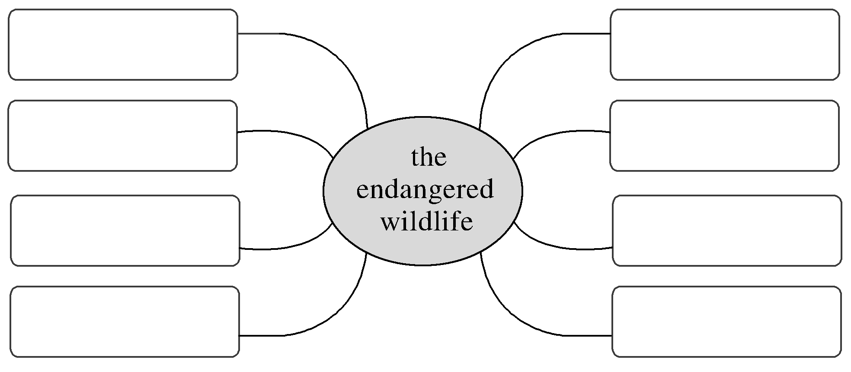
2.Brainstorming：Please name some wildlife in the world in English or in Chinese.
pangolin(穿山甲)，manchurian tiger(东北虎)，snow leopard(雪豹)，milu deer(麋鹿)，giant panda(大熊猫)，golden monkey(金丝猴)，white-flag dolphin(白鳍豚)，crested Ibis(朱鹮)

Slide 8
3.Look at the pictures on Page 14 and predict what message the posters share.
These pictures mean that some wildlife species ________________ and some ________________ so we need ________________.
are losing
are in danger
to protect them

Slide 9
Finish Ex.2 & Ex.3 on Page 14.

Slide 10
1.Speaking—Finish Ex.4 on Page 14 and Ex.1 on Page 15.
2.Pronunciation—Read the words aloud and find out their stress syllables, and then fill in the blanks.
[“〇”stands for primary stress, and “〇”for secondary stress, and “〇”for unstressed syllable.]

Slide 11
Example：habitat：〇〇〇
①species ____________ ②concern ____________
③average ____________ ④alarming ____________
⑤overseas ____________ ⑥literary ____________
⑦investigate ____________ ⑧contribution ____________
⑨archaeologist ____________ ⑩refrigerator ____________
〇〇
〇〇
〇〇〇
〇〇〇
〇〇〇
〇〇〇〇
〇〇〇〇
〇〇〇〇
〇〇〇〇〇
〇〇〇〇〇

Slide 12
语言知识积累
表示“观点”的常用表达
1.In my opinion/view...
2.I think/believe...
3.As far as I am concerned...
4.According to me...
5.As for/to me...
6.From my point of view...

Slide 13
文化知识习得
中国的濒危动物
1.中国华南虎。华南虎是中国特有虎亚种，体小且修长，腹部较细，头圆耳短，四肢粗大，尾较长，胸腹部杂有较多的乳白色，全身橙黄色并布满黑色横纹。1990年后，我国没发现过野生华南虎，很多专家都认为，华南虎的自然种群已经灭绝。
2.中华白鳍豚。 白鳍豚是中国特有的淡水鲸类，被称为“水中的大熊猫”。白鳍豚种群数量很少，为我国特有的珍稀水生兽类，生活于长江中下游湖北、安徽、江苏段的干流之中。它们大约在长江生活了2 500万年，有“活化石”的美称，由于数量奇少，被列为中国一级保护野生动物。

Slide 14
重音技巧点拨
1.重音知识
(1)重音：单音节词单独读时都重读，不必标注重音符号；两个或两个以上的音节才标注重音符号。
(2)次重音：在含有3个及3个以上音节的单词中，有的除了有主重音之外还有次重音，次重音表示读该音节时要弱于主重音节而强于其他音节。

Slide 15
2.重音的一般规律
(1)双音节词的重音多数在第一个音节上。
(2)含不可分开的前缀的双音节词，重音常落在第二个音节上。
(3)多音节词的重音多落在倒数第三个音节上。
(4)以-ic, -ial, -ian, -ion等后缀结尾的多音节词，重音落在倒数第二个音节上。
(5)三个音节以上的词除了主重音外，往往还带有一个次重音。次重音多落在第一个或第二个音节上。

Slide 16
1.mass adj.大量的；广泛的n.大量；堆；群
This mass extinction is caused by hunting, habitat destruction and pollution.(教材P₁₄)
这种大规模灭绝是由狩猎、栖息地破坏和污染造成的。
[合作探究] 体会mass的用法和意义
On his desk is a mass of books and papers.
他的书桌上有大堆的书籍和文件。
There are masses of people in the hall.大厅里有很多人。
I wonder if they are truly concerned with the interests of the masses.
我不知道他们是否真正关心民众的利益。

Slide 17
[自主发现]
①a mass of 大量的；众多的
②masses of 许多；很多
③the masses 民众；群众

Slide 18
[巩固内化]
单句语法填空/翻译句子
①There ____________ (be) masses of work for your children to do.
②院子里有一大群孩子。
________________________________________________________________________
[名师点津] “a mass of/masses of＋可数或者不可名词”作主语时，谓语动词的数与其后所接的名词的数一致。
is
There were a mass of children in the yard.

Slide 19
2.aware adj.知道；发觉；有……意识的 awareness n.意识
We must make people aware of the problem and help save the endangered wildlife before it’s too late！(教材P₁₄)
我们必须让人们意识到这个问题，趁着还不晚，帮助拯救濒危野生动植物！
[合作探究] 体会aware及其派生词的用法和意义
It is of great importance for you to be aware of the content of Tang Poetry.
了解唐诗的内容是非常重要的。
While chatting with them, I became aware of the advantages of physical exercises.
和他们聊天时，我意识到体育锻炼的好处。

Slide 20
I can learn more about how to protect pandas and raise people’s awareness of animal protection.我可以学到更多关于如何保护大熊猫，提高人们的动物保护意识。
[自主发现]
①make sb aware ____________ 使某人意识到
②____________ aware of sth 意识到
③be aware that... 意识到……
④raise sb’s ____________ of 提高某人的……意识
of
be/become
awareness

Slide 21
[巩固内化]
(1)单句语法填空
①You should make your parents aware ____________ the benefits of the training class.
②An ____________ (aware) of metaphors (暗喻) is very helpful in understanding poetry.
(2)同义替换
③Hardly had he entered the office when he realized (＝________________) that he had forgotten his report.
of
awareness
was/became aware

Slide 22
3.average n.平均数；平均水平adj.平均的；正常的；普通的
How many elephants are killed on average every day? (教材P₁₄)
平均每天有多少头大象被杀？
[合作探究] 体会average的用法和意义
The average of 6，8 and 10 is 8. 6，8，10的平均数是8。
400 people a year die of this disease on average.
平均每年有400人死于这种疾病。
To their great joy, their son’s school work is well above average.
令他们高兴的是，他们儿子的学习成绩远高于平均水平。

Slide 23
[自主发现]
①the/an average ____________... ……的平均数
②____________ (an) average 平均；平均起来
③____________ average 高于平均水平
④below average 低于平均水平
of
on
above

Slide 24
[巩固内化]
(1)单句语法填空
①An average of about 100 emails a week ____________ (be) received.
(2)补全句子
②_____________________(平均起来), each Chinese person read less than 8 books in 2018.
③This year the price of pork is ________________ (高于平均水平) compared to other years.
are
On (an) average
above average

Slide 25
4.concern vt.涉及；让……担忧n.担心；担忧；忧虑；关爱 concerning prep.关于
I’m concerned about the African elephants.(教材P₁₅) 我很担心非洲象。
[合作探究] 体会concern及其派生词的用法和意义
I’m now writing to you to express my concerns about sleep time of senior high school students.我现在给你写信是想表达我对高中生睡眠时间的担忧。
As/So far as I’m concerned, living in China is better than living abroad.
就我而言，住在中国比在国外要好。
If you have any information concerning the recent incident at the station, please contact the local police.
如果你有最近这次车站事件的相关信息，请与当地警察联系。

Slide 26
[自主发现]
①____________ concerned about 对……关切的；对……担忧的
②express one’s concerns ____________ 表达对……的担忧
③as/so far as one’s ____________ 就某人而言， 对某人来说
be/feel
about
concerned

Slide 27
[巩固内化]
(1)单句语法填空
①It does point out that many parents still limit electronic reading, mainly due to ____________(concern) about increased screen time.
(2)翻译句子
②对他来说，什么也比不上他女儿重要。
________________________________________________________________________
③现在，越来越多的人关心他们的健康。
________________________________________________________________________
concerns
As/So far as he’s concerned, nothing is as important as his daughter.
Nowadays more and more people are concerned about their health.

Slide 28
5.adapt vi.适应vt.使适应；使适合；改编 adaptation n.适应；改编本
Elephants need large living spaces, so it’s difficult for them to adapt to the changes.(教材P₁₅)大象需要很大的生存空间，所以它们很难适应变化。
[合作探究] 体会adapt的用法和意义
She found it difficult to adapt herself to the life in a foreign country.
她感到难以适应国外的生活。
The Wandering Earth is adapted from the short story written by Liu Cixin.
《流浪的地球》是根据刘慈欣的短篇小说改编的。
The True Story of Ah Q has been adapted for a play.《阿Q正传》已被改编为戏剧。

Slide 29
[自主发现]
①adapt (oneself) ____________ sth (使自己) 适应某事
②adapt...____________... 根据……改编……
③adapt...____________... 把……改编成……
to
from
for

Slide 30
[巩固内化]
(1)单句语法填空
①The play in this unit is adapted ____________ The Million Pound Bank.
②The ____________ (adapt) of the play by the famous writer became popular in the country.
(2)补全句子
③I’m sorry to hear that ______________________________________________.
听说你在适应新学校方面有困难，我很难过。
from
adaptation
you are having trouble adapting to your new school

Slide 31
6.measure n.措施；方法；尺寸vt.测量；度量；估量
What measures are being taken to help them？(教材P₁₅)
现在正在采取什么措施来帮助它们呢？
[合作探究] 体会measure的用法和意义
The tailor took my measure for a new suit.裁缝给我量尺寸做了一套新西装。
This room measures 10 metres across.这个房间(度量)宽十米。
[自主发现]
①take ____________ (to do sth) 采取措施(做某事)
②take one’s measure ____________ 量某人的尺寸做……
③measure＋数值 ____________
measures
for
度量为……

Slide 32
[巩固内化]
(1)单句语法填空
①Our classroom ____________(measure) 9 metres by 7 metres.
②There are some tall trees in our campus, some ____________ (measure) more than forty meters.
(2)补全句子
③It is time we __________________________(采取有效措施) to solve this problem.
measures
measuring
took effective measures

Slide 33
7.die out灭亡；逐渐消失
Our planet’s wildlife is dying out at an alarming rate.(教材P₁₄)
我们星球上的野生动植物正以惊人的速度灭绝。
[短语记牢] 记牢下列短语
die of 死于(内因)
die from 死于(外因)
die away (声音、风、光线等)渐息，渐弱
die down (慢慢)熄灭；平静下来；逐渐平息
be dying for sth/to do sth 迫切想要(做)某事

Slide 34
①Every possible means has been tried.However, nothing can prevent him dying of lung cancer.
一切可能的办法都试过了。然而，没有什么能阻止他死于肺癌。
②It’s reported that many people die from traffic accidents each year.
据报道，每年有许多人死于交通事故。
③Having been walking for nearly an hour, I am dying for a good sleep in bed.
走了将近一个小时，我非常想在床上睡个好觉。

Slide 35
[巩固内化]
(1)介、副词填空
①The sound of the car died ____________ in the distance.
②Unfortunately, the soldier died ____________ a wound in the chest.
③When the applause had died ____________，she began her speech.
(2)补全句子
④The volunteers try to convince people of the fact that ___________________________
________________________ (一些物种正处于灭绝的危险).
away
from
down
some species are in danger of dying out

