Slide 1
Unit 1 This is me
Reading 1
WWW.PPT818.COM

Slide 2
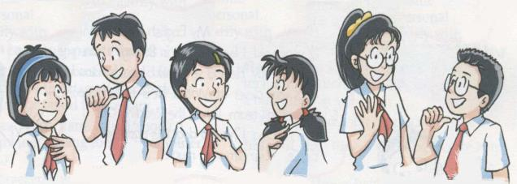
Do you remember their names?
Who are they ?
Amy
Simon
Millie
Kitty
Sandy
Daniel
/ei /
/ ai /
/ i /
/ i /
/ æ /
/ æ /

Slide 3
Study aims:
1.了解文章大意，完成相应的练习。
2.会用英语自我介绍和介绍他人。

Slide 4
Do you want to know more about them?
Millie
Simon
Sandy
Daniel

Slide 5
Self-learning：Read the text and answer two questions:
1. How many students are there in the passage?
Four.
2. Who are they?
They are Millie, Simon, Sandy and Daniel.

Slide 6
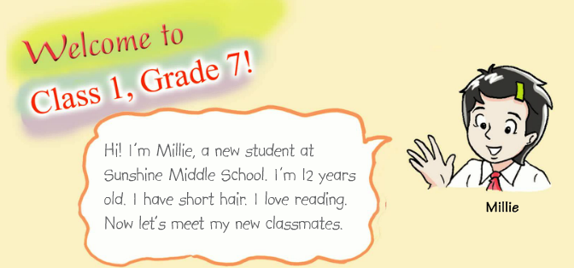
Exploration：
Read and answer!
1. How old is Millie?
2. What does Millie love?
3. What class is Millie in?
She is 12 years old.
She loves reading.
She is in Class 1.

Slide 7
1. What does Simon like?
2. What does he often do after school?
3. What does Simon look like?
He likes sports.
He often plays football after school.
He is tall.

Slide 8
Name
Sandy
Daniel
Birthplace
/
Nanjing
tall and slim
Looks
short
long hair
be good at Maths
Hobbies
music

Slide 9
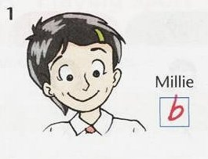
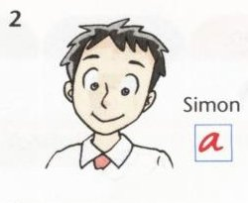
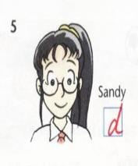
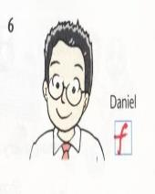
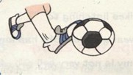
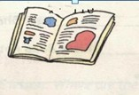
c
a
b
d
a
b
c
d
A: What does ______ like (doing)?
B: He/She likes ___________.

Slide 10
Checking: Finish B2 on P9
Millie is 11 years old.
Millie has short hair.
Simon is not tall.
Simon likes sports.
12
F
T
tall.
F
T

Slide 11
F
5. Sandy is short.
6. Sandy does not have long hair.
7. Daniel is tall.
8. Daniel is from Nanjing.
tall.
has long hair.
F
short.
F
T

Slide 12
Exploration: Read and finish B3 on P10.
Simon is ________. He often plays__________ after school. Sandy is tall and slim. She has ________ hair.
She likes ________. Millie’s hair is ________. She loves ________.
Daniel is from _________. He is good at _________.
tall
football
long
music
short
reading
Nanjing
Maths

Slide 13
Homework
1. Read the passage, pay attention to your
pronunciation.
2. Try to retell the passage.
3. Recite the new words.

