Slide 1
Unit 6 Birdwatching
第1课时
WWW.PPT818.COM

Slide 2
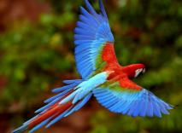
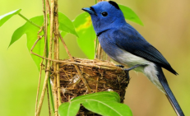
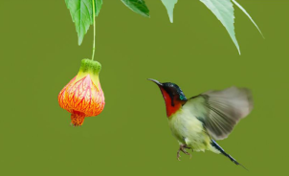
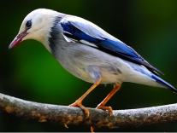
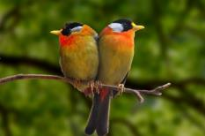
Do you like birds?

Slide 3
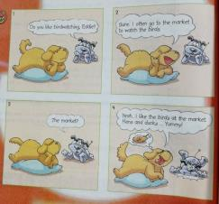
Comic strip
1 Do you like birdwatching, Eddie?
2 Sure. I often go to the market to watch the birds.
3 The market？
4 Yeah. I like the birds at the market.
Hens and ducks ...Yummy!

Slide 4
知识点
market /'mɑːkɪt/ n．市场
1
eg: There is a market in the middle of the town.
镇中心有个市场。
on the market上市，出售
eg：This kind of mobile phone is just on the market.这类手机刚刚上市。
归纳：

Slide 5
at the market 在市场上
eg：Do you like the dog at the market?
你喜欢市场上的那条狗吗？

Slide 6
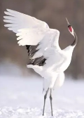
Welcome to the unit
A)The science teacher is showing the students some pictures of birds. She is also giving them descriptions of the birds. Match the pictures with the descriptions. Write the correct letters in the boxes.
b
1 Crane
tall long legs long thin neck
2 Sparrow
small brown and grey feathers
3 Swan
long thin neck white feathers
4 Eagle
broad wings brown feathers
a
b
a
c
d
d
c

Slide 7
B)Annie is asking Simon about birds. Work in pairs and talk about the birds you like. Use the conversation below as a model. The information in Part A may help you.
Annie：What's your favourite bird, Simon?
Simon：I like cranes.
Annie：What do cranes look like?
Simon：Cranes are tall. They have long legs and a long thin neck.
Annie：How many types of cranes are there in the world?
Simon：There are only 15 types of cranes. They're rare birds.,

Slide 8
知识点
feather /'feðə(r)/ n．羽毛
2
eg: Its blue-­and­-green feathers look so beautiful in the sun.
它的蓝绿色羽毛在阳光下看上去如此美丽。
考向
feather一般用复数形式，特指一根羽毛用单数。

Slide 9
知识点
What does cranes look like? 鹤长什么样？
3
考向
What does sb. look like? 用于提问人的长相、外貌，意为“某人长得什么样？”
What's sb. like? 用于提问人的性格、品质等，意为“某人是个什么样的人？”。

Slide 10
知识点
type /taɪp/ n．种类
4
eg: We have several types of apples.
我们有几个品种的苹果。
考向
辨析：type与kind

Slide 11
词条 | 含义及用法 | 示例
type | “种类”, 通常指同种类内部事物, 或相同物体的不同型号。它表示的分类一般都是客观的甚至是科学的，有一定数据标准。也可以用来指根据主观标准将人或物分类，此时可与kind互换。 | There are three main types of contracts. 有三种主要的合同。
kind | “种类”，特指某种性质相同，而且有极相似特征的东西，足以用某种方法分类，并置于一起。 | What kind of paper do you want？ 你想要哪一种纸？

Slide 12
一、根据首字母或所给汉语提示补全句子
1．We buy some fruit and vegetables at the m________．
2．Simon likes birds and he often goes b____________ at weekends.
3．Do you know what ________ (母鸡) eat?
4．We have a new ________ (种类) of rose.
5．The sparrow has brown and grey ________ (羽毛)．
arket
irdwatching
hens
type
feathers

Slide 13
二、完成句子
6. Swans have white feathers and long necks. (对画线部分提问)
What ________swans ________ ________？
7. There are seven types of swans in the world. ( 对画线部分提问)
________ ________ ________of swans in the world?
do look like
How many types

Slide 14
8. 我们英语老师总是鼓励我们尽可能经常地练习英语。(南充改编)
Our English teacher always ___________us___________ ___________English as often as possible.
encourages to
practice

Slide 15
本节课主要学习了以下知识点，请同学们及时巩固练习：
market, feather, type
What does cranes look like?

