Slide 1
Unit 11 Sad movies make me cry.
Section B Period 1 1a-2d
WWW.PPT818.COM
Notes:
1
1

Slide 2
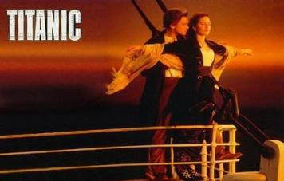
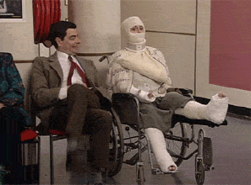


Warming up
Kinds of movies
tragedy
comic
documentary
action movie

Slide 3

How do you feel about the movie?
cry
Sad movies make me ________.

Slide 4
Comics make me _______.
laugh

Slide 5

Documentaries make me ________.
sleepy

Slide 6

Action movies make me _________.
excited

Slide 7
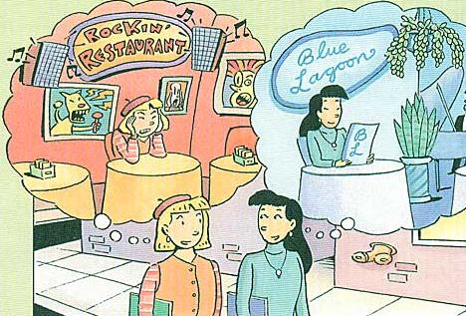
Look at the two restaurants below.
Which would you like to go to?
Why?
1a

Slide 8
Listen and fill in the blanks. Then match the restaurants with the statements.
1b
Rockin’ Restaurant
The ______ pictures make Amy _____________.
The _______ music makes Amy ____________.
Blue Ocean
The __________ music makes Amy _________,
but it makes Tina ______________.
awful
uncomfortable
loud
nervous
soft
relax
sleepy

Slide 9
Role-play a conversation between Amy and Tina.
1c
I’d rather go to Blue Ocean because I like to listen to quiet music while I’m eating.
I want to have the hamburgers at Rockin’ Restaurant.

Slide 10
Role-play a conversation between Amy and Tina.
1c
I’d rather go to Blue Ocean because I like to listen to quiet music while I’m eating.
I want to have the hamburgers at Rockin’ Restaurant.

Slide 11
Those awful pictures on the walls make me uncomfortable, and the loud music makes me nervous.
Let’s go to the Rockin’ Restaurant. I love their hamburgers.

Slide 12
So where do you want to go, Amy?
Let’s go to Blue Ocean. The soft music makes me relax.

Slide 13
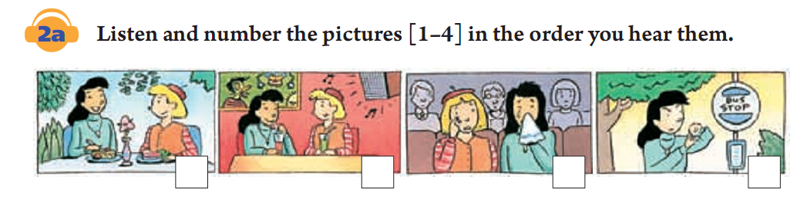
2a
Listen and number the pictures [1-4] in the order you hear them.
3
2
4
1

Slide 14
Listen again. Complete the
statements.
Waiting for Amy drove Tina
_______.
2. Amy didn’t want to ______ at
Rockin’ Restaurant.
3. Loud music makes John want to
_______.
2b
crazy
stay
dance

Slide 15
4. The movie was so sad that it made
Tina and Amy _______.
5. Sad movies don’t make John cry.
They just make him want to
_______.
cry
leave

Slide 16
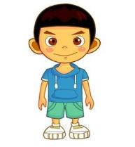

2c
Look at 2a and 2b. Role-play a conversation between Tina and John. Use the example to begin your conversation.
Well… yes and no. She was really late.
Did you have fun with Amy last night?
Waiting for her drove me crazy.
John
Tina

Slide 17
First we went Rockin’ restaurant. But the loud music made Amy nervous.
Where did you go for dinner?
That’s funny. Loud music always make me want to dance.
Me too. So then we went to Blue Ocean.
John
Tina

Slide 18
Did you go to the concert at the high school?
No, we went to the movies. And the movie was so sad that it made us cry.
John
Tina

Slide 19
Sad movies don’t make me cry. They just make me want to leave.
You sound just like my brother.
John
Tina

Slide 20
2d
Role-play the conversation.
Hey, Bert. I think I’ve made Alice mad and I’m not sure what to do about it.
What happened?

Slide 21
You know Julie is Alice’s best friend, right?
Well, the more I got to know Julie, the more I’ve realized that we have a lot in common. So we’ve been spending more time together lately.
Uh-huh.
adv. 最近

Slide 22
But what’s wrong with that?
Umm…it makes Alice unhappy because she thinks Julie is now better friends with me than with her.

Slide 23
Language points
1. I’d rather go to the Blue Ocean
Restaurant because I like to listen to
quiet music while I’m eating.
would rather do sth.，意为“宁可，宁愿
还是……好些”。
e.g. I’d rather play tennis than swim.
比起游泳我宁愿去打台球。

Slide 24
2. Yes, she was, and waiting for her
drove me crazy.
drive v. 迫使 drive sb.+adj.，使某人怎
样drive sb. crazy/mad 使某人发疯/发狂
e.g. That thing almost drive me crazy.
那件事几乎要使我发狂了。
You’ll drive mum mad one of
these days.
你这样总有一天会把妈妈急疯了的。

Slide 25
3. What happened?
happen ，发生，不及物动词。
常见的用法有：
(1) “sth.+happen+地点/时间”，
“某地/某时发生了某事”
e.g. What’s happening outside?
外面发生什么事了?

Slide 26
(2) “sth.+happen to+sb.” 意为“某人出了
某事(常指不好的事发生在某人身
上)”。
e.g. A car accident happened to him
yesterday. 昨天他发生了交通事故。
(3) “sb.+happen+to do sth.” 意为“某人
碰巧做某事”
e.g. I happened to meet her in the street.
我碰巧在街上遇见她。

Slide 27
4. The more I got to know Julie, the more
I’ve realized that we have a lot in
common.
the+比较级+从句 ，the +比较级+从句
“越……, 越……”
e.g. The harder you work, the greater
progress you will make.
你越用功，进步就越大。

Slide 28
5. Why don’t you ask Alice to join you
each time you do something with Julie?
Why don’t +sb.+do sth.?
=Why not + do sth.? 为何不……？
用来提出建议或劝告。
e.g. Why don’t you go with us?
Why not go with us?
你为什么不和我们一起去呢？

Slide 29
6. Then she won’t feel left out.
to be/feel left out 表示“被遗忘；被
忽略；被冷落”之类的意思。
e.g. No one speaks to him, he
always feels left out.
没人跟他讲话，他总是觉得被
人冷落。

Slide 30
Homework
一、Recite the conversation in 2d.
二、根据句意，用括号内所给单词的适当形式填空。
1. The boring movie makes me ________(sleep). I want to leave.
2. ________(drink) too much coffee is bad for your health.3. Jack is ________(real) nervous when speaking in front of so many people.
4. I haven’t been to his house, so I don’t know how ________(get) there.

Slide 31
Thank you!

