Slide 1
Unit 1 Can you play the guitar?
R 七年级下册
第3课时
WWW.PPT818.COM

Slide 2
Review
play chess
1.下国际象棋 __________________
2.说英语 __________________
3.擅长于 __________________
4.跟……说 __________________
5.弹吉他 __________________
6.（中国）功夫 __________________
7. 加入艺术俱乐部 __________________
speak English
be good at
talk to …
play the guitar
Kung fu
join the art club

Slide 3
1.你会游泳吗？(中译英，并作肯否回答)
____________________________________
____________________________________
2. 他会下棋吗？
____________________________________
____________________________________
Can you swim?
Yes, I can. / No, I can’t.
Can he play chess?
Yes, he can. / No, he can’t.

Slide 4
3. Jane和Jill会游泳吗？
_________________________________________
_________________________________________
4. —你们想加入什么俱乐部？
—我们想加入国际象棋俱乐部。
_________________________________________
_________________________________________
Can Jane and Jill swim?
Yes, they can. / No, they can’t.
— What club do you want to join?
— We want to join the chess club.

Slide 5
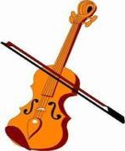
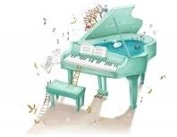
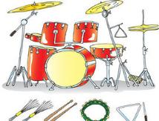
1a
Draw lines to match the words with the pictures.
drums
piano
guitar
violin

Slide 6
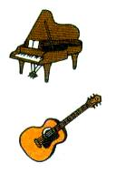
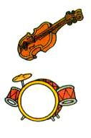
Listen and number the words [1-4] in the order of the sounds you hear in 1a.
1b
3
4
2
drums _____
piano _____
guitar _____
violin _____
3
1
4
1
2

Slide 7
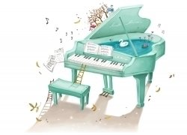
1c
Ask and answer questions about the instruments.
Can you play the piano?
Yes, I can.
piano

Slide 8
No, I can’t. what about you?
Can you play the guitar?
guitar
I can’t (play the guitar).

Slide 9
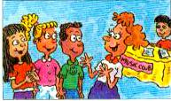
1d
Listen and circle the words and phrases you hear.
Play the violin sing
Play the guitar dance
Play the drums draw
Play the piano tell stories

Slide 10
Listen again. Fill in the chart with the words and phrases in 1d.
1e
Can
Can’t
Bill
play the guitar
sing
Cindy
sing, play the drums
play the piano
Frank
play the piano
sing or dance

Slide 11
Talk about what Bill, Cindy and Frank can and can’t do.
1f
Yes, he can, but he can’t sing.
Can Bill play the guitar?

Slide 12
No, she can’t, but she can sing and play the drums.
Can Cindy play the piano?

Slide 13
Language points
1. Yes, he can, but he can’t sing. 是的，他会，但是他不会唱歌。
but 在这里是转折连词，意为“但是”。
可连接两个并列的句子成分或两个并列分句。
例：你可以去，但是你必须先做作业。
You can go, but you should do your homework first.
but 不可与though/ although 连用。

Slide 14
Exercise
1. — Can you play the drums?
— No, I ______.
A. can B. not can C. can't
2. — Can your brother play chess? — Yes, he ______.
3. — Can they swim? — No, they _______.
C
can
can't

Slide 15
4. 补全对话。
A: Can you ___________(跳舞)?
B: Yes, I ______. Can you ______(画画)?
A: No, I want to join ________________ (象棋俱乐部).
B: I don't like ___________(象棋).
A: What club do you want to ________?
B: I want to join ____________________(游泳俱乐部).
dance
can
draw
the chess club
chess
join
the swimming club

