Slide 1

Subjects
WWW.PPT818.COM

Slide 2




Slide 3


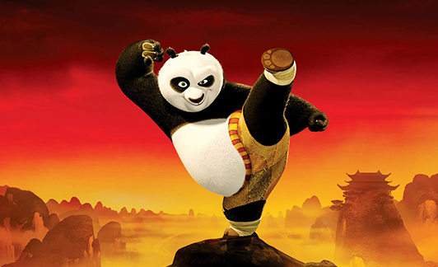

Slide 4

Learn the sounds
ck /k/

Slide 5
Jack
tick-tock
chick
clock
rock

Slide 6

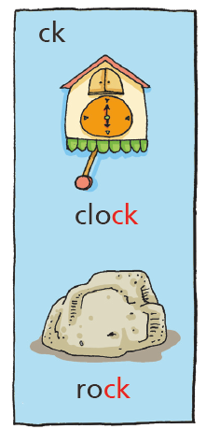
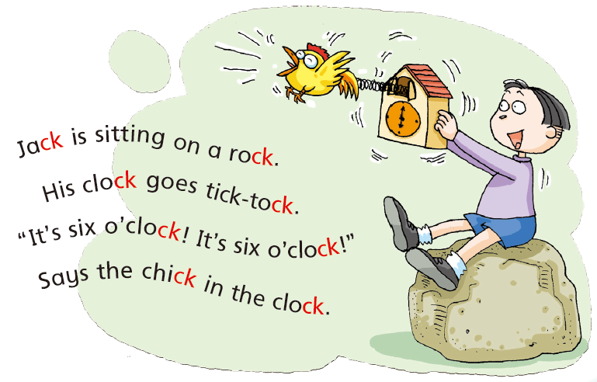


Slide 7


Chinese
Maths
English
Science
PE
Music
Art

Slide 8

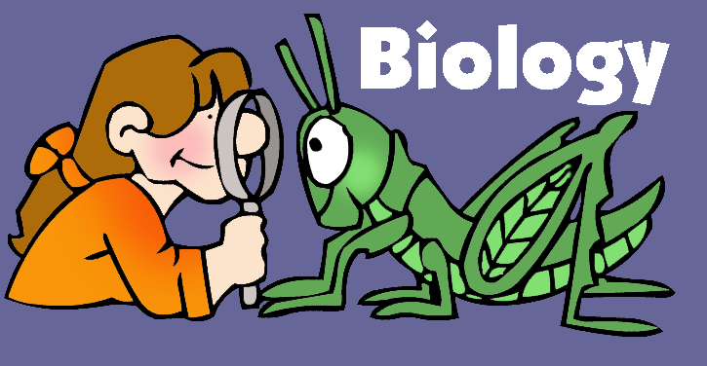

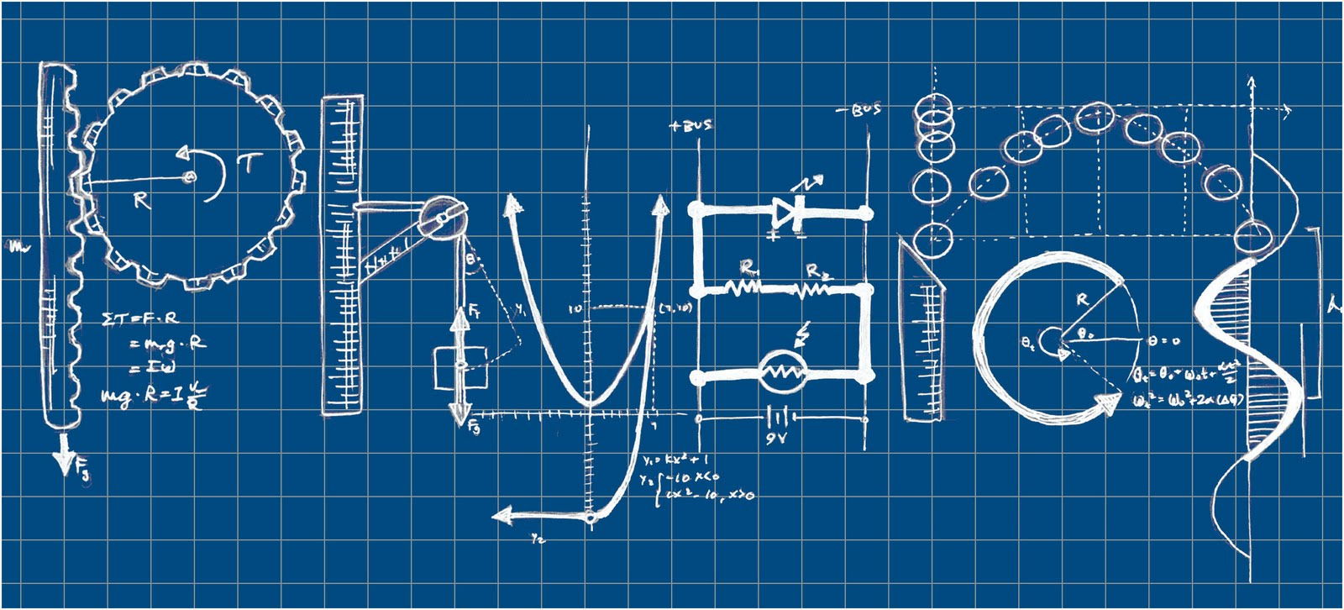
Geography
Physics

Slide 9
Read and complete
We read and write in our ____________ lesson.
We run and jump in our ____________ lesson.
We have fun with numbers in our ____________ lesson.
We learn ABCs in our ____________ lesson.
We paint and draw in our ____________ lesson.
We learn about animals and plants
in our ____________ lesson.
We sing and dance in our ____________ lesson.
Chinese
Maths
English
Science
PE
Music
Art

Slide 10
Think and say
What subjects do you like?
I like …
I learn to read and write in…class
It’s so

Slide 11
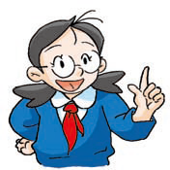

Chain drill
A: What subjects do you like?
B: I like … It’s …
What about you?
A: I like …
B: What subjects do you like?
C: I like … It’s …
What about you?
B: I like…
C: …
…

Slide 12


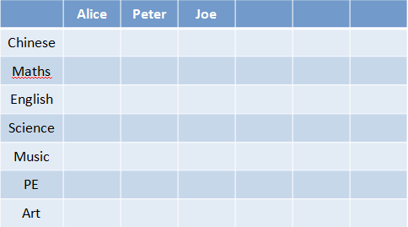
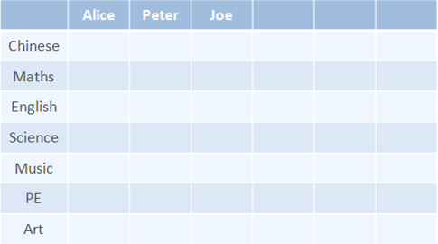
S1: What subjects do you like?
S2: I like …
Step 1 Write the names.
Step 2 Ask the questions.
Step 3 Tick the subjects.

Slide 13
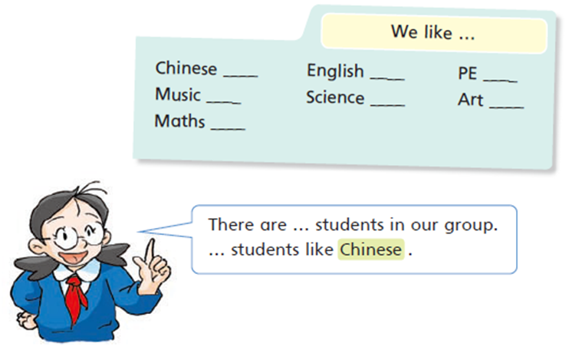
Step 4 Count and write the numbers.

